Slide 1
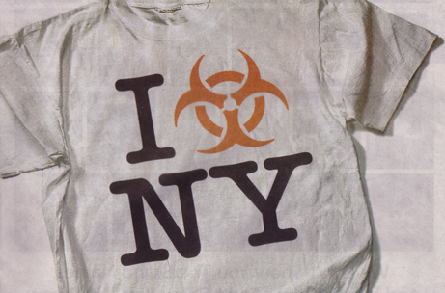
Bloodborne Pathogens/Infection Control Tuberculosis Awareness
CDM Training
Biological Safety Team
Christopher Aston Ph.D.
Cody Cameron
biosafety@columbia.edu

Slide 2
Hometown Heroes

Slide 3
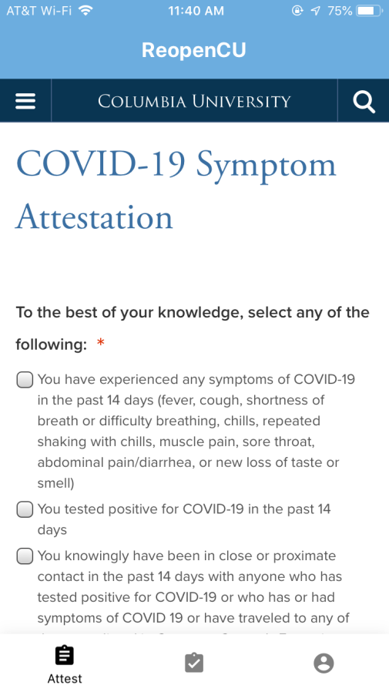
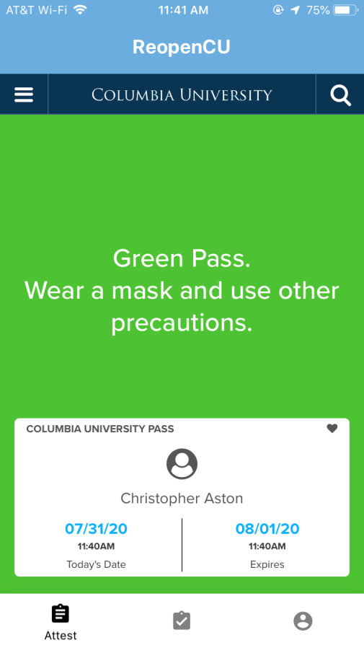
Return to campus, providing clinical care
PCR testing for SARS-CoV-2 infection
Daily symptom checks
N95 respirator fit testing

Slide 4
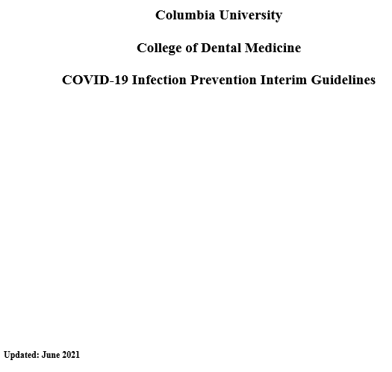
Important Guidelines and Manuals (1)
Patient Screening
Visitor Policy
Workforce Screening
Tracing and Tracking
Pre-Procedural Testing
Dental Treatment
Personal Protective Equipment
Personal Protective Equipment Conservation and Reuse
Cleaning and Disinfection
Notes:
Use of ultrasonic scalers should be limited to patients who are FULLY VACCINATED
If it is determined that using the ultrasonic scaler is absolutely necessary for a patient that is not fully vaccinated:

Slide 5
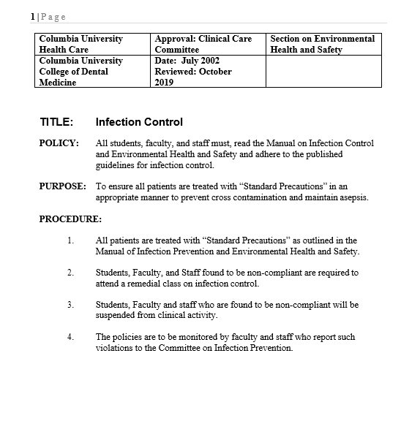
Important Guidelines and Manuals (2)
Instrument Processing
Dress Code for Clinical Care
Waste disposal
Incident/Accident Reporting
Receipt, Cleaning, Decontamination, Disinfection of Reusable Items.
Disposal of extracted teeth
Amalgam Disposal
Dental Unit Waterlines
Hand Hygiene
Disposal of sharps
Biological spills
Patient Protective Eyewear
Operatory Maintenance
Bed bugs

Slide 6
Training Outline
Infection Control and Standard Precautions
Bloodborne Pathogens
Sharps Safety and disposal
Environmental Surfaces
Spills
Personal Protective Equipment
Hand Hygiene
TB Transmission in Dentistry

Slide 7
Why Is Infection Control Important
in Dentistry?
Contact with blood, oral and respiratory secretions, and contaminated equipment can occur
Both patients and dental health care personnel (DHCP) can be exposed to pathogens
Proper procedures can prevent transmission of infections among patients and DHCP
Notes:
It’s a messy business with potential for…
2 way street…..
Dental Health Care personnel
The good news is that proper procedures, that we’re going to talk about….

Slide 8
Bloodborne Pathogens
HIV
Lifetime infection
No vaccine, no cure
HCV
Symptoms and transmission risk factors similar to HBV
Untreated-chronic infection and #1 reason for liver transplant
No vaccine
HBV
Jaundice
Risk factors: Sharps and needlesticks
Chronic infection develops ~5% of the time, increasing risk for cirrhosis, liver cancer
Environmental persistence on surfaces
Vaccine available

Slide 9
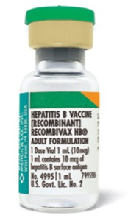
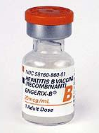
Bloodborne Pathogens: HBV Vaccine
Vaccine Efficacy >90%
Now part of childhood schedule
University policy to offer to staff and students with potential occupational exposure

Slide 10
First documented report of patient-to-patient transmission of hepatitis C virus associated with a dental setting in the United States
Improper sterilization techniques
Using single vials of medications on multiple patients
No written infection control protocol
Notes:
2013 ..
Blood tests conducted on patients treated at an Oklahoma oral surgery practice that has been closed over health concerns show that 57 have hepatitis C, three have hepatitis B and as many as three have HIV, officials said on Thursday. Health officials said it will take more investigation - including interviews with each patient and blood tests of the remaining patients - before they can determine whether the viruses were contracted at the dental offices, an extremely rare occurrence.
Health officials so far have screened 3,122 people who underwent oral surgery procedures at clinics operated by Dr Scott Harrington, a Tulsa oral surgeon who is accused of using improper sterilization techniques that may have exposed his patients to blood-borne viruses.“He also is suspected of using single vials of medications on multiple patients and allowing unlicensed individuals to perform procedures that would require licensure, such as administration of intravenous medications,” Organization for Safety Asepsis and Prevention (OSAP ) said in a statement. “The office had no written infection control protocol.
Next, we went through the needle protocol and I was counting the violations in my head. I asked the assistant to pull the instruments out of the autoclave and I was stunned. When we do an investigation, the first sign to us that something might be wrong is old, dingy equipment. It doesn’t save money to have outdated equipment or cut corners when it comes to safety. In this office, we found an old autoclave where the instruments were being wrapped in a baby diaper towel. I looked at the instruments and saw they were rusted. One was peeling or had debris still on it. I couldn’t believe it.
9/18/2013….. A Tulsa-area dentist whose practice was shut down because his equipment was rusty and his employees reused needles was responsible for the nation’s first transmission of hepatitis C between patients in a dental office, Oklahoma health officials said Wednesday.
Citing genetic testing performed at the Centers for Disease Control and Prevention, Oklahoma’s state epidemiologist said there was at least one instance in which Dr. W. Scott Harrington’s practice spread an infectious disease.
“This is the first documented report of patient-to-patient transmission of hepatitis C virus associated with a dental setting in the United States,” Dr. Kristy Bradley said. “When this initially began, we didn’t necessarily think we would find enough evidence of transmission, but there were enough red flags for us to (investigate).”
Bradley said the probe will not be able to determine exactly how the transmission of the disease occurred but speculated in an interview Wednesday that it could have been the result of contaminated dental instruments or cross-contamination from reused needles or syringes, among other possibilities.

Slide 11
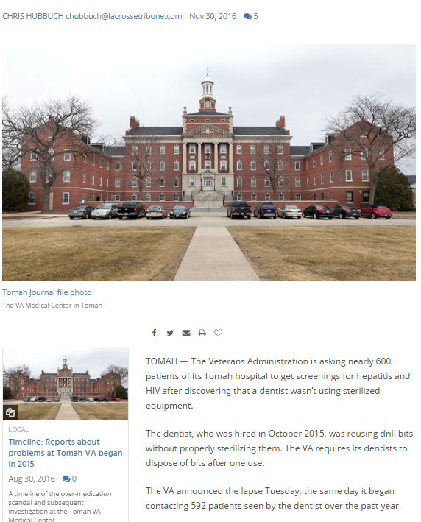
Replacement dental technician noted improper sterilization techniques
Hundreds of patients require bloodborne pathogen testing
Dentist removed from clinical care
Notes:
2016 – Wisconsin. Reusing drill bits without properly sterilizing them

Slide 12
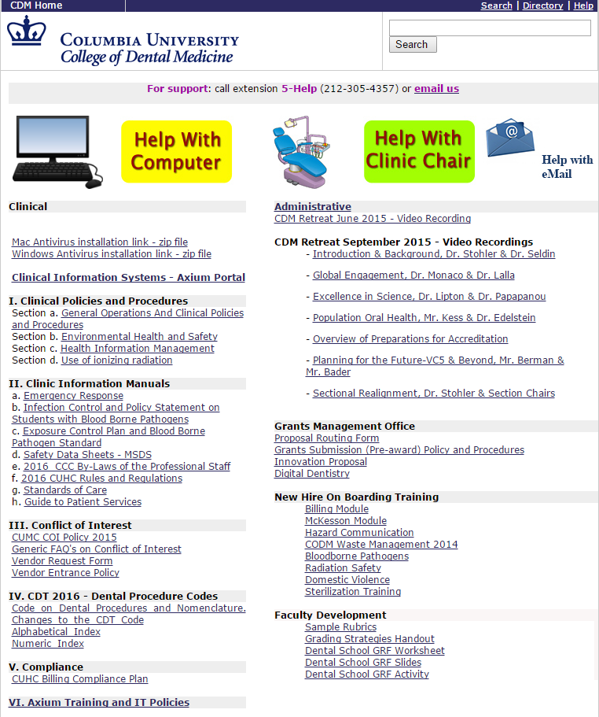
Infection Control: An Escalation Policy For Non-Compliances
Infection control initiative rolled out at Town Hall meeting, May 2019
Everyone has a role to play
Courageous conversations welcomed
Potential disciplinary action, loss of clinic privileges
Hand hygiene
Use of PPE
Sharps Safety
Safe Injection Practices
Sterile instruments and devices
Clean and disinfected environmental surfaces

Slide 13
Commission on Dental Accreditation (CODA)
Accreditation visits in 2016 and 2019
However….. Areas of improvement have been noted in infection control

Slide 14
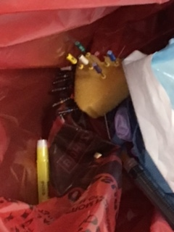
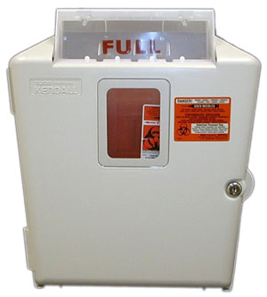
What happens when a sharp is inappropriately disposed into a bag?
You may get injured
Your colleague may get injured
Facilities custodians may get injured
This is an enormous liability for the College and University
Sharps must be disposed into the wall-mounted sharps container
Notes:
We have had several instances of Inappropriate Sharps Disposal at CDM. It’s always been an issue but has got especially concerning with 8 sharps having been found in the regular trash in September alone. And those were the ones that were found. There were probably others too.
You may get injured putting additional waste in the bag. You will need to seek immediate medical attention. You will consider taking post exposure prophylaxis drugs which have unpleasant side effects. Getting HIV is a lifelong thing.
Your colleague may get injured the same way. They will seek the same attention. How would you feel knowing that your negligence caused this
Facilities custodians may get injured. The custodians are our valued colleagues too. Do you know the name of the custodian who services your area? When custodians are injured by sharps they too take post exposure prophylaxis. Drugs with some unpleasant side effects. The good relationship we have with facilities workers and their union has taken years to build. Do you want to destroy that trust in a single moment?
If a complaint is lodged with OSHA this Federal Agency may come in and seem this as an unsafe work environment. They can put a stop work order on this clinic. No one gets to do any work, No one gets any dental care. If you think being here for 20 minutes is eating eating your valuable day, consider how much time you will be spending being retrained when the clinic is out of operation.

Slide 15
Regulated Medical Waste Management
Wall charts identifying appropriate disposal routes for regulated medical waste are posted throughout the clinics
Please take note of the types of materials that require disposal in a sharps container
Endodontic files
Dental wires
Any syringes with a needle
Scalpels
Dental Burrs
Anesthetic needles
Notes:
Does anyone remember this slide from 3rd year or 4th year annual training? Were you paying attention or doing something else on your phone? There is a copy of this chart in all the clinics as a friendly reminder.
These are all sharps. Even dental wires, even blunt end needles. Anything that could rip a red bag goes in the sharps containers.

Slide 16
These items are all sharps
Part of unused kit – Even unused sharps as part of a kit must be segregated prior to disposal.
Blunt needle – Needles used to dispense etching solution are still sharps
Notes:
Facilities pick up the bags, may note a problem with sharps as well as the location, and call our office. Waste is returned to CDM, Offenders will identified and counselled/lose clinic privileges.

Slide 17
How do I do the right thing?
You make a decision every time you discard something in the clinic – Make that decision the right one.
Look out for your colleagues. If you see an unsafe practice, say something.
As well as watching over what happens with the patient, Faculty should carefully observe how materials are disposed, and correct any aberrant behaviors.
Notes:
Check yourself before you wreck yourself…..

Slide 18
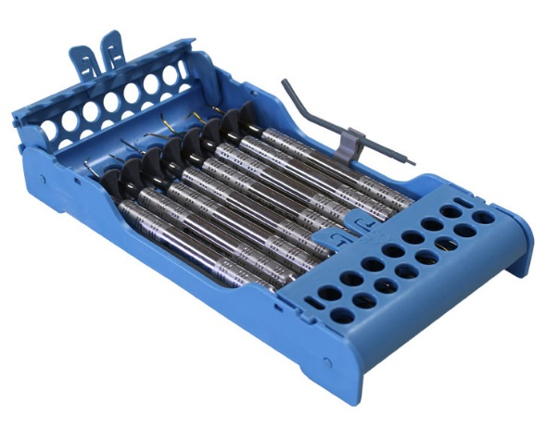
CDM Accomplishments
Potential bloodborne pathogen exposure in sterilization unit from dirty dental instrument jutting out of cassette. All cassettes have been replaced with better designs
(Zirc and LM Instruments).
Notes:
Brand new facility. As soon as it opened we were notified of numerous sharps being disposed in the red bags or regular trash. Facilities should be commended.
Wall charts not enough. Arrow labels needed right above the holes.
In service of all CDM staff and students and added training materials to CDM web site
Actions to be taken by custodial staff if a sharp is found on the floor.

Slide 19
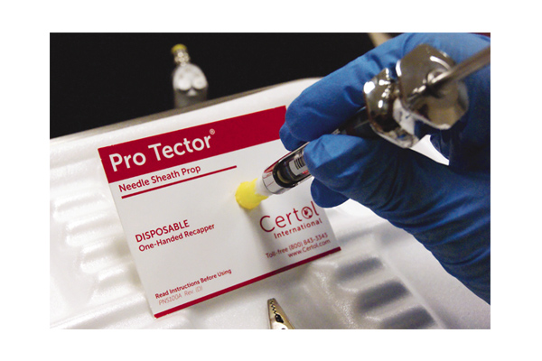
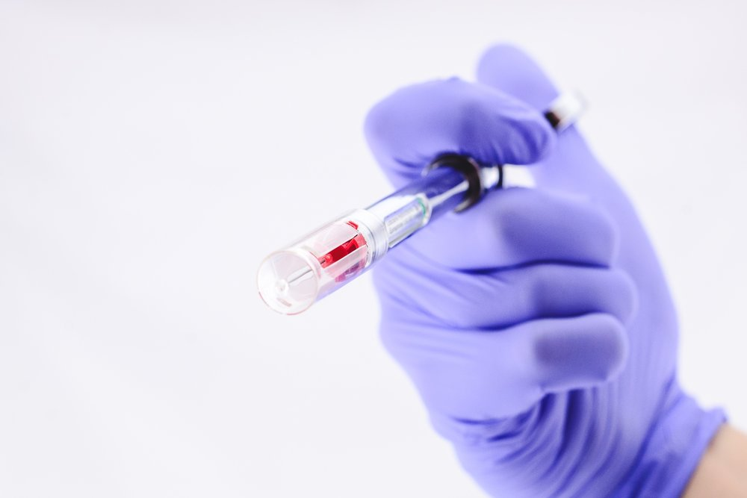
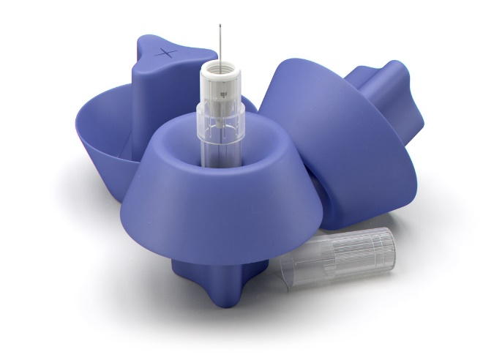
CDM Accomplishments
Evaluation of engineered sharps injury prevention (ESIP) devices in CDM
Notes:
CDM IC committee has spearheaded evaluation of ESIP devices.
Engagement of frontline staff. Opinions documented
Most injuries are not by syringe

Slide 20
Infection Control: Standard Precautions
Apply to all patients regardless of actual or perceived risk factors; treat all blood or OPIM as if infectious
Otherwise potentially Infectious Material (OPIM)
Body fluids, secretions incl. saliva , and excretions (except sweat), whether or not they contain blood
Non-intact (broken) skin
Mucous membranes
Notes:
Formerly known as universal precautions
Non-intact (broken) skin and Mucous membranes can also be a source of infectious material.

Slide 21
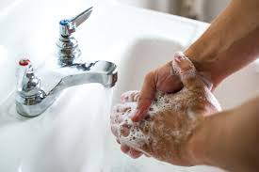
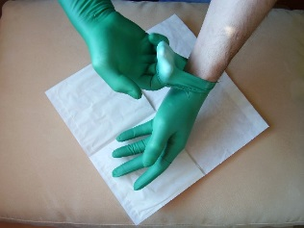
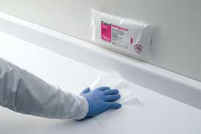
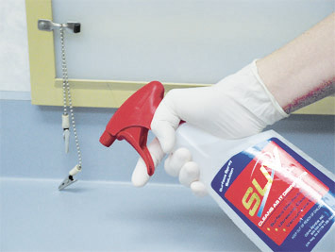
Elements of Standard Precautions
Hand washing
Use of gloves, masks, eye protection, and gowns
Disinfection of patient care equipment
Disinfection of environmental surfaces. Alternatively, cover what you can
Injury prevention
Notes:
More on hand washing later….
Use of sharps with safety features

Slide 22
Occupational Bloodborne Pathogen Exposure Evaluations at Columbia Student Health Services
Historically, what percentage of occupational exposures reported to Student Health Services consisted of Dental Students?
0 - 5%
5 - 44%
45 - 66%
67-100%
Notes:
In 2018 it was 73%

Slide 23
Bloodborne pathogen exposures across all campuses 2020: CDM ∝ CUIMC ∝ MS
8
Notes:
stacked

Slide 24
College of Dental Medicine Sharps Injuries 2020
CDM – Qualtrics incident reporting system
Potential sharps BBP exposures in staff 0 (4 in 2019)
Potential sharps BBP exposures in faculty 1 (2 in 2019)
Potential sharps BBP exposures in students 23 (37 in 2019)
CDM - SHS exposure evaluation records
Potential sharps BBP exposures in students 23
Exposures that were reported in Qualtrics with no follow up at SHS 2
Exposures that were evaluated at SHS but not reported in Qualtrics 13
2
8
13
Reports Evaluations
Notes:
Why are the reports so important?
Investigate in short order after the incident while the memories are still fresh.
Qualtrics platform easy to modify to ask questions to that pertain to type of sharp
Why are the evaluations important?
SHS provided the questions that they ask when a student comes in for an exposure evaluation. Questions sufficient to enable an investigation.
SHS asked to complete deidentified accident investigation form – Didn’t work because of duplication of effort.
Reluctance due to privacy and trust concerns
Students know to receive and evaluation (the more important step) but are not using the CDM Qualtrics reporting system enough.
Question in minutes about resident vs. post grads. All are covered by the program but are the post grads compensated employees?

Slide 25
College of Dental Medicine Sharps Injury Types 2020

Slide 26
Bloodborne Pathogens: Occupational Exposure
Refers to: ‘stick’ from any contaminated item; mucous membrane, non-intact skin exposure
Clean with Betadine and antimicrobial soap
Rinse eyes/mucous membranes 10 minutes
Inform supervisory person
Student Health/ER
All patients, students or faculty/staff injured in the clinical facility should file an "Accident Report - Qualtrics“
File University Accident Report for Workers Compensation
Notes:
What is occupational exposure?
Response is the same in all cases.
Source patient, if identifiable my be asked to consent to HIV testing if their status is unknown. HBV testing can be performed without consent.
Reporting of accidents is required for workers comp.

Slide 27
Bloodborne Pathogens: Post Exposure Evaluation
Baseline HIV, HBV, HCV testing (titers/viral load)
HIV Post exposure prophylaxis; anti-retroviral treatment may be indicated and is effective if given immediately (2 hour window) – REPORT IMMEDIATELY
Source patient name and MRN# is helpful
HBV Vaccination/Ig may be indicated
HCV No post exposure prophylaxis; anti-viral treatment may be indicated for established infections
Follow up testing
Notes:
Essentially the medical providers are going to offer you antiretroviral drugs and do some follow up testing.

Slide 28
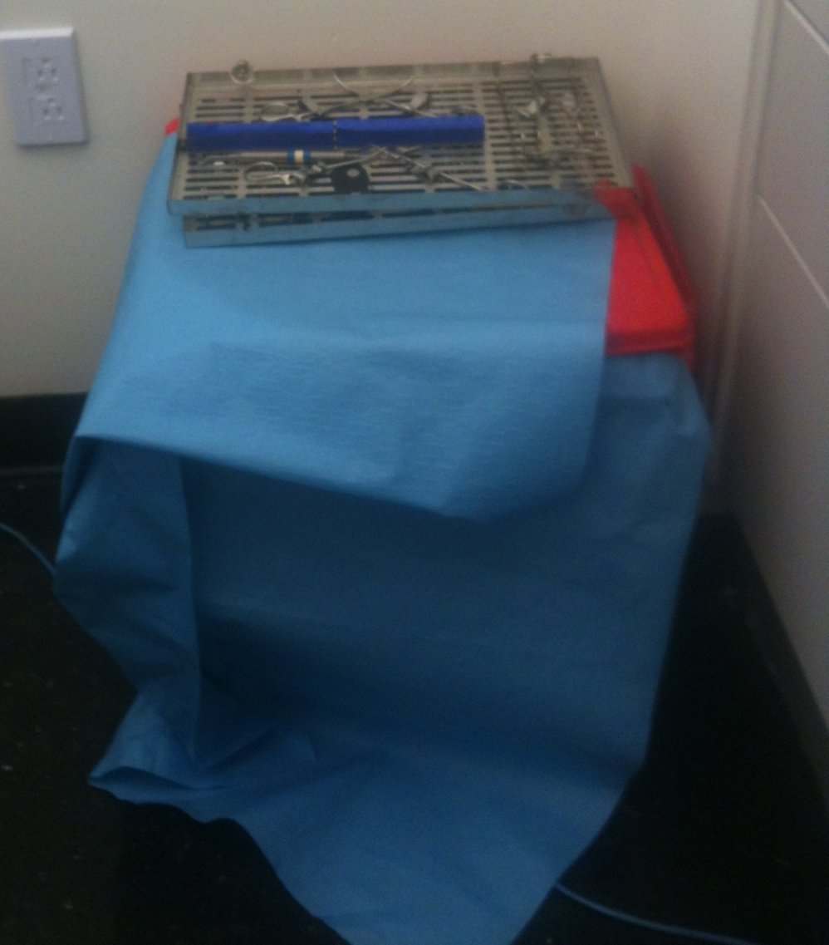
Red Bag Bins Are Not a Place to Store….
Coats
Bags
Dental trays
Anything!
Notes:
It doesn’t matter. Containment to prevent contact with the material, especially in public spaces; clinics.
There’s a red bag under this hole.
A single leak-resistant red biohazard bag is usually adequate to contain soft, regulated medical waste. Gloves PPE, gauze, anything visibly contaminated with blood, but non-sharp items.

Slide 29
Categories of Environmental Surfaces
Clinical contact surfaces
High potential for direct contamination from spray or spatter or by contact with DHCP’s gloved hand
Housekeeping surfaces
Do not come into contact with patients or devices
Limited risk of disease transmission
Notes:
There are two categories of environmental surfaces.
Clinical contact surfaces have a high potential for direct contamination from patient materials either by direct spray or spatter generated during dental procedures or by contact with DHCP’s gloved hand. These surfaces are known as fomites; they can later contaminate other instruments, devices, hands, or gloves.
Housekeeping surfaces do not come into contact with patients or devices used in dental procedures. Therefore, they have a limited risk of disease transmission.

Slide 30
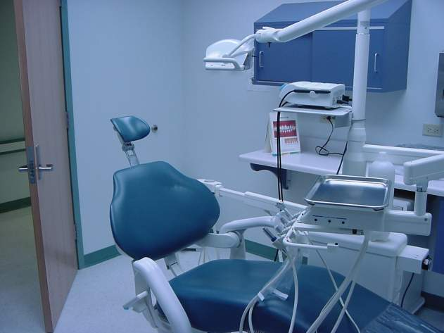
Environmental Surfaces: Clinical Contact Surfaces
Notes:
This slide shows some examples of clinical contact surfaces, including a light handle, countertop, bracket tray, dental chair, and door handle (shown by arrows).
You can put removable tape on them to prevent them from becoming a fomite

Slide 31
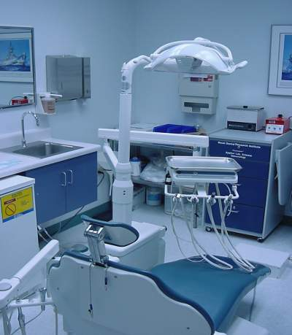
Environmental Surfaces: Housekeeping Surfaces
Notes:
May become contaminated
Not directly involved in infectious disease transmission
Do not require as stringent decontamination procedures

Slide 32
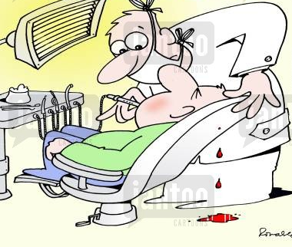
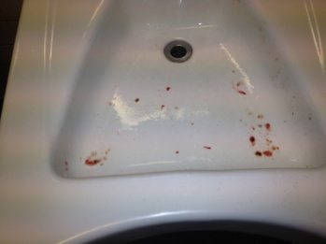
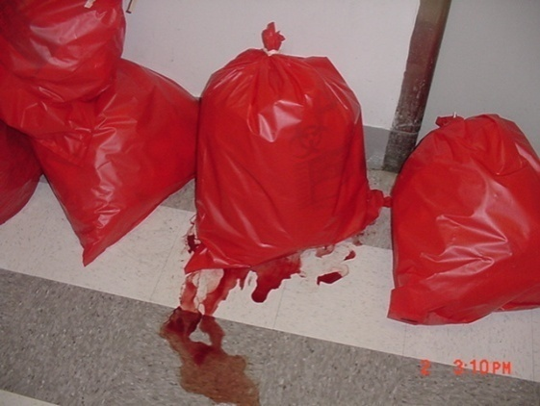
Spills
Small blood spills on clinical contact surfaces can be cleaned up by CODM staff/students
Cleaning materials and PPE are available in the clinics
Gloves, paper towels, bleach
When to ask for help?
Spills on housekeeping surfaces, large spills, aspiration system failure

Slide 33
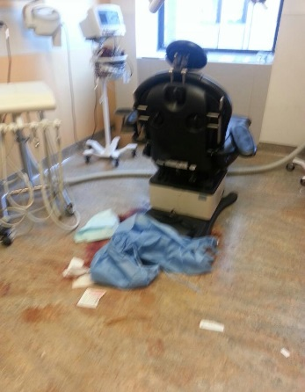
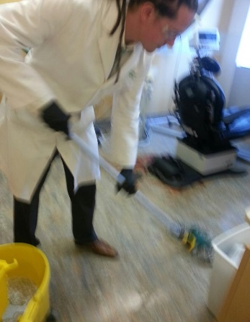
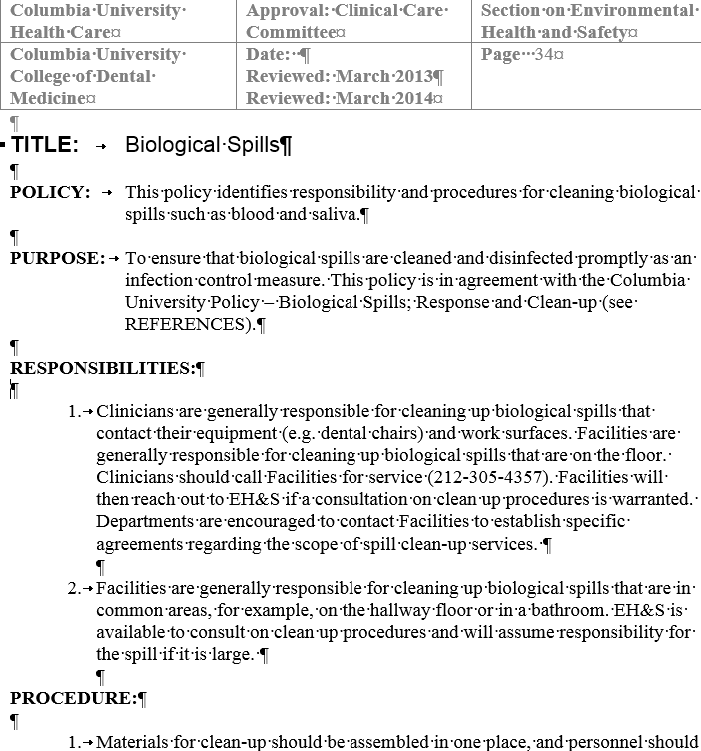
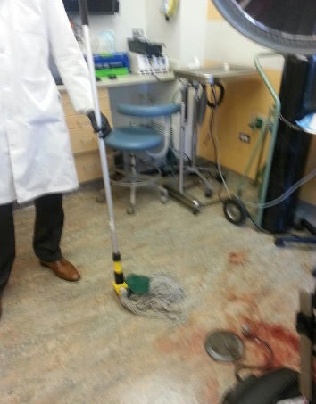
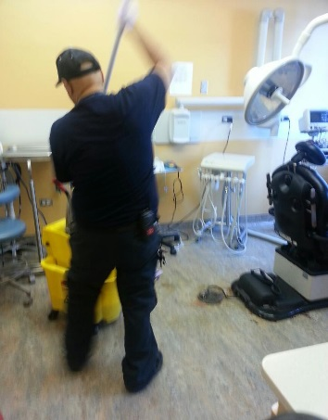
Spills

Slide 34
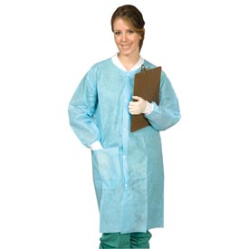
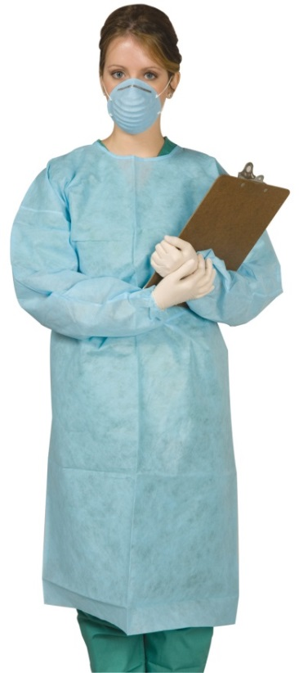
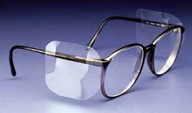
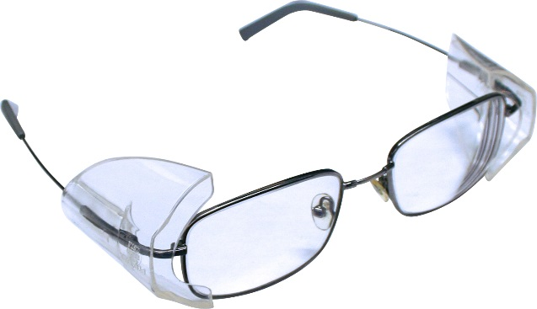
Personal Protective Equipment (PPE)
Disposable gowns should also be changed daily or when they become visibly soiled; They can be disposed of in normal (non-red bag) waste
Gowns are either front or rear-opening; NOT reversible
Surgical masks and protective eyewear (providers and patients) must be worn at all times when splatter, splash or aerosol producing procedures are being performed, or observations of procedures are being made
Side shields required
Notes:
EH&S and CDM are considering providing eye protection for patients. May see such a program in one of the clinics.

Slide 35
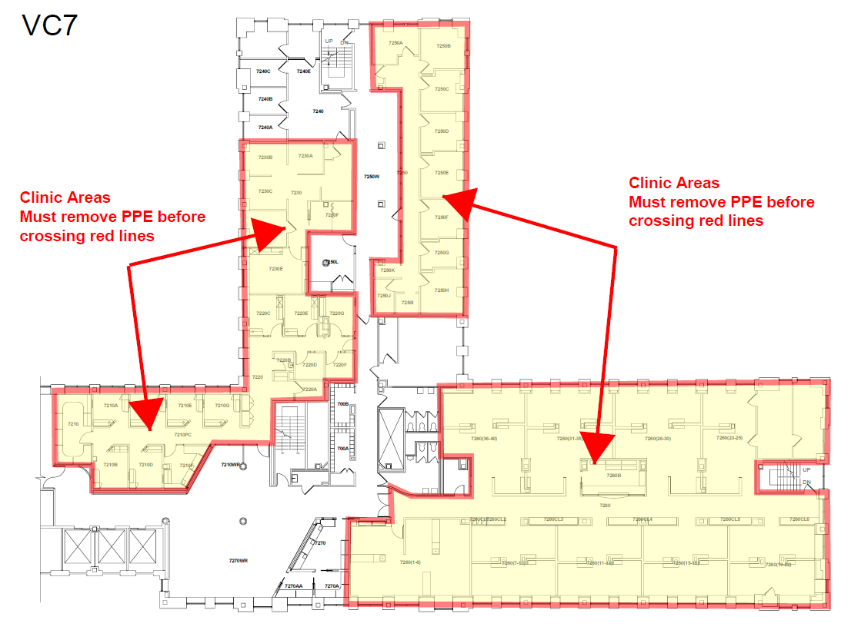
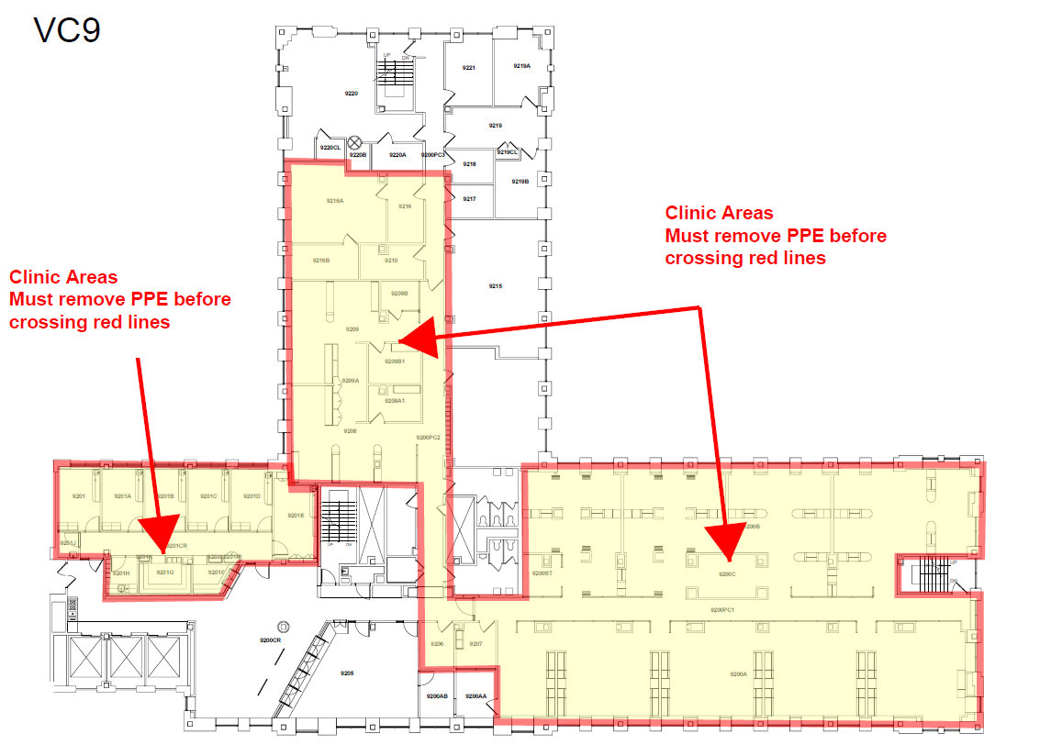
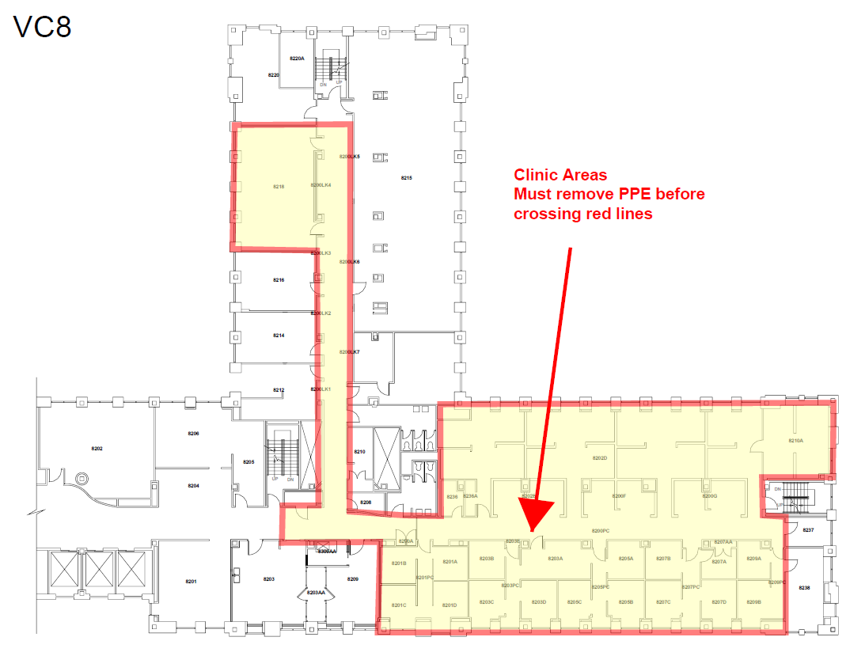
PPE is to be removed when leaving patient care areas
VC5

Slide 36
Personal Protective Equipment (PPE): Gloves
Minimize the two-way transmission of microorganisms between patients and providers
Reduce contamination of the hands of health care personnel by microbial flora that can be transmitted from one patient to another
Are not a substitute for hand washing or sanitizing
Notes:
Gloves are worn for three reasons:
To minimize the risk of health care personnel acquiring infections from patients.
To prevent pathogenic organisms from being transmitted from health care personnel to patients.
To reduce contamination of health care personnel's hands by organisms that can be transmitted from one patient to another.
Wearing gloves does not eliminate or replace the need for hand washing. Hand hygiene should be performed immediately prior to putting on and after removal of gloves. Because gloves might have small holes or tears that are not noticeable, or hands can become contaminated as gloves are removed. Such circumstances increase the risk of wound contamination and exposure of the DHCP’s hands to microorganisms from patients.

Slide 37
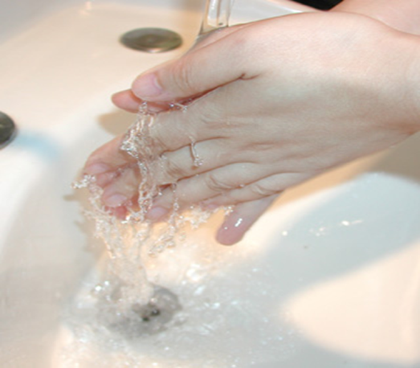
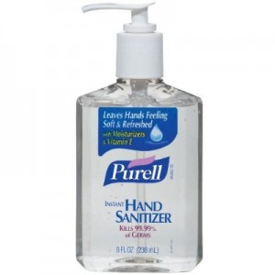
Special Hand Hygiene Considerations
When removing gloves, no glove is 100% effective
Change ASAP after visible contamination
‘Purell’ or soap and water?
Technique is important
or
?
Notes:
Hand cleansing is the most effective means of infection control,
Is alcohol-based or soap and water better? Ask audience – which is the more effective means of hand cleansing?
CDC report indicates alcohol might be better. However, depends on how dirty your hands are to start with, the bacterial or viral agent tested and the contact time of the alcohol-based cleanser.
The New York State clinical laboratory regulations require washing with soap and water over use of alcohol-based hand cleansers.
Remember that you may have touched your wrist when removing your first glove, so pay attention to washing your wrists and the backs of your hands.
Ask yourself whether you would want to touch your face after cleaning your hands. If not, you may want to spend a little more time at the sink.

Slide 38
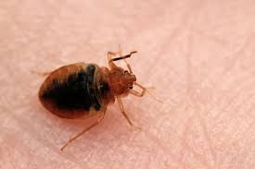
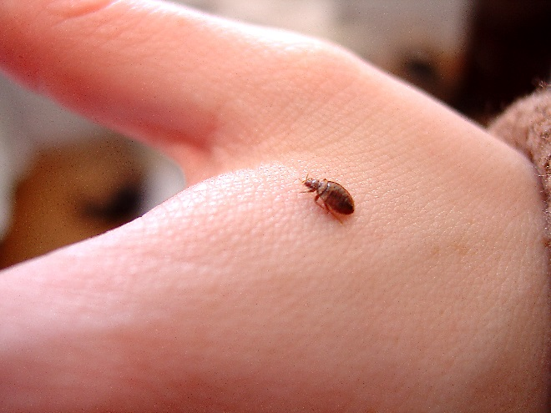
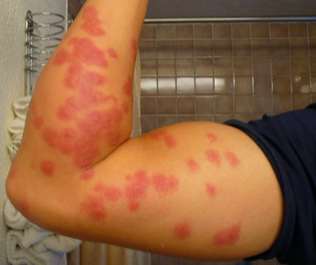
Bedbugs
If bed bugs or bites are apparent, talk discreetly to your patient about them, as you would with any other medical issue.
PPE and terminal cleaning procedure should be adequate to control transmission of bed bugs
When to ask for help? If you suspect bed bugs may be present your clinic or office should call the facilities help desk. Facilities will send a contracted exterminator over to lay glue traps. If bed bugs are evident, chemical extermination will be performed.

Slide 39
Transmission of Mycobacterium Tuberculosis
Spread by droplet nuclei
Immune system usually prevents spread
Latent infection: Bacteria can remain alive in the lungs for many years (not transmissible)
Notes:
Mycobacterium tuberculosis (TB) is spread from person to person through the air. When a person with pulmonary TB coughs or sneezes, tiny particles, known as droplet nuclei, are expelled into the air. The particles are an estimated 1-5 μm in size, and normal air currents can keep them airborne for prolonged periods of time and spread them throughout a room or building. Infection may occur when a person inhales droplet nuclei containing TB organisms. Unlike the large droplets we talked about earlier, these are smaller and more persistent.
During the first few weeks after infection, organisms can spread from the initial location in the lungs to the lymph nodes in the center of the chest and then to other parts of the body by way of the bloodstream. Within 2 to 12 weeks, the body's immune system usually prevents further multiplication and spread, although they can remain alive in the lungs for years. This condition is referred to as latent TB infection.
Photo credit: Centers for Disease Control and Prevention, Atlanta, GA.

Slide 40
TB Transmission in Dentistry: Risk
Risk in dental settings is low
Only one documented case of transmission
Tuberculin skin test conversions among DHCP are rare
Notes:
Overall, the risk for transmission of TB in most dental settings is quite low.
There has been only one case report of transmission of tuberculosis bacteria from an infected dentist to patients, reportedly transmitted by direct inoculation of extraction sites through the dentist's fingers (Smith WH, Davies D, Mason KD, Onions JP: Intraoral and pulmonary tuberculosis following dental treatment. Lancet 1982;1:842-4).
In addition, tuberculin skin test conversions among DHCP are rare, even among populations of dentists at high risk for exposure to TB patients.

Slide 41
TB Transmission in Dentistry: Prevention
Baseline medical surveillance of DHCP (PPD/quantiferon)
Assess patients for history of TB
Defer elective dental treatment
If patient must be treated:
DHCP should wear a respirator
Isolation; separate patient from others/mask
Refer to facility with proper TB infection control precautions
Notes:
Periodic updates of medical histories should include questions concerning history of TB exposure, infection or (current or past) treatment for active TB, and symptoms consistent with TB.
Elective dental treatment should be deferred for any patient suspected or known to have active TB until they have been evaluated by medical personnel.
DHCP should wear a face mask (surgical) or N-95 respirator for all patient contact. Any patient with suspected or possible infectious TB should be separated from other patients or DHCP, given a surgical mask to wear, and provided with tissues for coughing or sneezing. Refer the patient to a facility with proper TB infection control precautions for medical evaluation or urgent dental treatment.
If you are in an office or facility that will provide dental treatment for patients with TB, additional precautions are necessary. Refer to CDC Guidelines for Preventing the Transmission of MTB in Health-care Facilities. MMWR 1994;43(No. RR-13)

Slide 42
Questions?
biosafety@columbia.edu

