Slide 1
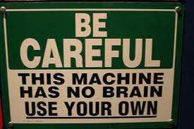
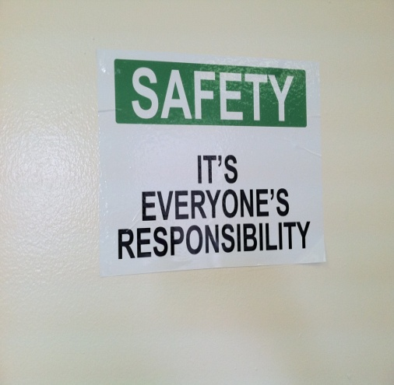
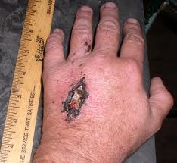
Dental Shop Safety
Environmental Health and Safety

Slide 2
Training Outline
Types of machines at dental school lab
General shop hazards
General shop safety rules
What to do in case of injury
Machine specific hazards and precautions

Slide 3
Introduction
Shops are present on all campuses of Columbia University
College of Dental Medicine casting lab has various types of machines for teaching and training students
This training is intended as an introduction to general shop safety
You must also get machine specific safety training from the Lab Supervisor before using any shop equipment

Slide 4
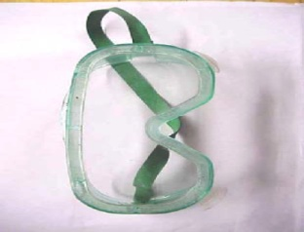
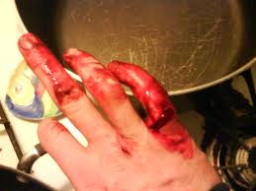
General Shop Hazards
Hazard to Eyes:
Metal chips, particles, and or dust
Use Appropriate safety glasses, goggles, shields, etc.
Hazard to Hands:
Sharp chips, rotating/moving parts, cutters, etc.
Keep your fingers away from moving parts
Do not clean moving parts, use proper PPE

Slide 5
General Shop Hazards
Entanglement Hazards:
Long hairs, necklace, necktie, dangling ID badge
Jewelry, loose cloths, watch or ring may get
Caught in moving machine and drag you along
Always remove or secure them before work
Hazards to Lungs:
Dust in grinding or handling powdery materials

Slide 6
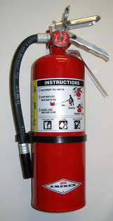
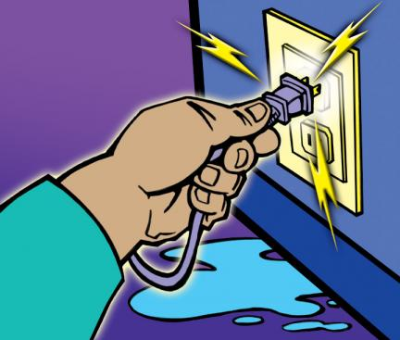
General Shop Hazards
Fire Hazards:
Keep flammable materials (oily rags, paper) away from source of heat
Oil rags must be kept in a safety can
Know where the fire extinguishers are located in the shop
Call Public Safety or 911 in case you cannot extinguish fire
Electrical Hazards:
Identify the location of the emergency stop prior to start of work
Equipment and electrical system must be properly grounded & secured
Lock-out/Tag-out Equipment before any manipulation
Watch for frayed, exposed, or old wiring to protect from electrical shocks or electrocution
Do not use extension cords to avoid tripping hazards

Slide 7
Shop Safety Guidelines
No visitors (non CU-employees/students) will be allowed in the shop while the machinery is in operation unless accompanied by the supervisor
No one under the age of 18 is allowed to use any tools or machinery unless assisted by a supervisor or a trained person
Everyone must wear safety glasses when entering the shop! No one (such as a custodial staff, facilities maintenance personnel, etc.), enters the shop without safety glasses unless those machines have shielding in place
Never work alone! Always use the “buddy system”

Slide 8
When working in a dental lab, fundamental safety rules to observe are?
Never use a machine if you do not have machine specific training
B. Always secure loose hair and jewelry before starting work
C. Do not work alone, “use buddy system”
D. All of the above

Slide 9
In Case of an Injury
Report to your Supervisor:
Any physical accidents regardless of severity
Any damaged, defective tools, machines, or other equipment
Discuss with your supervisor if you need to work after shop working hours.
In an emergency - Call your Campus Public Safety Office
CUMC = 212- 305-7979 or 911

Slide 10
EH&S Responsibilities
Provides oversight for this policy.
Conducts periodic audits of shops
Provides General Shop Safety Training
Investigates all accidents or unsafe conditions.
Completes annual monitoring

Slide 11
Encourage Safety Culture
Set good example by working safely
Question unsafe practices
Report unsafe conditions to your supervisors
Always use proper PPE as required
Keep work area clear of scraps and litter and Keep work site clean
Never use your hands to wipe away debris

Slide 12
Machine Specific Training
This general shop safety training does not replace machine specific shop training
Each machine has specific operating procedures and safety requirements
Talk to your supervisor to arrange machine specific training before using any machine
You will not be allowed to use a machine before you receive a machine specific training

Slide 13
Equipment specific
Maintain and unit and inspect before use
Secure all loose clothes and hair in place to prevent possible injury
Wear safety glasses
Know where the emergency shutoff is
Unplug the unit before maintenance

Slide 14
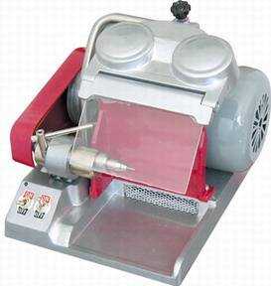
Machine Specific Hazards
TRIMMER MACHINE & HIGH SPEED LATHE
Ensure guards are in place before using
Keep clear of blade and other moving parts - keep your fingers away
Do not push model against abrasive wheel with excessive force
Use proper grounding
Always keep the security door closed - never turn the motor on with door open

Slide 15
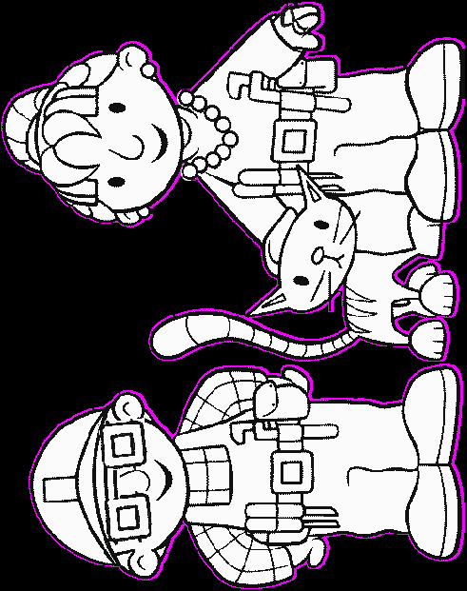
Safety Rules Review
Be Smart
Tie Long Hair
Wear Safety Glasses
Remove
Jewelry
Remove or Cover Tie
No Pets
No Open Toe Shoes
No Slippery Foot Wear

Slide 16
Thank you!
Any Questions?
occusafety@columbia.edu

