Slide 1
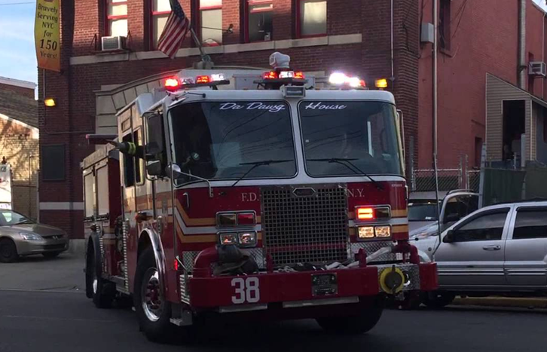
Fire Safety
College of Dental Medicine

Slide 2
Training Outline
RACE & PASS
Using a Fire Extinguisher
Types of Fire Extinguishers
If You or Someone Catches on Fire
Butane Torches
Reminders
Notes:
I’m going to go through why you, as a member of the CODM, may come across fire causing agents , what regulations apply to fire safety, the potential hazards of that exposure and the basic steps you can take to protect yourself and avoid those hazards.

Slide 3
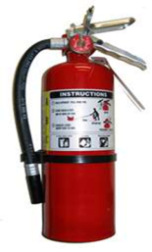
RESCUE
RACE
In Case of Fire:
Rescue
Alarm
Confine
Extinguish / Evacuate
To use Fire Extinguisher:
Pull Pin
Aim Hose
Squeeze Handle
Sweep From Side to Side
Not just yourself!
People with special needs
People in immediate area
ALARM
Manual Alarm Station located by exits
Notify occupants as you leave
Listen for instructions
Call Public Safety 212-305-7979

Slide 4
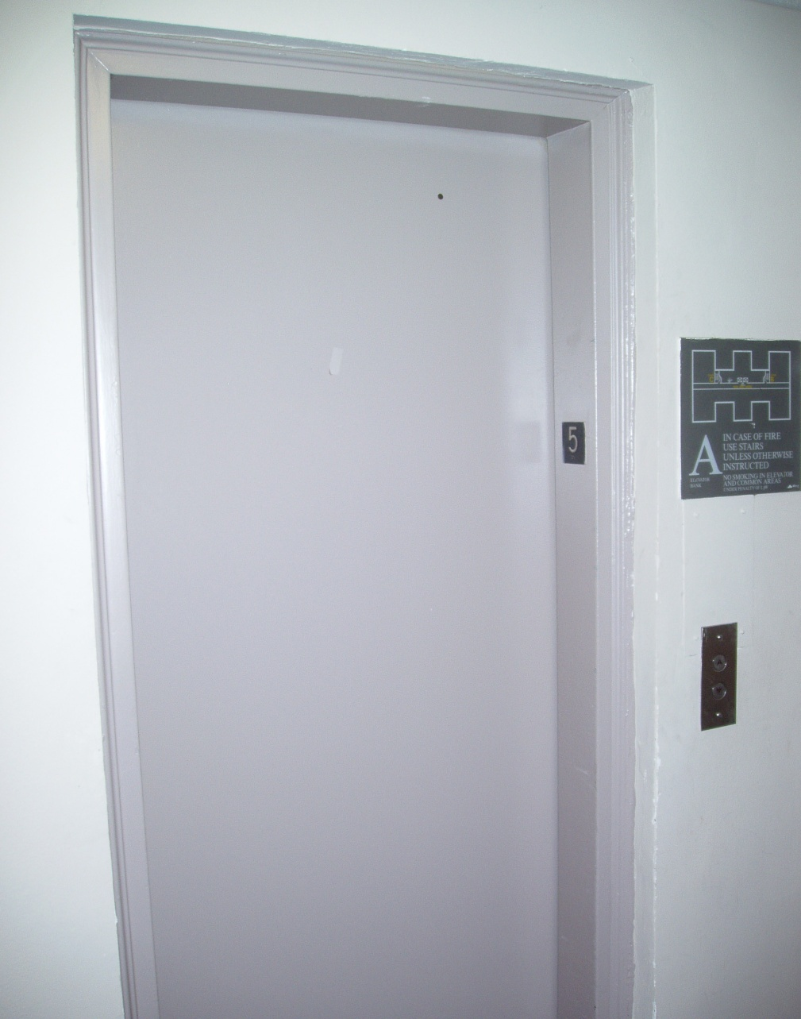
CONFINE
RACE
Close all doors and windows as you leave
Leave unlocked if possible
Keep fire, smoke, odor in room of origin
EVACUATION
Use closest stairway
Know your way out!
If needed, shelter in place
DO NOT USE ELEVATORS

Slide 5
Using a Fire Extinguisher

Slide 6
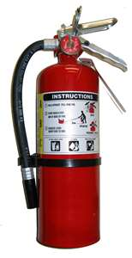
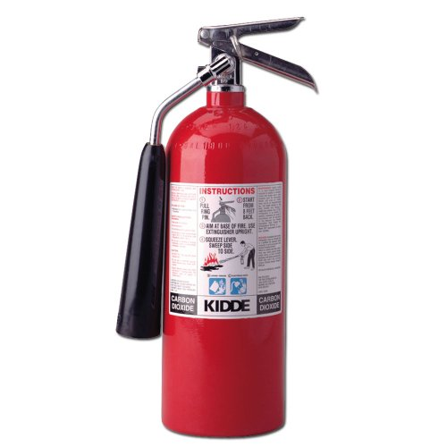
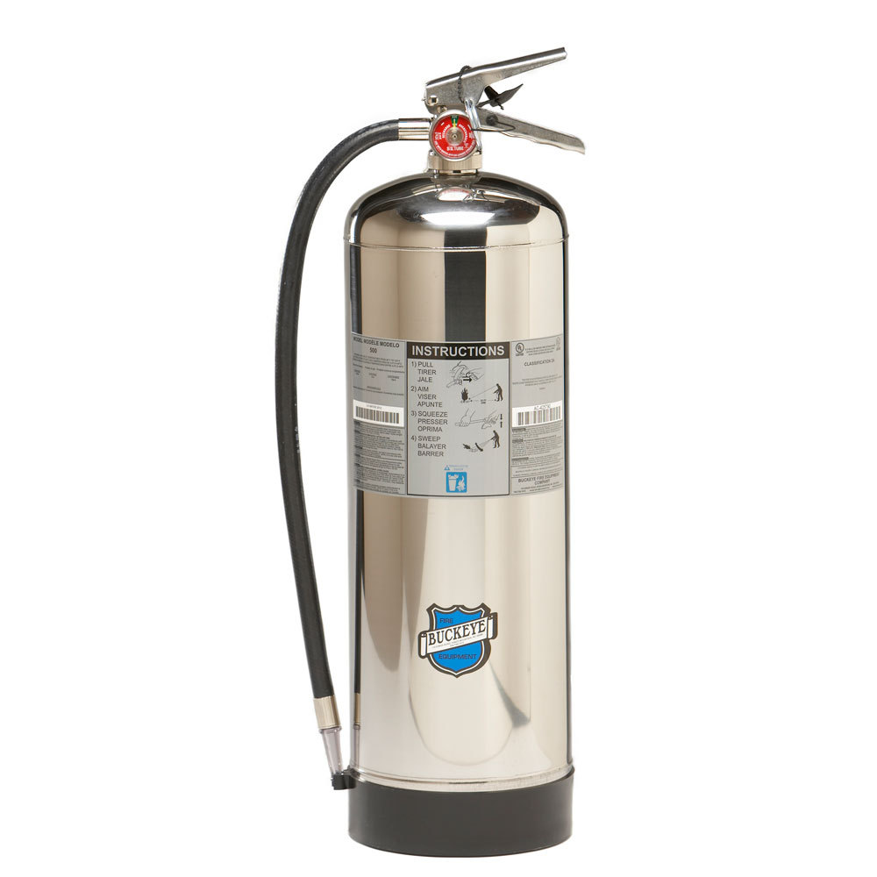
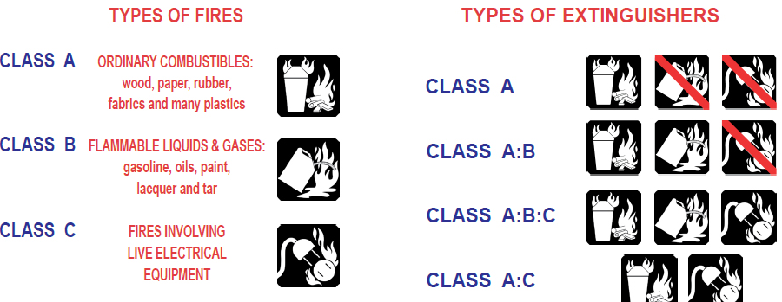
Types of Fire Extinguishers
Dry Chemical
Co2
Water

Slide 7
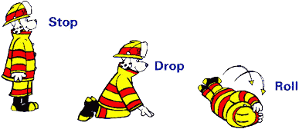
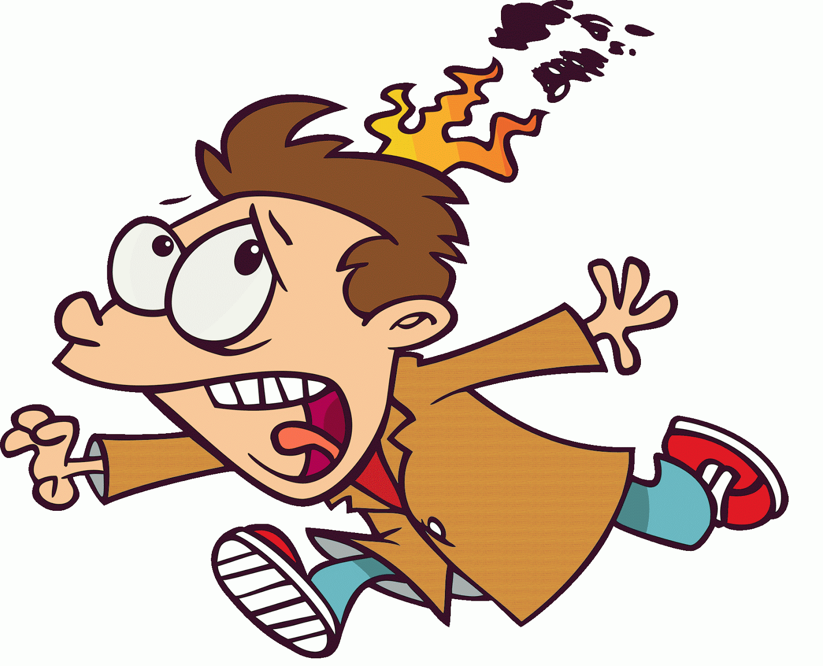
If You or Someone Catches on Fire...
Try and remain calm
Call out for help
STOP DROP and ROLL
Use water from the sink and/or wet towel
Use the fire extinguisher

Slide 8
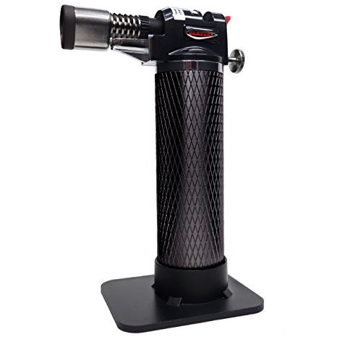
Safe Use of Butane Torches
Operation:
Be sure that the nozzle on the canister is not clogged or dirty
Be sure your work area is free of flammable fuels or materials
Secure loose clothing, hair etc. before use
Butane torches will be kept in the stand when in use in the laboratory
Keep the flame pointed away from you while in use
Butane torches on the laboratory bench must will be extinguished when not in use

Slide 9
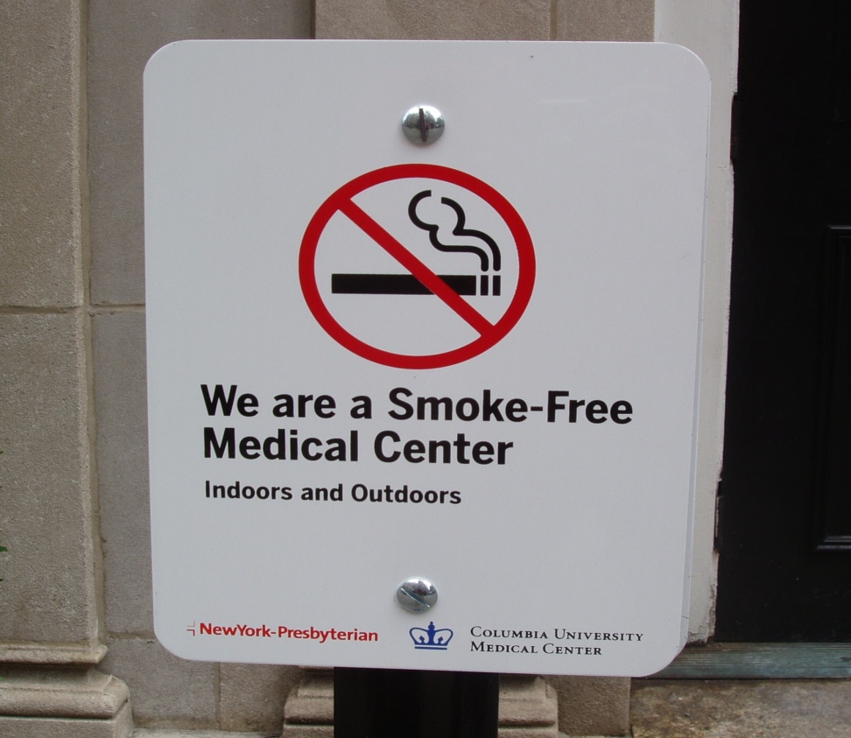
Reminder:
Columbia University Medical Center is Smoke-Free!

Slide 10
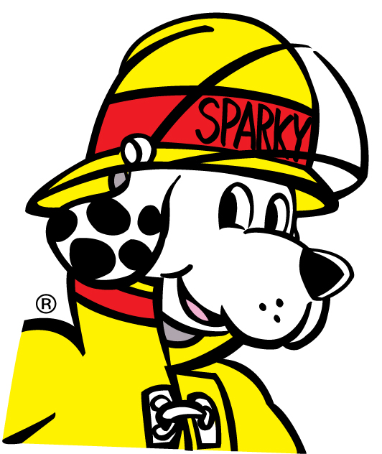
Thank you!

