Slide 1
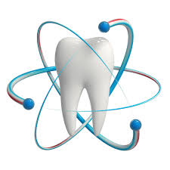
College of Dental Medicine HAZCOMM and Environmental Health & Safety

Slide 2
Training Outline
Crucial for a safe work place
Policy/procedures may vary
Required by Occupational Safety & Health Administration (OSHA)
To understand your rights & responsibilities
Participate in safety programs and take appropriate action
Notes:
By conducting laboratory work following guidelines and safety procedures you not only protect yourself, but also your colleagues
Policy and procedures my vary from university to university
The Occupational safety and health administration requires you to take the Laboratory Safety Training if you work in a lab.
The Right to know policy encourages you to understand your rights and responsibilities at work
Last but not the least to participate in safety programs and adopt safety culture.

Slide 3
Training Outline
Hazard Identification
Hazard Control Methods & PPE
Emergency Procedures
Roles & Responsibilities (Training)
Notes:
This is the training outline. We shall start from discussing the roles and responsibilities followed by learning about hazard identification. We shall discuss methods to prevent and mitigate hazards and the importance of personal protective equipment. Lastly we will end this training session by learning about how to respond to emergency procedures.

Slide 4
Roles & Responsibilities
Columbia University & PI
You
Identify Hazards
Provide personal protective equipment (PPE)
Provide information
Provide training
Including task specific training
Ensure your own safety
Report hazards
Use personal protective equipment (PPE)
Follow procedures
Get trained
Promote a safe, healthy & environmentally sound workplace
Notes:
Roles and Responsibilities falls in two basic categories: First- You as Dental staff which includes faculty, dental hygienist, assistants, laboratory technicians & volunteers, visiting dental staff, support personnel, and glassware washers.
The second category involves the Columbia University which includes Environmental Health and Safety team and administrative and academic dental staff.
Lets discuss Columbia University’s roles-
To ensure if you are safe, identify hazards and communicate those hazards. The university provides the PPE free of charge. Columbia University is also responsible to provide safety information and trainings needed for the dental staff to function efficiently. They also provide task specific trainings based on each dental laboratory/ clinics requirements
Each worker is responsible for ensuring their own safety while we as Eh&s are here to offer our timely assistance to adopt and promote safety culture.
Your responsibilities involve- if you see a hazard please step forward to notify it to EH&S, public safety or your administrative dental staff.
Knowing how to access the Laboratory Safety & Chemical Hygiene Plan, reviewing it, and being familiar with related policies and procedures.
Knowing where SDS are stored or accessible.
Attending Laboratory Safety and Hazardous Waste Management Training and other trainings applicable to dentistry
Safely handling and disposing of chemicals.
Using appropriate PPE when working in the dental laboratories and clinics.

Slide 5
Roles & Responsibilities:
EH&S
Consultants
Services Provided
Technical Guidance
Institutional Health and Safety Program Development
Laboratory Inspections and Surveys
Conduct Research Safely in Compliance with Regulations
General Safety Training
Hazardous Waste Disposal
Emergency Response
Hazard Assessments
Laboratory Commissioning and Decommissioning
Laboratory and Equipment Clearances
Notes:
We are not the police., We are not facilities. EH&S offers a broad range of services and actively develops partnerships with faculty and departmental personnel to ensure a safe work environment and compliance with University policy and applicable regulations in the most efficient manner possible. These endeavors are realized through programs such as personnel training, chemical hygiene plan, biological safety, environmental safety, fire safety, occupational safety, and asbestos and lead management in compliance with local, state and federal regulations.
Our Goals include:
Setting an example for effective health and safety programs;
Minimizing risk of exposure to hazardous chemical, physical or biological agents;
Minimizing risk of work related injury and illness;
Minimizing risk to the environment; and
Realizing these goals with a minimum burden on education and research activities.
EH&S provide services such as general lab safety training, we provide free hazardous waste pick up, emergency response such as managing spills, hazard assessment if you are working on a new experiment/ process and feel unsafe or if you are concerned about exposure to some chemical then we can do exposure assessment.
We also do laboratory decommissioning and commissioning as well as laboratory equipment clearances so if the PI is moving or re locating we intervene and certify all biological chemical and radiological material is removed from the lab. We certify that its clear for somebody else to go in and clean. We are here as consultants if you are concerned about safety aspect, get in touch with us.
Each year, EH&S delivers 12 hours of safety and environmental management training to more than 400 CDM staff and students. The training covers topics such as laboratory and occupational safety, hazard communication, environmental stewardship, waste management, bloodborne pathogens and fire & life safety. In addition, CDM has clinical policies and procedures specifically established to address these topics as it relates to clinical care. These are available through the CDM intranet website.

Slide 6
Agenda
Roles & Responsibilities (Training)
Hazard Identification
Hazard Control Methods & PPE
Emergency Procedures

Slide 7
Hazard Identification: Regulatory Introduction
Columbia University laboratories and dental clinics must comply with rules set by the following regulatory bodies:
New York City
Fire Department (FDNY)
Department of Environmental Protection (DEP)
Department of Health and Mental Hygiene (DOHMH)
New York State
Department of Environmental Conservation (NYSDEC)
Federal
Department of Labor: Occupational Safety and Health Administration (OSHA)
United States Environmental Protection Agency (USEPA)
Notes:
OSHA “Occupational Safety and Health Administration” is a government agency within the US Department of Labor created in 1970 by the Occupational Safety and Health Act, responsible for worker safety and health protection by developing specific standards to protect biological, chemical, environmental, physical, and psychological workplace hazards that may apply to dentistry.
OSHA's Mission is to assure safe and healthful working conditions for workers by setting & enforcing standards and by providing training, outreach, education and assistance.
Columbia University laboratories and dental clinics must comply with the regulatory agencies like OSHA DEP, NIOSH and if they make inspections, EH&S represent the university and escort the officials to laboratory and clinic spaces, write reports for them and be accountable for laboratory safety. We conduct safety survey and are available to offer assistance on any safety issue. We have guidelines on our website to learn more about EH&S clearances, PPE, SDS, chemical tracking, emergency response and more information on adopting safety culture.

Slide 8
Hazard Identification: OSHA Hazard Communication Standard
You have a right to know about the hazards you may be exposed to and how to protect against exposures
The classification of chemical hazards and the dissemination of safety information to personnel working with chemicals
(29 CFR 1910.1200)
Notes:
OSHA is Occupational safety and health administration which a federal government agency administers the worker right-to-know portion of the law through the Globally Harmonized System for Hazard Communication rule, Chapter 296-901, WAC. The rule requires employers to inform and train their employees about the hazards of chemicals they may be exposed to during normal working conditions or in foreseeable emergencies.
OSHA has HAZCOM COMMUNICATION STANDARD which means dental staff has the right to know about the hazards that they may pose and how to protect against these hazardous exposures.

Slide 9
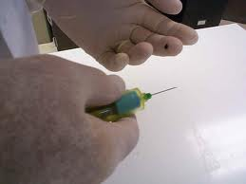
Hazard Identification:
Recognizing & Evaluating Hazards
Signs
Labels
Notes:
“The employer shall provide employees with information and training to ensure that they are apprised of the hazards of chemicals present in their work area.” 29CFR
Safety and hazard information is available from multiple sources.
Hazard classification: Provides specific criteria for classification of health and physical hazards, as well as classification of mixtures.
You communicate hazards at workplace by paying attention to signs, labels/ pictograms. you must know these signs to recognize hazards. These pictograms are based on Globally Harmonized System. Globally Harmonized System (GHS) is a system for the classification and labeling of chemicals on a international level. For example Radiation sign if ur dealing with radioactive materials

Slide 10
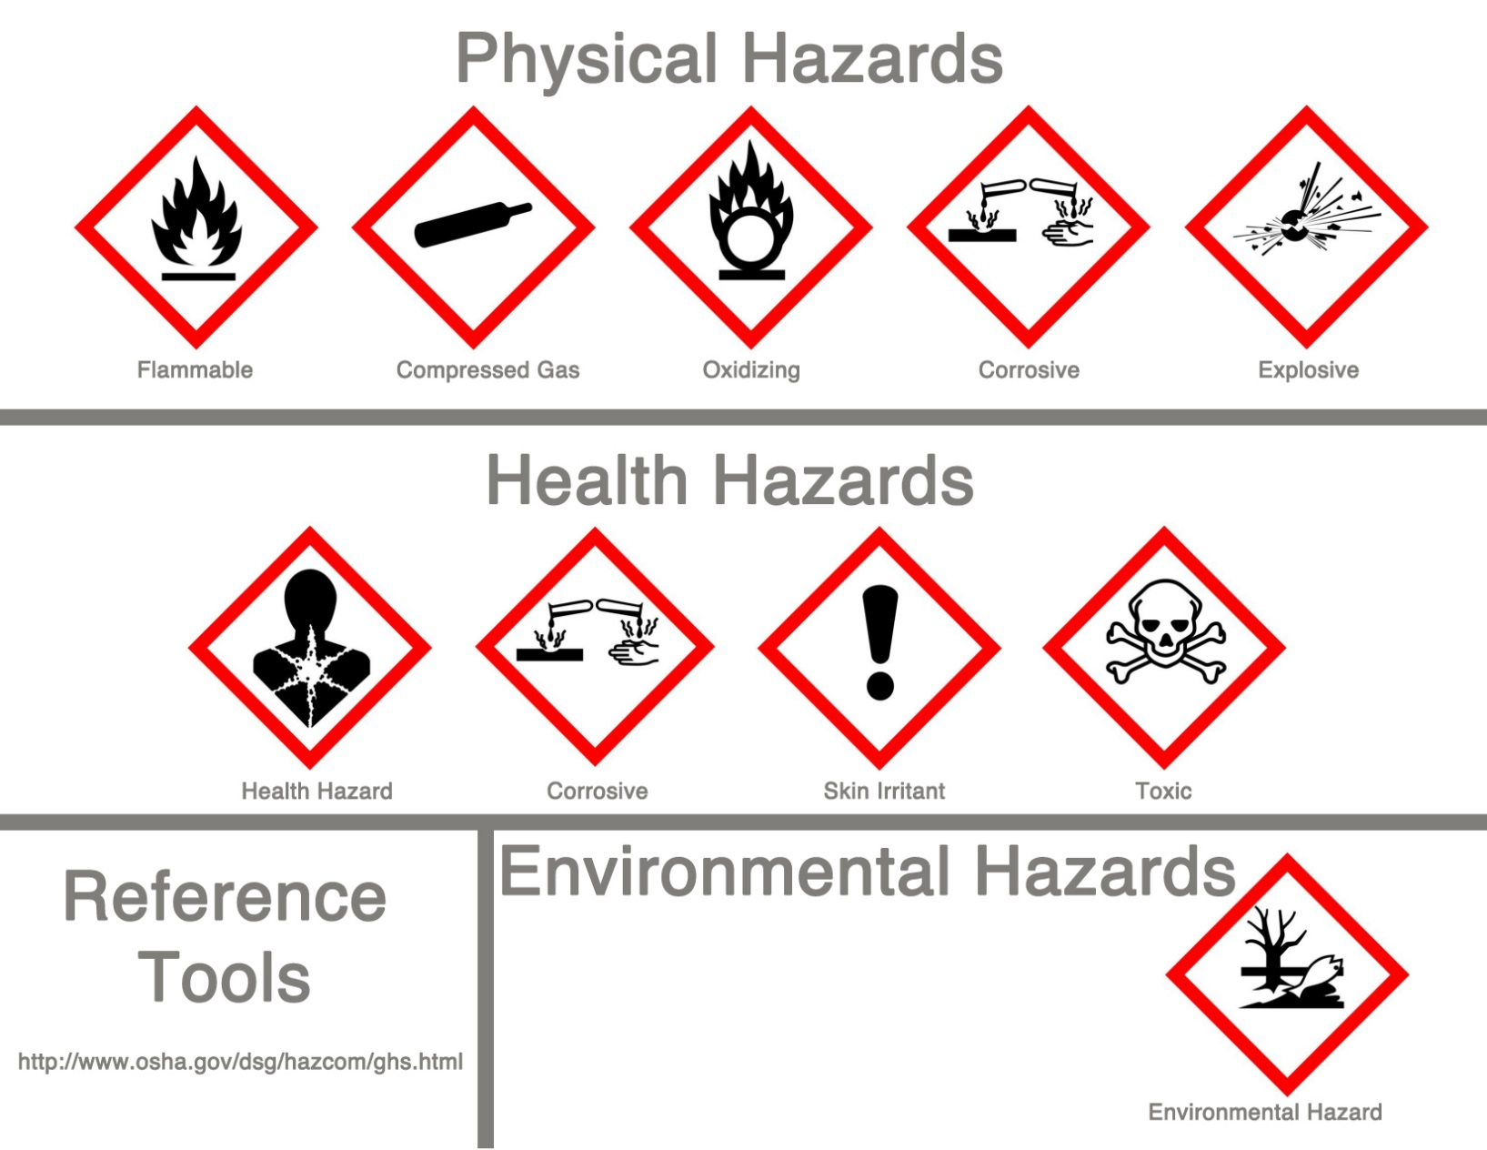
Hazard Identification: Pictograms & Hazards
Notes:
you need to be aware of are the GHS pictures or pictograms. These pictograms convey health, physical, and environmental hazards information.
There are a total of 9 pictures that depict hazard classes.
5 of the 9 pictograms included in the physical hazard class include: Explosives, oxidizing liquids, flammable liquids, compressed gases, and corrosive to metals.
4 of the 9 pictograms include health hazards: Acute toxicity (skull cross bones), skin corrosion (corrosives), Skin irritation (exclamation point), and aspiration hazard (Star man)/ specific target organ toxicity (STOT)
The 1 pictogram that conveys a picture for both physical and health hazard is corrosive materials. This picture is designated with a corrosive material spilling out a test tube onto a human hand and onto a piece of metal because corrosive chemicals can erode metals as well as cause damage to human skin.
Environmental hazard is any chemical that may be harmful for the marine life and so such chemicals should never go down the drain and Columbia has no drain disposal policy.

Slide 11
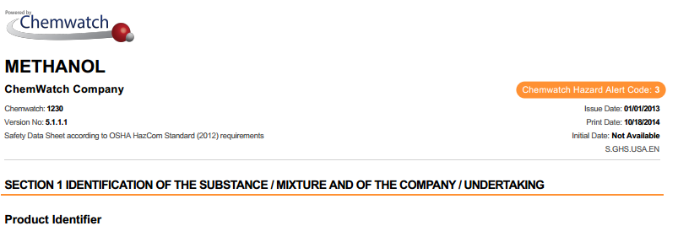
Hazard Identification: Safety Data Sheets (SDS)
Identification
Hazard Identification
Composition
First Aid Measures
Fire-fighting measures
Accidental release measures
Handling & Storage
Exposure Controls
Physical & Chemical Properties
Stability & Reactivity
Toxicological information
Ecological information
Disposal considerations
Transport information
Regulatory information
Other information
Notes:
All SDS are standardized under GHS. The SDS include 16 different guidance sections with 4 new sections of information that the old MSDS do not provide. These sections include: Other information, Regulatory info, transport info, disposal considerations. However only sections 1-10 pertain to you and sections 11-16 pertain to industry
Section 8 of the SDS will always contain information about exposure limits, engineering controls and ways to protect yourself, including personal protective equipment.
All labels and SDS are linked in a certain fashion where the information on the label is related to the SDS. For example, the precautionary statements would be the same on the label and on the SDS.
SDS provides more specific information than the old MSDS such as Regulatory information (Safety, health and environmental regulations specific for the product in question), Transport information, Disposal considerations, Ecological information, concise toxicological information such as delayed/immediate effects due to exposure, stability/reactivity such as conditions to avoid shock/vibration, chemical/Physical Characteristics, Exposure controls/PPE, Hazard identification (GHS label elements), first aid, accidental release measures, and handling/storage

Slide 12
Hazard Identification: Using ChemWatch
Columbia’s online source for safety data sheets
Available from any computer on the CU network
Available:
https://research.columbia.edu/content/safety-data-sheets
Notes:
You can obtain SDS from our CHEMwatch service following the link.

Slide 13
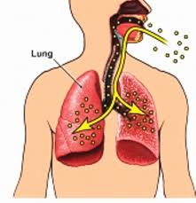
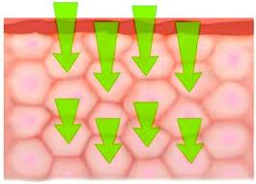
Hazard Identification: Routes of Exposure
How might you be exposed to a chemical hazard?
Inhalation
Absorption
Ingestion
Notes:
you can be exposed to hazard through 3 ways- inhalation by inhaling the chemical for example- Nitrous Oxide (N2O) commonly called laughing gas, the gas promotes combustion similar to oxygen and an anesthetic agent, dental workers are exposed to Nitrous Oxide (N2O) during administration of this anesthetic gas to patients. To prevent this exposure dentist must select scavenging masks of proper sizes to fit patients. ➢ Prudent use of N2O to appropriately sedate patients is encouraged.
Absorption can occur through direct contact via skin or exposure to eyes/ diffusion of gas to skin. Example: Methyl methacrylate (MMA) monomer (or just ‘monomer’) which is used in making dentures and plates, it can be absorbed into the body by inhalation, through the skin, and by ingestion. It can also lead to cross contamination if you have food and beverages in your working area. Practicing proper hand washing techniques is the best mechanism to avoid accidental ingestion exposure.
Columbia University has strict no food/ beverages policy which means under no circumstances can the dental laboratories/clinics be used for the storage or consumption of food.

Slide 14
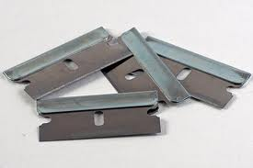
Hazard Identification: Routes of Exposure
Injection: Puncture/Laceration
Sharps, Needles, razor blades, and glass, can cause cuts, lacerations, and punctures
All needles, syringes and blades must be discarded in rigid sharps containers regardless of the status of biological contamination
Limit use, do not recap needles
Do not remove needles from syringes
Do not bend, break, or manipulate syringes
Notes:
Dental practitioner are exposed to a number of work related hazards- One such hazard could be due to needle stick or sharp injury. It could occur while administering injections, suture procedures or dental procedures that utilize sharps.
The Needlestick Safety and Prevention Act became law in 2000. It requires dental practices to evaluate and select safer sharps devices as they become available.
Adherence to standard infection control practices is the best way to prevent blood-borne infections in the dental setting. This employs :Proper storage of sharp instrument
Equipment maintenance
Proper managing and handling
Carefully carried out procedures
Ensuring the needle and surgical blade are sheathed/covered when not in use
Keeping full control of sharp instruments and retaining full concentration while handling such instruments
Keeping gloved fingers behind the cutting edge of surgical blades and elevators or the points of probe or needles
Over gloving or using double gloves, if needed.
One hand needle recapping, and needle bending directly by fingers should be avoided.
Using instruments in stead of fingers to place disposable contaminated sharps in an accessible sharps container.
Washing hands immediately after removing gloves.
Contaminated reusable sharps should be placed in immediately after use in a puncture-resistant and labeled sharp box containers.
Taking care when cleaning away the surgical sharps, wires, etc.

Slide 15
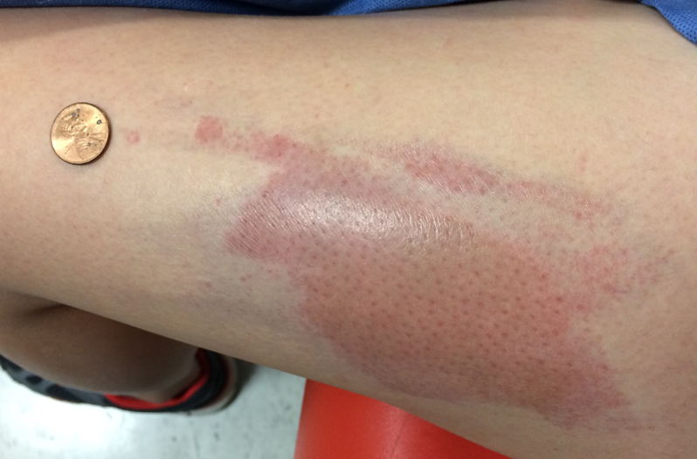
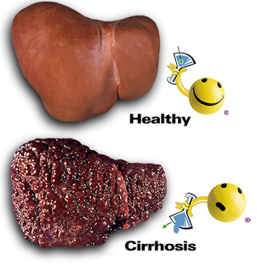
Hazard Identification: Chemical Health Hazards
Acute Health Effects:
An exposure to a hazardous material with immediate symptoms but is often reversible
Headaches, dizziness, burns from corrosive chemicals and/or rash
Chronic Health Effects:
Prolonged or repeated exposure to hazardous materials may lead to irreversible damage with symptoms that are not immediately apparent
Cancer, mutation, and/or reproductive effects
Notes:
Will verbally cover acute and chronic health effects, common signs and symptoms, and a basic description of each listed Health Hazard.
Time distinction not a severity distinction… each category can be mild or severe.
An acute disease lasts for just a short time but can begin rapidly and have intense symptoms. An acute disease can be mild, severe or even fatal e.g. colds, influenza and strep throat.
Chronic disease: A chronic disease is persistent. It lasts for a long period of time and might recur. Like an acute disease, a chronic disease can be mild, severe or fatal. It produces symptoms that last for three months or more.

Slide 16
Agenda
Roles & Responsibilities (Training)
Hazard Identification
Hazard Control Methods & PPE
Emergency Procedures

Slide 17
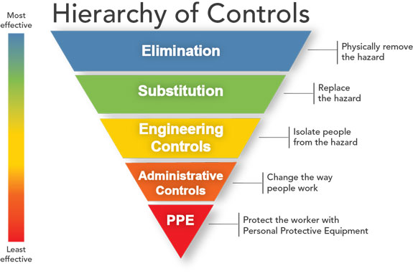
Hierarchy of Hazard Control Methods
https://www.cdc.gov
Notes:
The idea behind this hierarchy is that the control methods at the top of the list are potentially more effective and protective than those at the bottom. Following the hierarchy normally leads to the implementation of inherently safer systems, ones where the risk of illness or injury has been substantially reduced.
It means, Consider elimination before all other options. So you first try to physically remove the hazards, by substituting less hazardous alternatives that give similar results. If you cannot remove the hazard then you place a barrier between the worker and the hazard. Adopt safe work practices. We do have PPE policy on our website, please wear proper PPE as the dental procedure demands.
http://www.cdc.gov/niosh/topics/engcontrols/

Slide 18
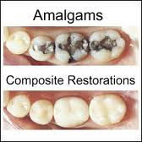
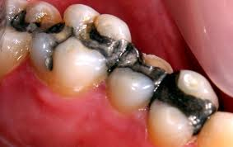
Hazard Control Methods: Elimination & Substitution
Mercury Dental Filling vs Resin Composite
Notes:
The silver fillings used by dentists to restore teeth are composed of a metal "amalgam" containing roughly 50% elemental mercury and 50% other metals (mostly silver with some tin and copper).  The mercury found in amalgam fillings has raised some safety concerns over the years. Amalgam can release small amounts of mercury vapor over time, and patients can absorb these vapors by inhaling or ingesting them. Dental staff can be exposed to mercury by inhalation of vapors, cross contamination, skin absorption, skin sensitizer, corrosive as liquid.
A 2004 study found a link between cognitive impairment (including mood) and mercury exposed-dentist. “Ritchie et al.,2004” ➢ A Norwegian study has documented a decline in cognitive abilities of the studied dental professionals greater than the non-mercury exposed individuals. “Moen et al., 2008”
There are also Environmental concerns associated with mercury:
➢ The WHO reports that one-third of the mercury in the sewage system comes from dental amalgam flushed down the drain.
➢ It is estimated that about half of the mercury released from current and historical dental amalgam use remains potentially bio available, making all individuals exposed to mercury pollution to some degree.
The Environmental Protection Agency: responsible for regulating mercury and mercury compounds discharges into the environment (atmosphere, waters and landfills).
The Food and Drug Administration: for regulating mercury levels in food, drugs, cosmetics and medical devices.
The Occupational Safety and Health Administration responsible for regulating workplace mercury &worker exposure to mercury and its compounds, both in industry as well as in professional practices.
Few steps to follow control Mercury exposure are:
1. Elimination of mercury containing equipment. Substitution with less harmful product such as composite restorations. 2. Mechanical amalgamators to ensure no physical contact. 3. Protective clothing, gloves, eye and face protection, and respiratory protection based on hazard assessment. 4. Properly designed and maintained ventilation systems. Local exhaust ventilation may be required. 5. Education of workers in the nature of the hazard. 6. Monitoring of the work environment. 7. Good hygiene practices. 8. Appropriate storage of products to decrease exposure.

Slide 19
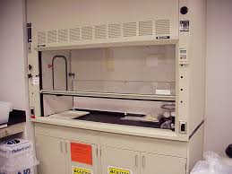
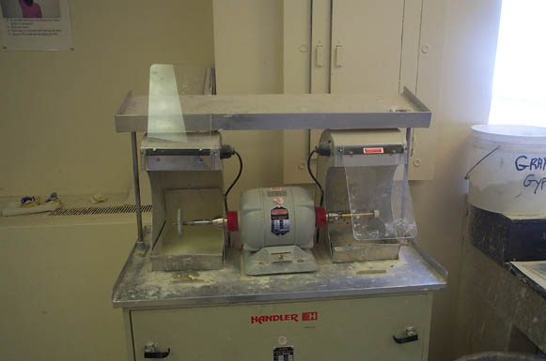
Hazard Control Methods: Engineering Controls
HVAC system, Fume hoods and Machine guards
Notes:
Dental technologist are exposed to various dusts and chemical fumes, many of which are known carcinogens. The problem may be compounded where the technologist works in a confined space and in conditions of poor ventilation
The fume hood is often the primary control device for protecting laboratory workers when working with flammable and/or toxic chemicals.
Before using a fume hood:
■ Make sure that you understand how the hood works.
■ You should be trained to use it properly.
■ Know the hazards of the chemical you are working with;
refer to the chemical’s Material Safety Data Sheet if you
are unsure.
■ Ensure that the hood is on.
■ Make sure that the sash is open to the proper operating
level, which is usually indicated by arrows on the frame.
■ Make sure that the air gauge indicates that the air flow is
within the required range.
When using a fume hood:
■ Never allow your head to enter the plane of the hood
opening. For example, for vertical rising sashes, keep the
sash below your face; for horizontal sliding sashes, keep
the sash positioned in front of you and work around the
side of the sash.
■ Use appropriate eye protection.
■ Be sure that nothing blocks the airflow through the baffles
or through the baffle exhaust slots.
■ Elevate large equipment (e.g., a centrifuge) at least two
inches off the base of the hood interior.
■ Keep all materials inside the hood at least six inches from
the sash opening. When not working in the hood, close the
sash.
Dental laboratory technicians that work with alloys containing metals such as beryllium that is used for castings of bridge framework and other dental prosthesis components are at risk for developing beryllium sensitization and chronic beryllium disease.
➢ While the amount of beryllium used in dental alloys is small ‘’ 0.05 - 2%’’, there is still a risk of developing beryllium sensitization or CBD through breathing the dust and fumes produced while altering the alloys.
➢ The World Health Organization’s listed beryllium as a "known human carcinogen.
➢ To ensure that dental laboratory technicians exposures to beryllium are maintained below the current OSHA PELs. The following engineering controls are recommended:
1. Where possible, alloys that do not contain beryllium should be substituted for beryllium-containing alloys in dental work;
2. All procedures related to casting, cutting, grinding, or polishing beryllium-containing dental alloys should be conducted using properly designed and installed local exhaust ventilation;
3. Vacuum systems and local exhaust ventilation systems should be equipped with high-efficiency particulate air (HEPA) filters.
Machine Guards: Be cautious and alert when working with machine guards: Can grip hair or clothing
Can force the body into a dangerous position
Direct injury from cutting action
Flying chips or sparks
Saws, drills, lathes, mills
Precautionary steps involve :Prevent contact between hazardous moving parts and body or clothing
Secure guard: not easily removed
Protect from objects falling into machinery
No new hazards: sharp/rough edges
No interference with job/comfort/speed
Management:
Ensure all machinery is properly guarded
Supervisors:
Train employees on specific guard rules in their areas
Ensure machine guards remain in place and are functional
Immediately correct machine guard deficiencies

Slide 20
Hazard Control Methods: Administrative Controls
Policies, procedures, effective communication and best work practices designed to ensure the safety of personnel
Consult an experienced staff or faculty member before modifying a protocol or designing a new experiment
Notes:
Most Effective Hazard Controls. The best way to protect workers is to remove or eliminate the hazard from the workplace using the following hazard control methods: Substitution. Substitute dangerous chemicals, equipment or work methods with safer and less hazardous ones to eliminate the hazard altogether. Administrative controls include the following:
– Written operating procedures, work permits, and safe work practices;
– Exposure time limitations (used most commonly to control heat stress and ergonomic hazards);
– Monitoring the use of highly hazardous materials;
– Alarms, signs, and warnings;
– and training

Slide 21
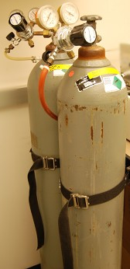
Hazard Control Methods: Administrative Controls - Compressed Gases
Gases in cylinders are under high pressure and compressed gas cylinders can be destructive to life and property if damaged.
Seek instruction from an experienced person before handling compressed gas cylinders.
Always secure cylinders to a stable mount.
Remove regulators and apply cap when the cylinder is not in use.
It is important to segregate incompatible gases.
Example: Compressed oxygen tanks separated from flammable gases by 20 feet.
Notes:
All compressed gas cylinders must be properly stored in compliance with Cal/OSHA and NFPA code requirements.
-All cylinders whether empty or full must be stored upright and secured by chains, straps or in racks to prevent them from falling due to accidental contact, vibration, or earthquake
-If a cylinder valve cannot be opened, the valve should never be forced. If a valve cannot be opened by hand, the cylinder should be returned and another obtained. Employees must not attempt to repair cylinders or cylinder valves, or to force stuck or frozen cylinder valves.
-Cylinders must be segregated by contents. For example, flammable gases must be stored separately from oxidizing gases by a distance of 20 feet or a 5 foot high, one-hour fire-rated wall.

Slide 22
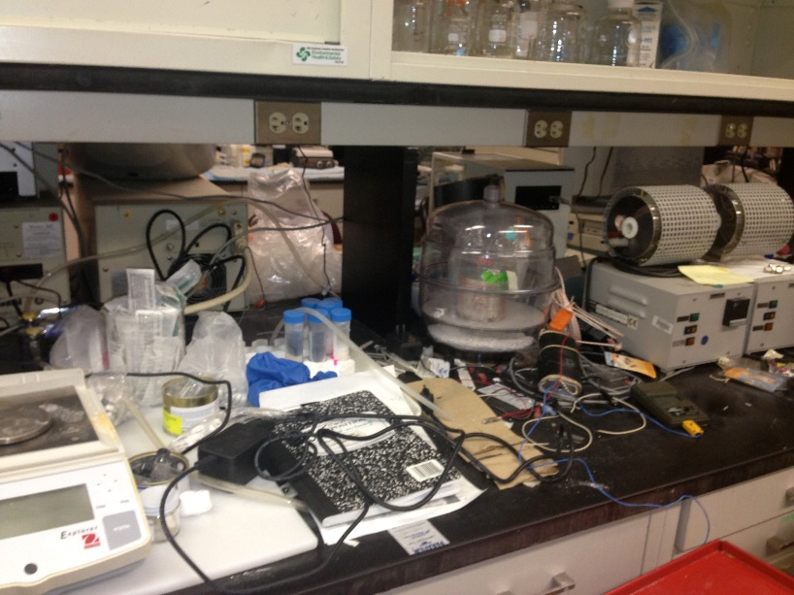
Hazard Control Methods: Administrative Controls - Housekeeping
Do not place or store items on top of cabinets, light fixtures & radiators
Do not block aisles and exits
Maintain tidy workstations
Notes:
Administrative controls are features of one’s work practices designed to reduce exposure.
Chemical substitution, Mercury is a TOXIC metal. Clean-up of spilled mercury is time and resource-intensive.
Proper storage and segregation of hazardous materials
Proper housekeeping practice
Extension cords are only to be used temporarily and should never be draped across the floor. Extension cords should only be used for small portable devices, never for large pieces of equipment eg. a refrigerator.
Poor housekeeping contributes to accidents and can hinder emergency response activities.
Do not block exits, aisles, or doorways.
Do not block access to emergency equipment.
Do not store chemicals in excess of lab’s limts
Handle and store glassware with care.
Do not store chemical containers on the floor.

Slide 23
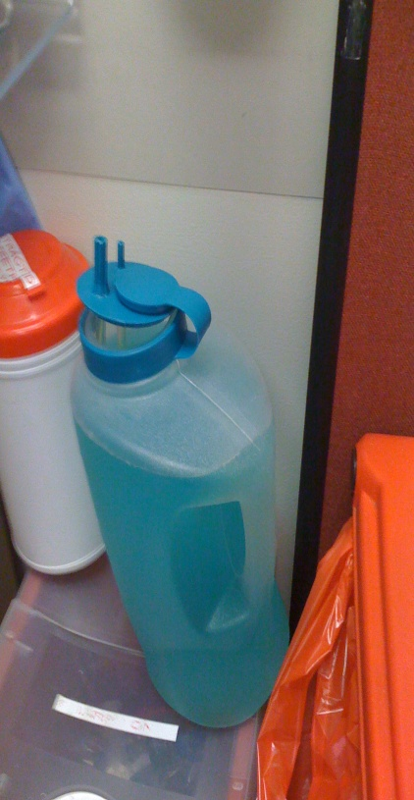
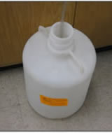
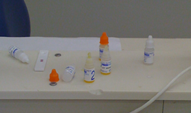
Hazard Control Methods: Administrative Controls
Proper storage and segregation of hazardous materials.
Proper chemical container labeling
No Labels
Open Containers
???
Notes:
Administrative controls are features of one’s work practices designed to reduce exposure. For example- closing open containers, labelling the containers needed.
Chemical substitution
Proper storage and segregation of hazardous materials
Proper housekeeping practice
Prudent inventory and purchase order management
Appropriate training and Right to Know information (such as MSDS)

Slide 24
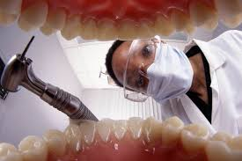
Hazard Control Methods: Personal Protective Equipment (PPE)
Must be worn at all times in the Clinic:
Proper work attire
Scrubs
Lab coats/aprons
Safety glasses/goggles
Protective gloves
Notes:
▪ PPE - used in conjunction with other controls (engineering and administrative) to provide additional protection to workers. ▪ PPE - designed to protect workers from infectious disease by breaking the chain of infection at the “portal of entry or exit” of the microorganisms. ▪ PPE as Gloves, gowns, eye protection and other protective clothing.
section 19, Occupational Safety and Health Act 1984 Duties of employers towards their employees.
Dental Staff must select appropriate personal protective equipment based on the risk factors associated with your work.

Slide 25
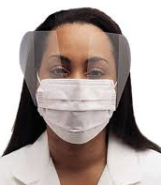
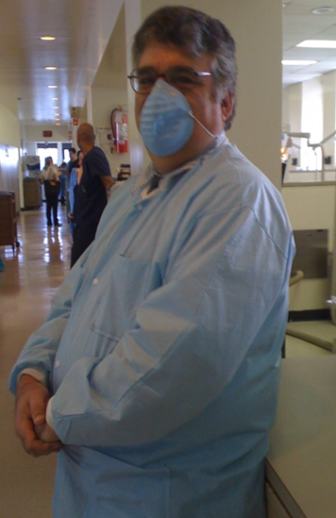
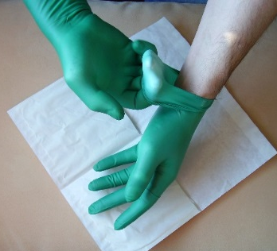
When working in the lab & clinic you must wear PPE & proper attire or you will be asked to leave the immediately
Hazard Control Methods: Personal Protective Equipment (PPE)
Notes:
➢ Appropriate sizes of personal protective equipment (PPE) “provided at NO COST to the employee” must be used and then removed prior to leaving a work area or upon contamination.
Personal protective equipment
✓ Disposable Gloves shall be readily accessible, replaced as soon whenever their ability to function as a barrier becomes compromised. ✓ Masks with eye protection devices, as goggles or glasses with solid side shields, or chin-length face shields, shall be worn whenever splashes, spray, spatter, or droplets of blood or OPIM (OTHER POTENTIALLY INFECTIOUS MATERIALS) may be generated.

Slide 26
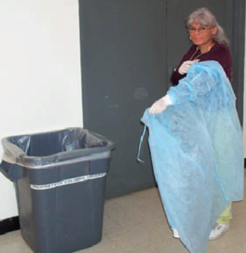
Hazard Control Methods: Personal Protective Equipment (PPE)
General Areas
Wearing gloves on elevators is NOT permitted
Never Touch elevator buttons or door knobs with gloves
Always remember to remove your gloves when you leave your work station
Remember to remove disposable gowns before leaving clinical areas
Never step outside of VC with gowns & gloves
Notes:
Never leave your work area in a mess – always clean up after yourself
Never wear PPE/gloves outside the VC work space and do not touch elevators/ door knobs with the same.

Slide 27
Agenda
Roles & Responsibilities (Training)
Hazard Identification
Hazard Control Methods & PPE
Emergency Procedures

Slide 28
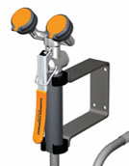
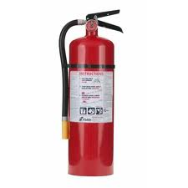
Emergency Procedures: Equipment
Eye Wash Station
Fire Extinguisher
Keep Clear of Obstruction!
Notes:
Please brief yourself well with these emergency equipment- eye wash stations, extinguisher, and safety showers. Next time you visit ur clinics and labs make sure u know where each one of them are placed and if they are not obstructed.
In case of emergency u want to access them immediately and efficiently.
Your specific eye wash station may look different.
Facilities test fire extinguishers monthly and test and recertify overhead showers annually.

Slide 29
Emergency Procedures: Using an Eye Wash
Wash a contaminant out of the eye by providing a continuous flow of water.
Activate the eye wash station and enable “hands-free” operation.
Gently position your eyes into the water stream.
Flush your eyes for a full 15 minutes.
Test it weekly – Do not wait for an emergency!
Notes:
Eye wash stations must be tested weekly. EH&S does trimester safety surveys and in 2017 in our third quarter safety survey we focused on checking for working eye wash stations in the lab. We inquired if the lab members were aware about its usage, function and how often did they test.
The eye wash station must be tested weekly, it must have clean running devoid of dirt and dunk. This is important because in case of chemical splash in eyes your laboratory have clean running water to wash the eyes.
Testing an eye wash is as simple as allowing the water run for few minutes and adopting this practice once weekly the eye wash stations will be functional with clean running water.
If there is a splash in your eye the eye wash station must be within 10 seconds of reach and u must flush the water in ur eyes for good 15 minutes, you will hold your eyes open. Do not try to constrict your eyes because if a chemical penetrates in to ur eye it can be painful.
If ur wearing contacts the procedure will remain the same chances are either the contacts would come off automatically with water force or you can remove them after washing the eyes.

Slide 30
Emergency Procedures: Spills
Manageable
Unmanageable
Call Facilities to mop up spills of non-hazardous materials
Examples:
Water
Bleach
Other disinfectants
Small amounts of low hazard chemicals & biological spills can be managed by you!
Call EH&S at (212) 305-6780 with:
Chemical identity if known
Volume
Location
Your name, UNI, and telephone number
Notes:
It important to know difference between a manageable and unmanageable spill.
A manageable spill is small, dinner plate, for example if u spill a small bottle of ethanol, you can easily clean that up with an absorbent material.
But if u spill a gallon of monomer then that would fall under an unmanageable spill and u alert everyone in the lab and evacuate. Contact Public Safety.
They will eventually contact EH&S and we will show up in our cool tyvecs suit like astronauts and clean the spill for u. Bc we are professionally trained in managing large spills.
In general, to assess a spill you must think about how toxic the spill is and the amount of it.
Each lab has spill kit make sure u know where it is.
Now I will play a video on how to tackle a manageable spill.

Slide 31
Emergency Procedures: Personal Contamination
Flush contaminated eyes, face, arms, and body area with copious amounts of water
Remove contaminated clothing
If there are no visible burns, wash gently with soap and warm water
Seek medical attention, if necessary
If there are no visible burns, wash gently with soap and warm water
Inform your supervisor
Notes:
Spills of hazardous materials that involve personal contamination increase the possibility of exposure, particularly if the chemical is capable of being absorbed through the skin.
if u get exposed to chemical contamination, get rid of the contaminated clothing and wash the area for good 15 minutes. For medical attention, contact workforce health safety, take the sds and go to the nurse practioner or doctor.
Don’t forget to contact the public safety, inform ur PI.

Slide 32
Emergency Procedures: Reporting Laboratory Emergencies
Reporting Fire, Smoke Conditions or Personal Injury
Campus | Public Safety from a Campus Phone | Public Safety from a Personal Phone | EH&S
Medical Center | (212) 305-7979 | (212) 305-8100 | (212)305-6780
Provide:
Name & UNI
Location (building, room)
Phone number
Incident details
Any Personal injury
Notes:
If u don’t have the number of public safety, please take a picyure of the screen so that’s its on ur phone.
When reporting an emergency to public safety;
Provide with ur name, uni, phone number so that if u get disconnected they can call u back, location of the emergenmcy , details specially if there is any personal injury. Public safety are professional call center and they can get in touch with nypd / fdny in second. They know the buildings and floors better than fdny or nypd and they can reach faster than anyone.

Slide 33
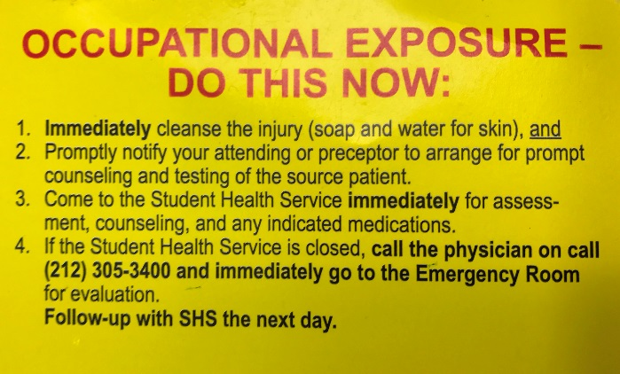
Spills and Emergency Procedure: Where to go for Injuries & Health Emergencies
Campus | Hours | Employees | Public Safety Contact
CUMC | Business-Hours | Workforce Health & Safety Harkness Pavillion | (212) 305-7979
 | After-Hours | NYPH Emergency Depart. First Floor of the Vanderbilt Clinic (VC)
Campus | Hours | Students | Student Health Services
CUMC | Business-Hours | Student Health Services | (212) 305-3400
Notes:
It is highly recommended to save after hours emergency contact information on your phone.

Slide 34
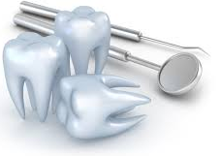
Reminder
Be familiar with the location of emergency equipment
Address manageable spills as soon as they occur
If this cannot be done immediately, mark off the area and ALERT those around you
Take Action! Call Facilities or EH&S immediately
SAFETY FIRST/SAFETY ALWAYS
Notes:
In conclusion although not frequently reported, dental professionals may be at risk for exposure to numerous occupational health hazards wither in the dental clinic or during manufacturing dental prostheses in the dental laboratory. there is an ever growing need for occupational health practitioners to be aware of the work processes in this occupation, to recognize possible hazards, and to implement specific measures to control and reduce hazards associated with their occupations.
Last but not the least

Slide 35
Contact Research Safety:
labsafety@columbia.edu

