Slide 1
Radiation Safety
College of Dental Medicine
(CODM)
Notes:
The goal of this brief presentation is to demonstrate to you that with some easy but effective radiation safety practices we can keep exposures to hospital personnel minimal.

Slide 2
Training Outline
Sources of Radiation Exposure
NYC Regulations
Potential Hazards of Radiation
Principles of Radiation Protection
Obligations of CODM Employees
Notes:
I’m going to go through why you, as a member of the CODM, may come across radiation, what regulations apply to your use of radiation, the potential hazards of that exposure and the basic steps you can take to protect yourself and avoid those hazards.

Slide 3
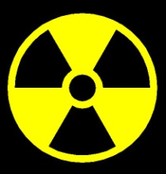
Common Sources of
Radiation Exposure
Everybody on the planet is exposed to radiation.
Radiation occurs naturally in the atmosphere, in building materials, and even in our own bodies.
Naturally occurring background (baseline) radiation levels in the United States averages approximately 3 mSv per year.
This background radiation is not included in occupational radiation exposure reports.
Individuals are also exposed to man-made sources of radiation in hospitals, dental clinics, nuclear power plants, etc.

Slide 4
Notes:
This slide provides an eye-opening glimpse into the changing patterns of radiation use in the USA.
In 1987, a nationwide survey by the National Council on Radiation Protection and Measurements found that an average person in the USA received 82% of their annual radiation dose from naturally-occuring sources, and 18% from man-made sources – including medical use. The same organization repeated their survey over two decades later and found that the same average person received 50% of their annual radiation dose from man-made sources. Although the level of naturally occuring radiation remained the same, the increasing use of medical radiation significantly shifted the distribution and proportions of an average person´s radiation exposure.
4

Slide 5
Notes:
It is important to emphasize that the 1987 survey reported an average effective dose of 3.6 milliSieverts per year. By 2009, this figure nearly doubled to 6.2 milliSieverts per year.
A more detailed breakdown of the pie chart from the previous slide is seen here.
As you can see, the increase in radiation from medical procedures is responsible for most of the change. There is no denying that medical radiation use is essential in modern medicine, but its judicious use is critical in ensuring that neither the patient nor the caregivers are exposed to more radiation than they really need. It is also important for associates who are not in direct patient care to recognize that radiation is used in many areas within our facilities.
5

Slide 6
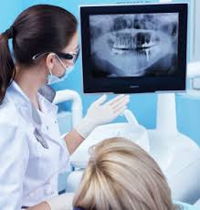
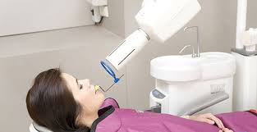
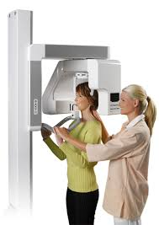
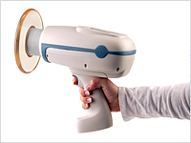
Sources of Radiation Exposure at the CODM
Notes:
In the dental world, the main source of radiation exposure we see is from dental x-rays, which now come in different forms like intraoral units and the cone-beam ct, and for the students in training you might see the handheld nomad units as well.

Slide 7
Potential Hazards for Radiation Workers
High Dose Risks
Deterministic Effects
Low Dose Risks
Stochastic Effects
Threshold dose below which effect is not observed
Severity of effect increases with increasing dose
e.g. Cataracts, erythema, fibrosis, hematopoietic damage
No threshold dose for effects to appear
Severity of effect is unchanged with increasing dose
e.g. Cancer
Notes:
- When we discuss the hazards of radiation, we can divide the risks into 2 categories: high dose and low dose risks
At very high doses, we see deterministic effects, which only occur above a specific threshold of dose, such as cataracts and erythema (skin redness),
and these effects get worse as the dose increases above the threshold
When exposed to low doses, we see stochastic effects, which means random
These effects are probabilistic, there isn’t a certain amount of dose we can determine at which they will or will not occur or will get worse
And the most common example of this is cancer
Again, at the maximum you are likely to get exposed to is just 10mrem, which only falls under the low dose risks

Slide 8
New York City Regulations
The safe use of radiation is governed by Article 175 of the Rules of the City of New York
CUMC and NYP use radiation under licenses and permits issued by the New York City Department of Health and Mental Hygiene
Applicable regulations are available for review by any CUMC and NYP employee by contacting Radiation Safety
Notes:
The safe use of radiation in the clinical setting is regulated by Article 175 of the rules of the city of NY, which forms the guidelines we follow to make sure your work environment is both safe and in compliance with the various x-ray licenses and permits we hold with the city department of health and mental hygiene.
For your reference, a copy of these permits and regulations are available to you at any time at our department.

Slide 9
NYC Regulations
Exposure Type | Annual Limit (mrem)
Whole Body (Deep) | 5,000
Lens of Eye | 15,000
Whole Body (Shallow) | 50,000
Extremity | 50,000
Any Individual Organ | 50,000
Embryo/Fetus (DPW) | 500 /entire pregnancy
 | 50 /month of pregnancy
*Note: The average annual exposure of CODM personnel is less than 10 mrem (nearly background)!
Notes:
An important part of the regulation limits the total exposure an occupational radiation worker can get in a year, which is 5000 mrem for the whole body.
Different body parts have different specific limits, because different body parts are more and less sensitive to radiation,
and similarly there is a much lower limit of exposure to pregnant workers.
However, here at CODM the average annual exposure of personnel is below 10 mrem
-- so your exposure is significantly lower than the limit, and in fact in many cases lower than threshold when you would be required to wear a dosimeter badge.
Which is why day to day most of you are not required to wear a badge or wear lead.

Slide 10
Area Monitors
Federal regulations state that any employee that is expected to receive 10% of the Annual Occupational Radiation Limit must be given personal dosimetry.
Annual Occupation Limit – 5000 mrem
Personal Dosimeters – 500 mrem
A 3-Year study was conducted to analyze radiation exposure in the College of Dental Medicine.
In the past, CODM was issued personal dosimeters but after analyzing the exposure records of individuals in CODM, we found all exposure were approximately background levels.
In December 2012, the Dean of the College of Dental Medicine and the Radiation Safety Officer agreed to discontinue personal dosimeters for CODM (JRSC Approved).
Instead of Personal Dosimeters, we provide area monitors.
Each employee has an obligation to report unsafe conditions in your x-ray areas to the Radiation Safety Office.
Each employee has the right to be informed of their occupational radiation exposure (area monitor reports) which are kept with your manager.

Slide 11
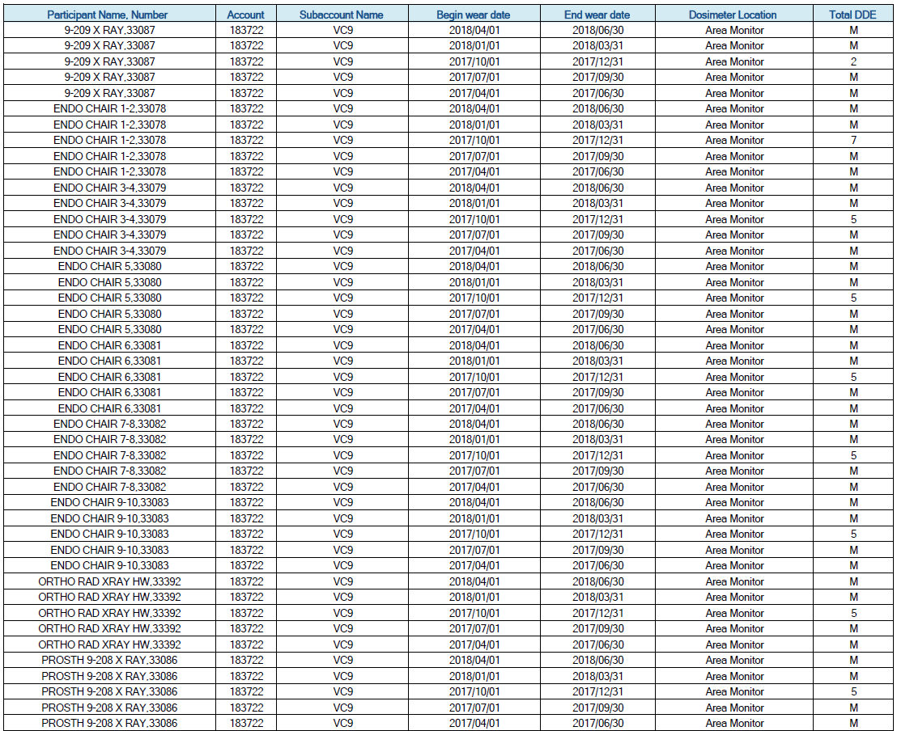
Dosimetry Reports

Slide 12
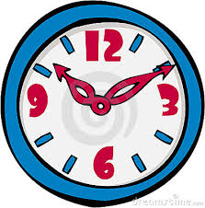
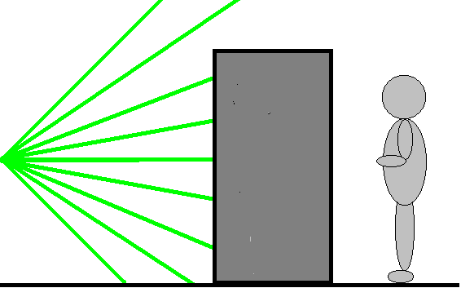
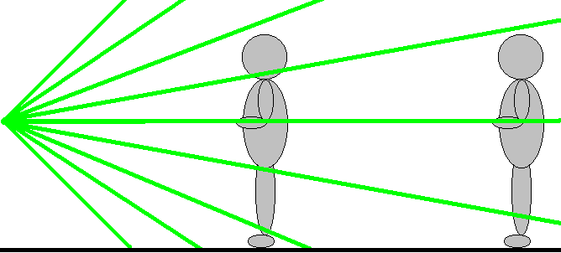
Principles of Radiation Protection
ALARA = As Low As Reasonably Achievable
Time
The less time exposed, the less dose received
Distance
The greater the distance, the less dose received
Shielding
A physical barrier of high-Z material (i.e. lead or concrete) can absorb photons
Only use machine when you have to
Stand outside room during exposure
Walls of most dental offices provide adequate shielding from x-rays
Notes:
The philosophy behind health physics is ALARA: as low as reasonably achievable
Meaning we want to keep your radiation exposure as low as possible while allowing you to properly do your work
And that’s how we have been able to keep the average doses in CODM so low
There are 3 basic principles you can follow to achieve this level of radiation protection:
time distance and shielding
…
Any combination of these 3 will help you achieve the goal of ALARA, so if one is not available try to maximize your use of the other 2
Some of the x-ray rooms in codm don’t have a shielding barrier, there is no door, so simply maximize you distance as much as possible
(within reason to still perform your task of taking the x-ray image)

Slide 13
Declared Pregnant Workers
The embryo and fetus have a heightened sensitivity to radiation
CUMC provides a voluntary and confidential program for workers/students who are pregnant while working with radiation
The program provides for enhanced protection and dosimeter monitoring of the unborn child
All individuals interested in the program should set up a confidential consultation with a Radiation Safety team member
Notes:
-as I mentioned earlier, the embryo and fetus have a heightened sensitivity to radiation.
-we offer a voluntary and confidential program for workers/students who are pregnant while working with radiation.
- Which provides for enhanced protection and dosimeter monitoring of the unborn child.
-Any individuals interested in the program, even if you just have questions but don’t want to declare your pregnancy, can set up a confidential consultation with the Radiation Safety Officer by reaching out to our office.

Slide 14
Clinical Radiation Safety Contact Information
Email: rso-clinical@columbia.edu
Phone: (212) 305-0303

Slide 15
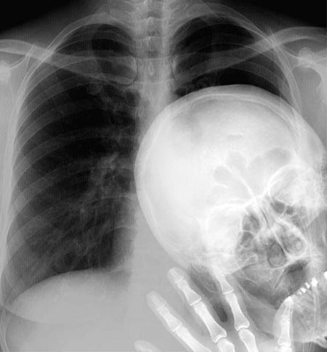
Thank you!

