Slide 1
Waste Management Guidelines in the College of Dental Medicine
Prepared by:
Columbia University EH&S
in partnership with the College of Dental Medicine
October 2021

Slide 2
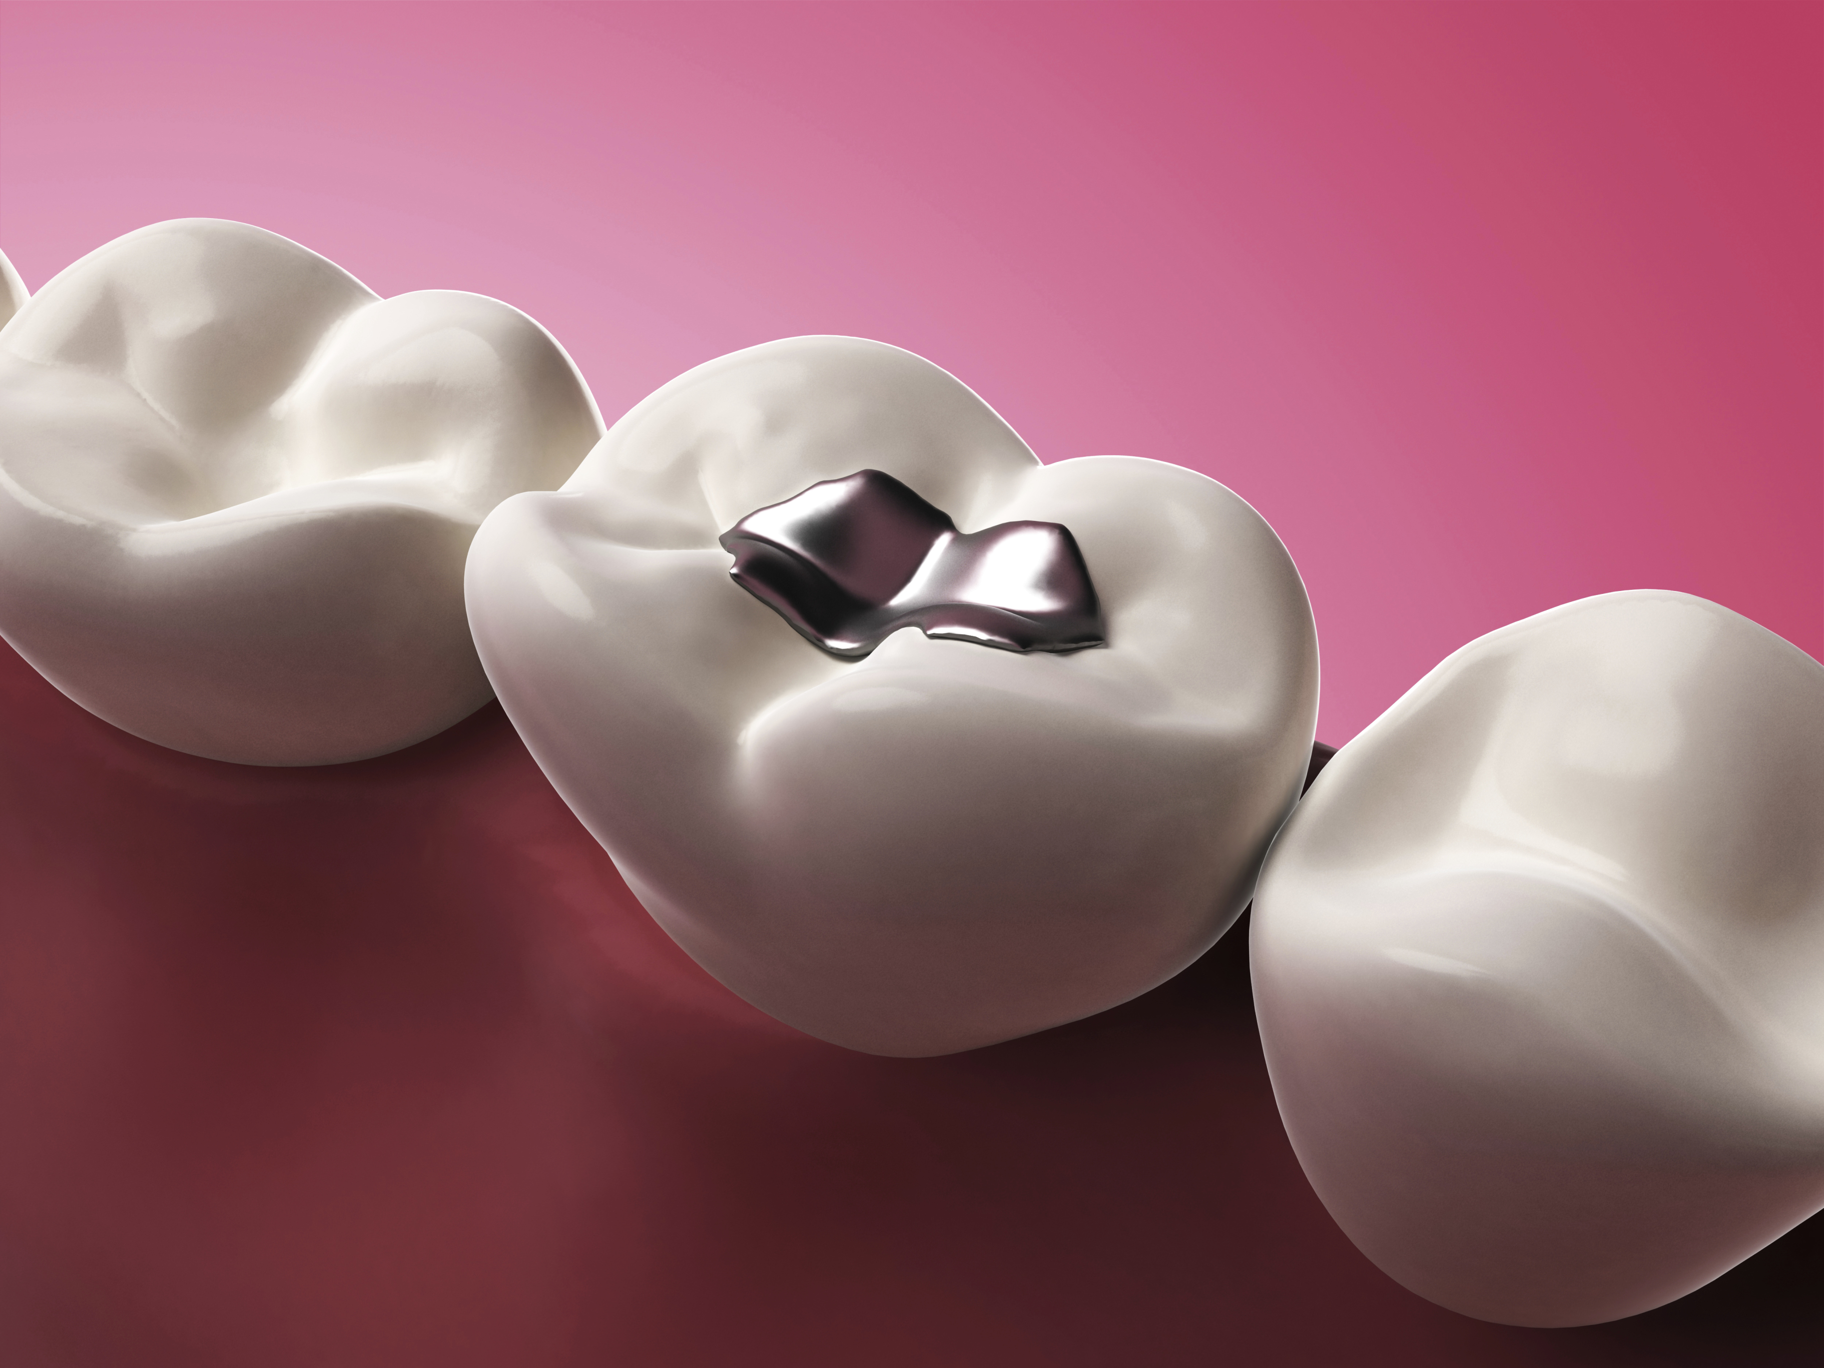
Training Outline
Introduction
No Drain Disposal
Dental Waste Management
Types of Hazardous Dental Waste
Amalgam, Capsules, Teeth
Chair Side Traps
Aerosol Cans
Butane and Torches
Pharmaceutical waste
Sharps
Used Batteries
Review

Slide 3
Introduction
New York State Law requires that mercury and mercury amalgam waste generated in dental practice be properly managed to avoid environmental contamination.
In collaboration with EH&S, the College of Dental Medicine (CDM) has prepared an updated, streamlined program for the management of wastes generated in CDM clinics (on campus).

Slide 4
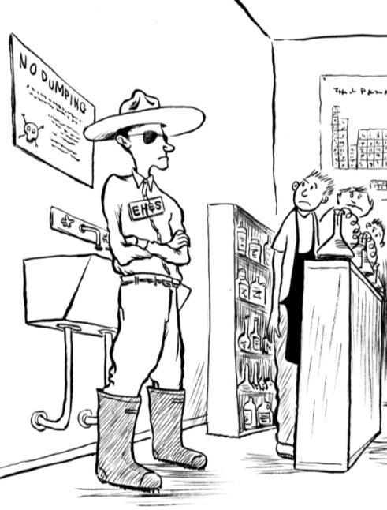
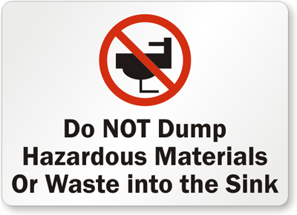
Columbia University Policy: No Drain Disposal
Fundamental to CDM’s commitment to proper waste management is its adherence to the University’s “No Drain Disposal” Policy
No Drain Disposal Policy
All hazardous waste must be collected for safe and proper disposal through EH&S
Notes:
Here again, a final reminder about the no drain disposal policy.

Slide 5
Dental Waste Management: Types of Waste
The following types of dental waste are specifically addressed in this presentation:
Amalgam and capsules
Extracted Teeth (with amalgam)
Extracted Teeth (no amalgam)
Chair-side traps
Lidocaine and Marcaine carpules
Other pharmaceutical waste
Aerosol cans
Butane and Torches
Sharps
Used Batteries

Slide 6
Dental Waste Management: Amalgam
Specifically, the following types of dental amalgam waste are now managed under CDM’s streamlined collection program:
Amalgam capsules
Non-contact amalgam scrap
Extracted teeth with amalgam
Chair-side traps with visible amalgam*
(* - special collection practices apply; see “Chair Side Traps” slide)
Notes:
Lidocaine and Marcaine – handled as non-haz – CONFIRM
Recapping from our agenda, these are the types of materials that we will examine, and while some of the labels may look different from one another, the fundamental practices are the same
Collect, label, lid, locate and leaks

Slide 7
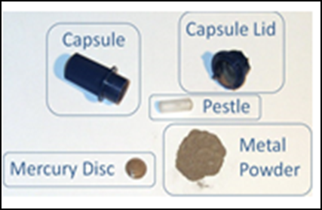
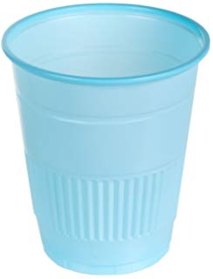
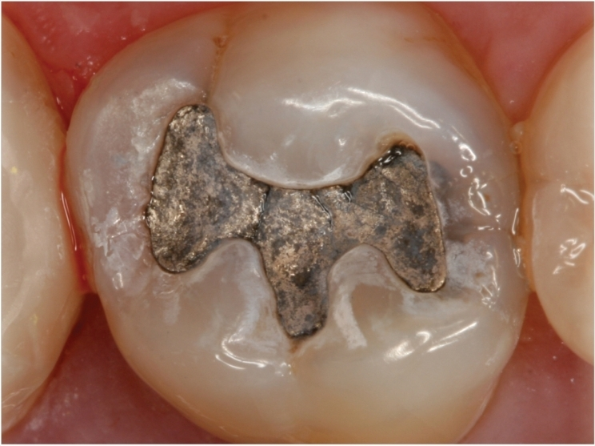
Dental Waste Management: Amalgam & Capsules
Effective July, 2019: CDM personnel will collect and store all contact and non-contact scrap amalgam in wall-mounted containers labeled as “Amalgam Waste” in accordance with the following procedures:
Tray-based sorting – all amalgam-containing materials used during patient care are sorted into “Dixie” ® cups and set aside on the instrument tray.
At the conclusion of treatment, tray contents are returned to the designated collection point for used instruments in each clinical area
“Dixie”® cup(s) are emptied into “Amalgam Waste” containers located near each instrument tub and collection point. “Dixie” ® cups are then discarded in regular trash.

Slide 8
Dental Waste Management: Amalgam & Capsules
Following patient care, the tray and/or instrument cassettes, along with the segregated cup(s) of collected waste are transported by the provider to the designated collection point for the floor.
Containers are mounted on VC 7th, 8th and 9th floors.

Slide 9
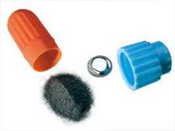
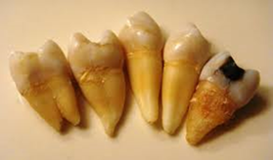
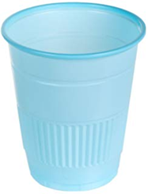
Dental Waste Management: Amalgam & Capsules - SUMMARY
Teeth with amalgam restorations ONLY!*
* - Note, containers will be pre-filled with disinfectant solution. If amalgam-containing tooth is also contaminated with blood, proceed with disposal into Amalgam Waste container.

Slide 10
Dental Waste Management : Amalgam & Capsules - SUMMARY
Tray-based sorting of all contact and non-contact scrap amalgam, amalgam capsule waste and extracted teeth with amalgam restorations
All materials disposed in mounted containers labeled “Amalgam Waste”
Never put scrap amalgam, extracted teeth with amalgam or chair traps containing visible amalgam in the sharps container, red biohazard bag, in the trash, or down the drain.

Slide 11
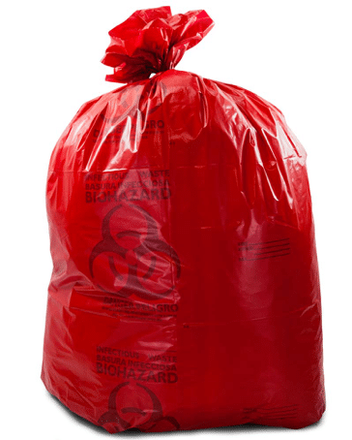
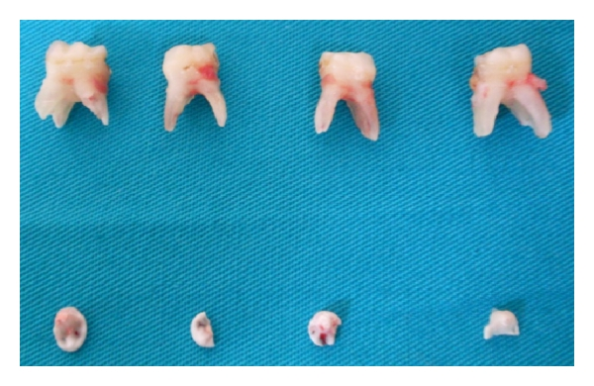
New Management Practice: Extracted Teeth without Amalgam
To simplify management and eliminate unnecessary collection of extracted teeth, the regulated medical waste (RWM) “red bag” should be used for all amalgam-free extracted teeth

Slide 12
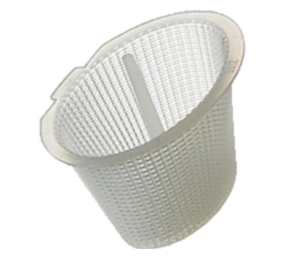
Dental Waste Management: Chair Side Traps
Traps containing mercury amalgam will be centrally collected by CDM staff, on a pre-determined frequency, into Amalgam containers.
*All chairside traps that DO NOT contain visible amalgam should be discarded in the RMW red bags

Slide 13
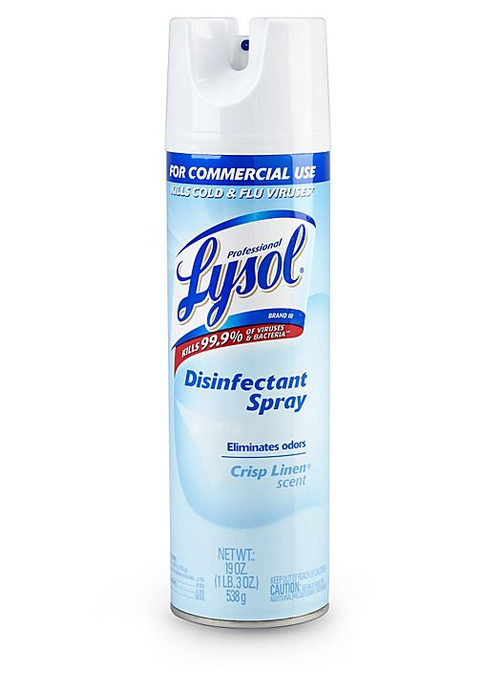
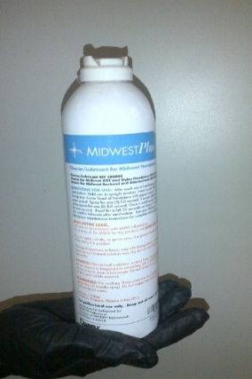
Dental Waste Management: Aerosol Cans
Aerosol cans, even if empty, must have the original cap placed on the can or the nozzle removed. Used torches must ONLY be discarded in designated torch containers.
Disposal containers are located in the clinic on VC 8 and 9, as well as the model lab on VC 8.

Slide 14
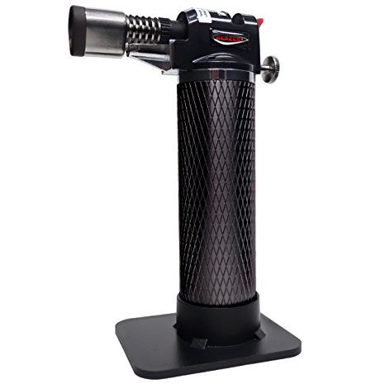
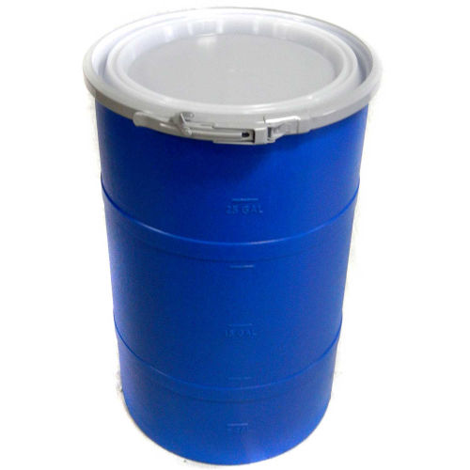
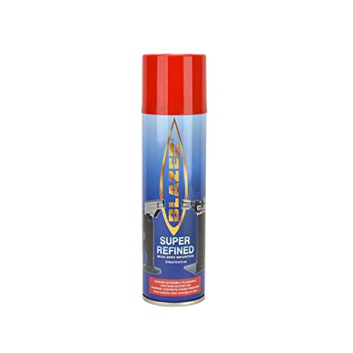
Dental Waste Management: Butane and Torches
Empty butane refill cans must have the original cap placed on the can or the nozzle removed.
Spent torches (e.g., those with broken igniters) must be collected separately from butane refills and other aerosol cans.
Torches and butane refills can cause explosion or fire if mixed in the same collection drum!!
Always place torches and butane refills in separate, designated containers, only!!
Spent torches only!
Butane refills only!

Slide 15
Dental Waste Management: Pharmaceutical Waste
All expired medications should be returned to Central Sterile.
Expired medications may not be discarded in the trash, RMW or down the drain
EH&S CANNOT ACCEPT
DEA Controlled Substances*
* - See https://research.columbia.edu/content/use-and-management-controlled-substances for more information

Slide 16
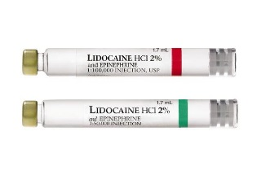
Dental Waste Management: Pharmaceutical Waste
Following patient care, needles used for anesthetic administration must be discarded in a sharps container.
Empty carpules may also be deposited in sharps containers.
Carpules and sharps must NOT be disposed in Amalgam Waste containers!

Slide 17
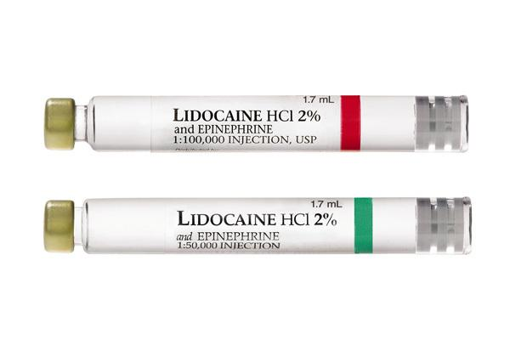
Dental Waste Management : Pharmaceutical Waste
Lidocaine or Marcaine carpules that are full or partially full should be discarded in the designated containers on each floor.
Expired, bulk carpules must be brought to Central Sterile – Staff will request EH&S pick-up, as needed
Notes:
Can go in more than one place – container set up or sterilization room

Slide 18
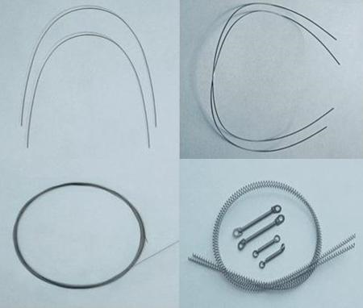
Dental Waste Management: Sharps
Management practices for sharps are unchanged under the new procedures.
All sharps must be collected in red, puncture resistant sharps containers, including:
Needles
Razor blades
Dental/orthodontic wire
Broken glass
EMPTY anesthetic carpules

Slide 19
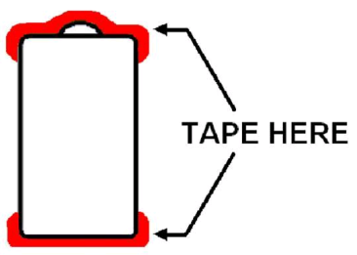
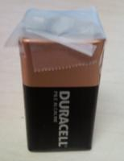
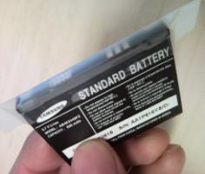
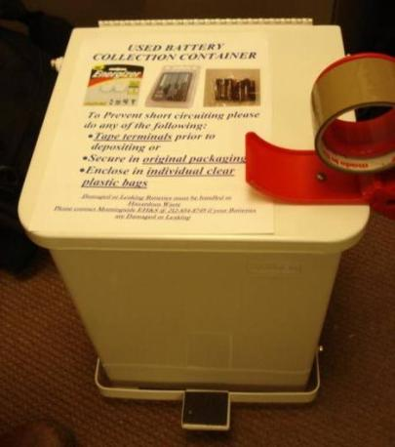
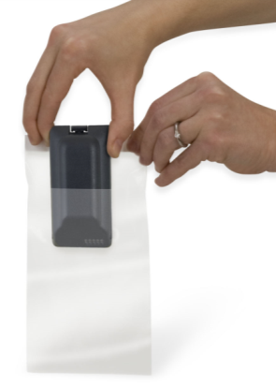
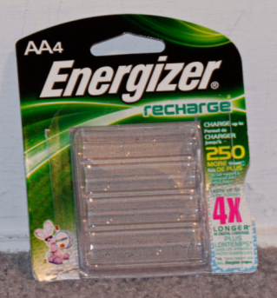
Dental Waste Management: Used Batteries
Management practices for used batteries are unchanged under the new procedures.
Batteries must be taped, bagged, or otherwise protected from contact with one another, and disposed in hallway collection containers located in hallways between VC/P&S/Black Buildings on floors 7,8 and 9.
battery
No wet chemistry batteries

Slide 20
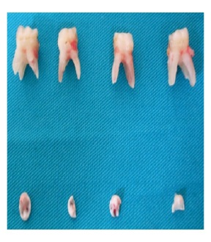
Dental Waste Management: Review
Amalgam Waste (capsules, teeth with amalgam, traps with amalgam)
Extracted Teeth (non-amalgam)
Chair-side traps (without amalgam)

Slide 21
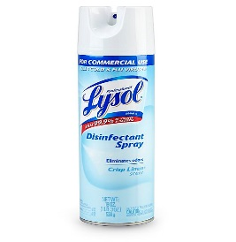
Dental Waste Management: Review
Aerosol Cans
Butane Torches

Slide 22
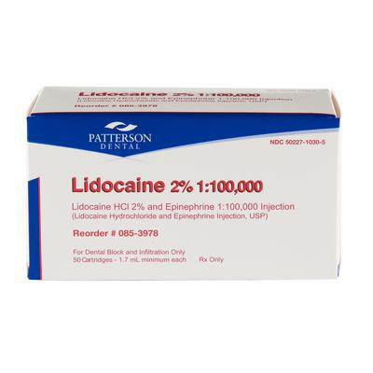
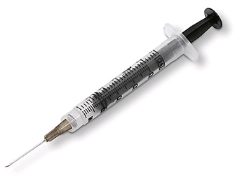
Dental Waste Management: Review
Lidocaine and Marcaine (empty)
Lidocaine and Marcaine (full)
Sharps
Batteries
(Return to Central Sterile)

Slide 23
EH&S Research Safety Team
Contact Us:
labsafety@columbia.edu
EH&S Website:
www.ehs.columbia.edu
EH&S Office
(Medical Center Campus):
617 W. 168th Street, 2nd Floor
(212) 305-6780
Notes:
Different buildings or departments have a go-to contact, a Research Safety Specialist, RSS. Shown here is the group alias labsafety@columbia.edu where you can reach all of us, if you do not know your lab’s RSS. Below this are address and phone numbers for two of our main offices. Please note we also support the Manhattanville, Lamont, and Nevis Campuses, and personnel from those campuses are welcome to reach our office through any of the listed contact points.

Slide 24
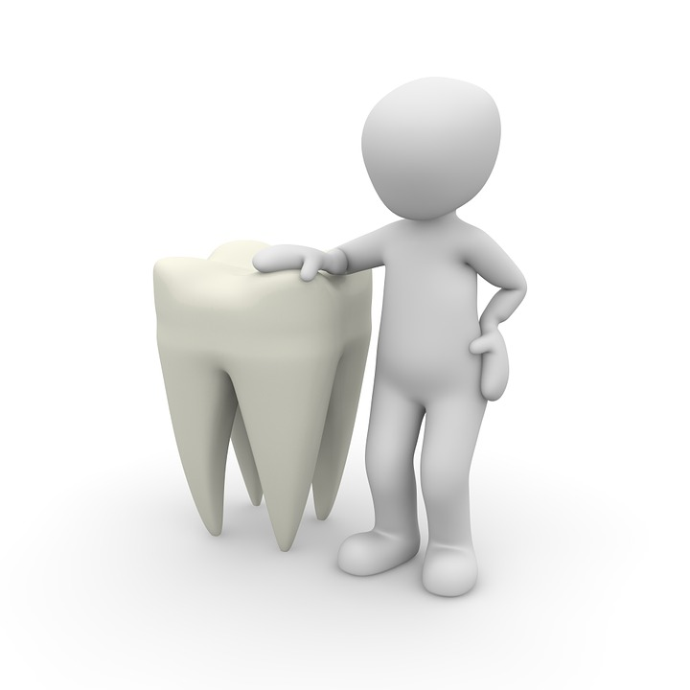
Thank You!!

