Slide 1
Appropriate Sharps Disposal College of Dental Medicine biosafety@columbia.edu

Slide 2
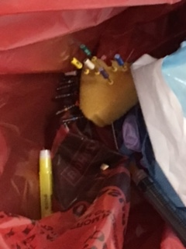
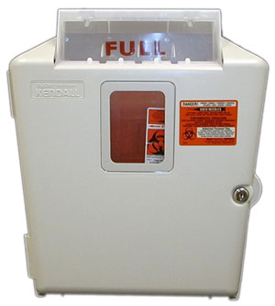
What happens when a sharp is inappropriately disposed into a bag?
You may get injured
Your colleague may get injured
Facilities custodians may get injured
This is an enormous liability for the College and University
Sharps must be disposed into the wall-mounted sharps container
Notes:
We have had several instances of Inappropriate Sharps Disposal at CDM. It’s always been an issue but has got especially concerning with 8 sharps having been found in the regular trash in September alone. And those were the ones that were found. There were probably others too.
You may get injured putting additional waste in the bag. You will need to seek immediate medical attention. You will consider taking post exposure prophylaxis drugs which have unpleasant side effects. Getting HIV is a lifelong thing.
Your colleague may get injured the same way. They will seek the same attention. How would you feel knowing that your negligence caused this
Facilities custodians may get injured. The custodians are our valued colleagues too. Do you know the name of the custodian who services your area? When custodians are injured by sharps they too take post exposure prophylaxis. Drugs with some unpleasant side effects. The good relationship we have with facilities workers and their union has taken years to build. Do you want to destroy that trust in a single moment?
If a complaint is lodged with OSHA this Federal Agency may come in and seem this as an unsafe work environment. They can put a stop work order on this clinic. No one gets to do any work, No one gets any dental care. If you think being here for 20 minutes is eating eating your valuable day, consider how much time you will be spending being retrained when the clinic is out of operation.

Slide 3
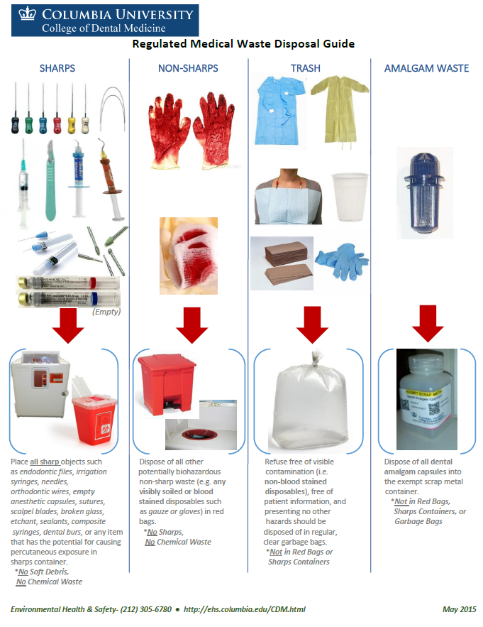
Regulated Medical Waste Management
Wall charts identifying appropriate disposal routes for regulated medical waste are posted throughout the clinics
Please take note of the types of materials that require disposal in a sharps container
Endodontic files
Dental wires
Any syringes with a needle
Scalpels
Dental Burrs
Anesthetic needles
Notes:
Does anyone remember this slide from 3rd year or 4th year annual training? Were you paying attention or doing something else on your phone? There is a copy of this chart in all the clinics as a friendly reminder.
These are all sharps. Even dental wires, even blunt end needles. Anything that could rip a red bag goes in the sharps containers.

Slide 4
These items are all sharps:
Part of unused kit – Even unused sharps as part of a kit must be segregated prior to disposal
Blunt needle – Needles used to dispense
etching solution are still sharps
Notes:
Facilities pick up the bags, may note a problem with sharps as well as the location, and call our office. Waste is returned to CDM, Offenders will identified and counselled/lose clinic privileges.

Slide 5
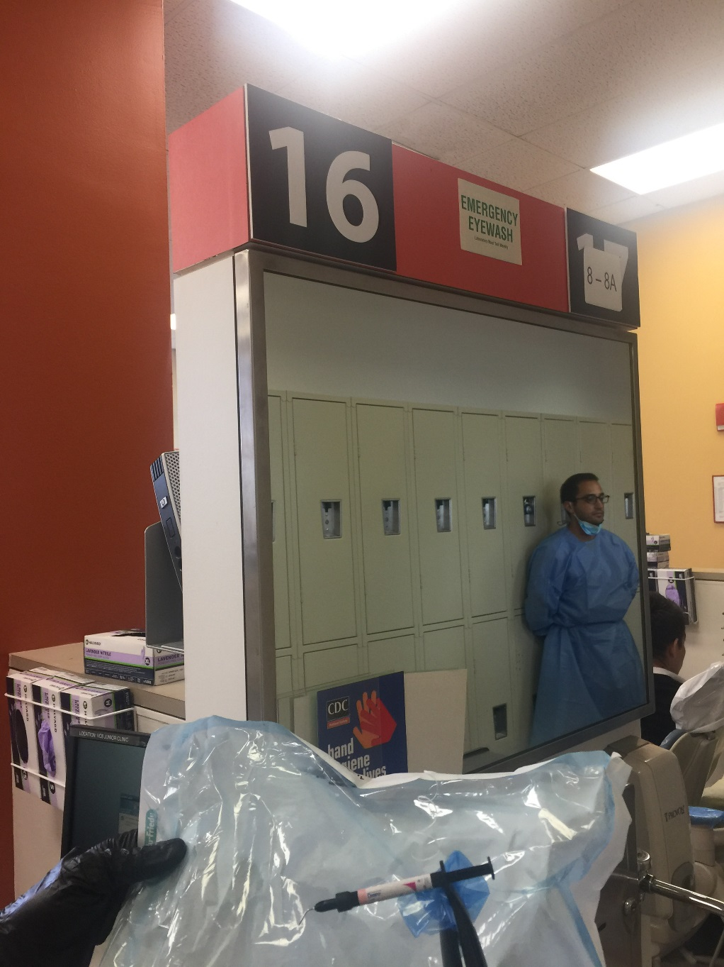
Compliance Rounds
EH&S and clinic administrators perform compliance rounds to monitor waste bags for inappropriately disposed sharps
Penalties for non-compliance can include revocation of clinic privileges
Notes:
Rounds performed last Friday to ascertain the extent of the problem. We pored over the trash with plastic tongs. 4 sharps found in regular trash. Identified this as a systemic problem. If we can associate provider names with discarded sharps, offenders will be counseled and may lose clinic privileges

Slide 6
How do I do the right thing?
You make a decision every time you discard something in the clinic - Make that decision the right one
Look out for your colleagues
If you see an unsafe practice, say something
As well as watching over what happens with the patient, Faculty should carefully observe how materials are disposed, and correct any aberrant behaviors
Notes:
Check yourself before you wreck yourself…..

