Slide 1
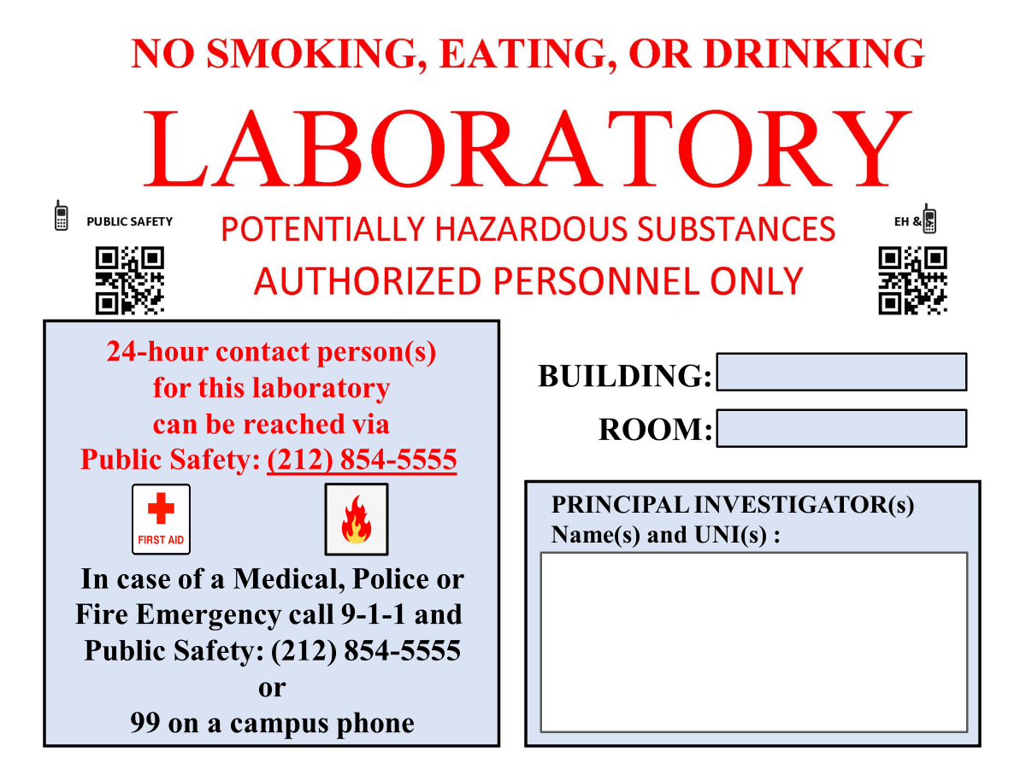
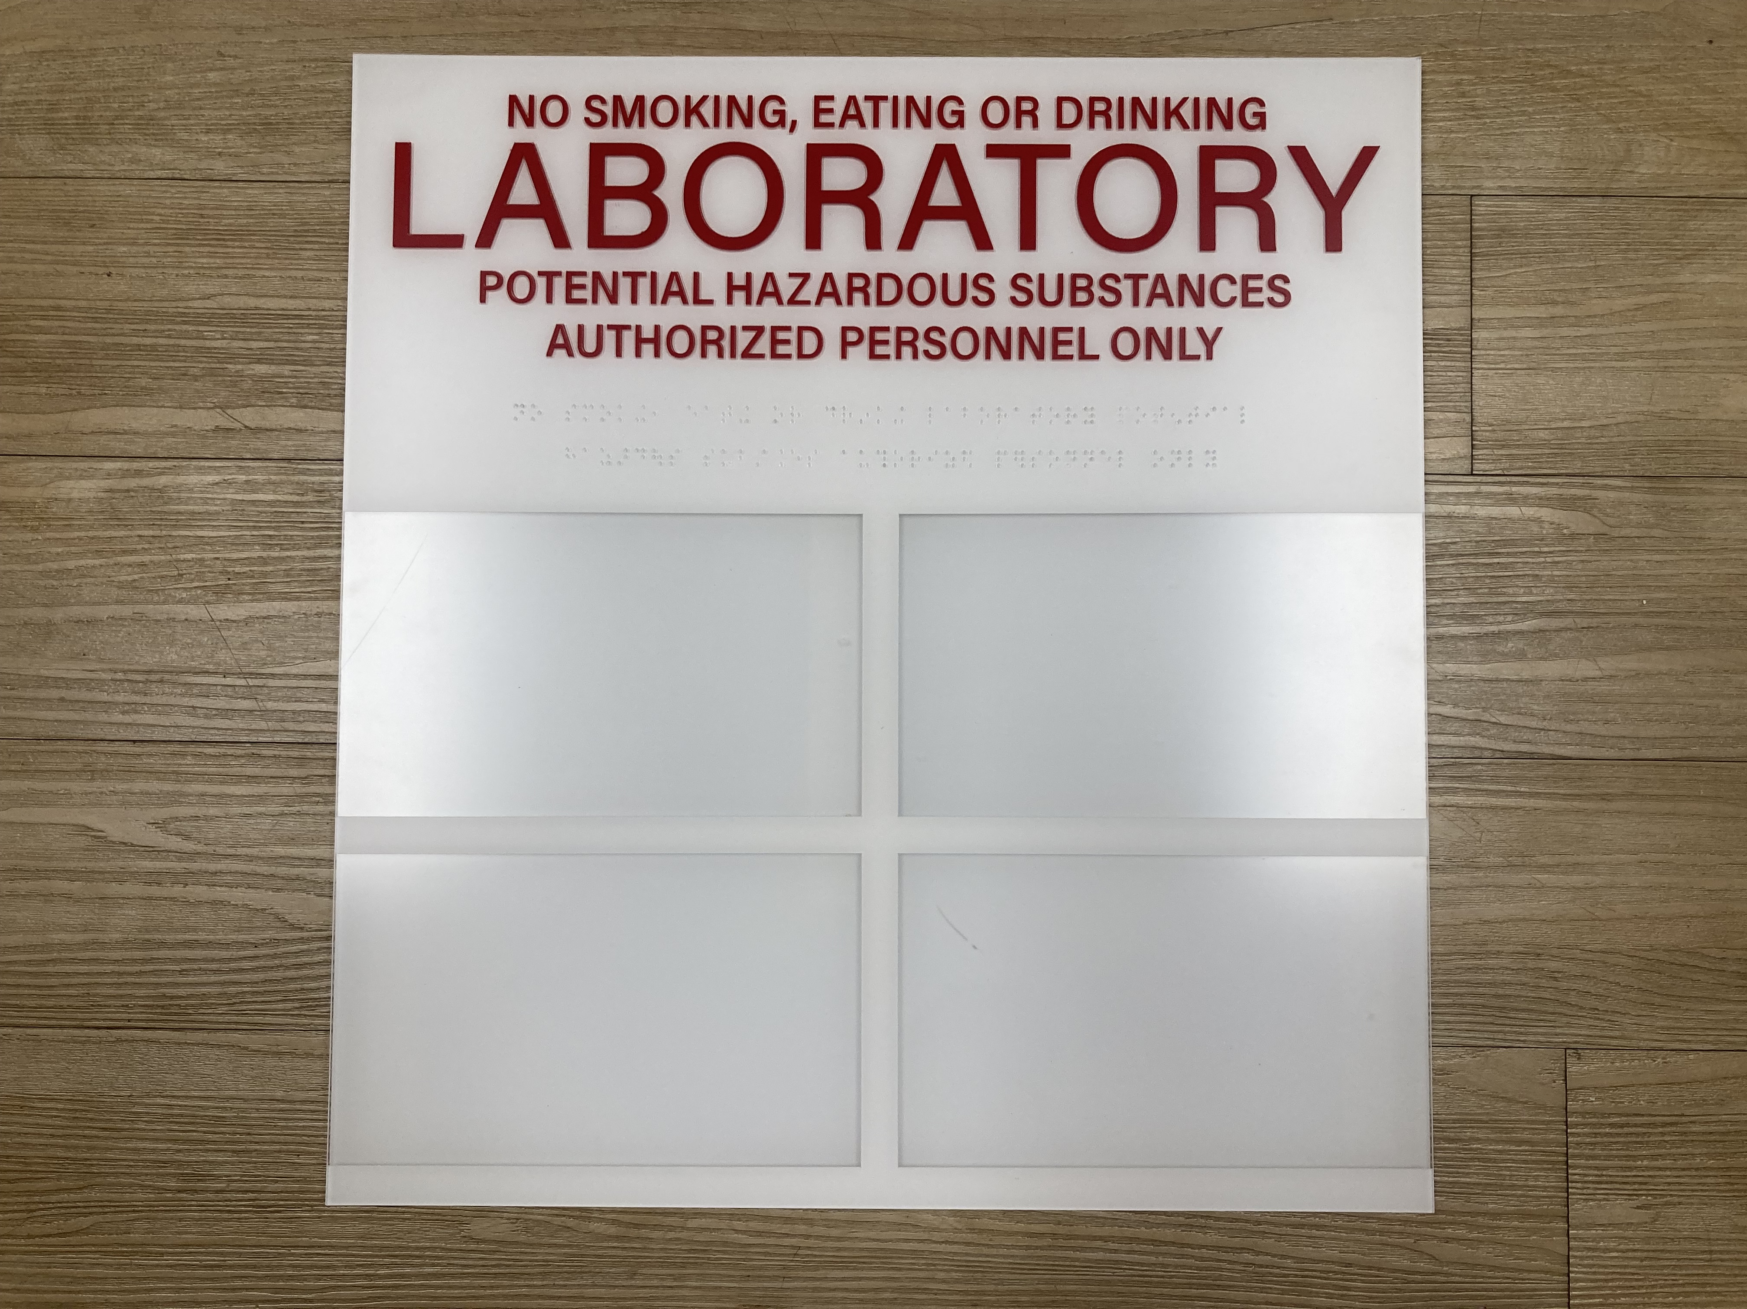

Welcome to the Morningside laboratory door sign generator courtesy of Environmental Health & Safety!
In the event of an emergency, it is required for laboratory spaces to have emergency contact information as well as laboratory hazards posted on the outside of each laboratory door. Completion of this door sign generator is required by EH&S.
This file can be used to generate door signs for all laboratories at Morningside. This process should take 5-10 minutes.
1) Please download this file and open in PowerPoint for best results.
2) Determine what door sign your laboratory has:
• No door sign holder or one page door sign (Go to slide 2)
• 4 x 4 door sign holder (Skip to Slide 5)
3) Please follow instructions on individual slides and fill out each door sign to the best of your ability.
Please contact labsafety@columbia.edu if you have any questions or concerns about this sign maker. Thank you!
Quad 1
Quad 2
Quad 3
Quad 4

Slide 2
Welcome to the Morningside laboratory door sign generator courtesy of Environmental Health & Safety!
Slides 2-4 can be used to generate door signs for laboratories with no door sign holder or different door sign holder than the 4 x 4 door sign holder.
Step 1: Refer to slide 3 and 4 and determine what hazard pictograms apply to the laboratory.
Step 2: Copy and paste hazard pictograms onto the door sign on slide 4 in the “Laboratory Hazards” section.
Step 3: Fill out occupancy information on slide 4 in the “Principal Investigators” section.
Step 4: Once slide 5 is completed and all sections are filled out, print out the full size slide (scaled to fit 8.5” x11” paper) and post on/near the laboratory door.
Please contact labsafety@columbia.edu if you have any questions or concerns about this sign maker. Thank you!

Slide 3











Laboratory Hazard Pictograms
The following pictograms will be used for the laboratory hazards section of your door sign (found on slide 5). Please copy and paste relevant symbols between this slide and slide 5. To determine what hazard pictograms are relevant, please consult chemical Safety Data Sheets (SDS) and/or the laboratory's LATCH hazard assessment.
Toxics
Health Hazards
Corrosives
Flammables
Oxidizers
Explosives/Reactives
If your laboratory stores compressed gases, please use each relevant hazardous gas symbol below. Refer to the hazard labels on each compressed gas cylinder to choose from the symbols below. If the laboratory only stores inert gases, use the green inert gas sign only.
Flammable Gas
Compressed Gas (Inert)
Oxidizing Gas
Corrosive Gas
Quad 3
Notes:
Missing: water reactive, cryogenic, unstable
Insert cryogenic sign
Change gas and dangerous when wet, spontaneously combustible to GHS pictograms

Slide 4




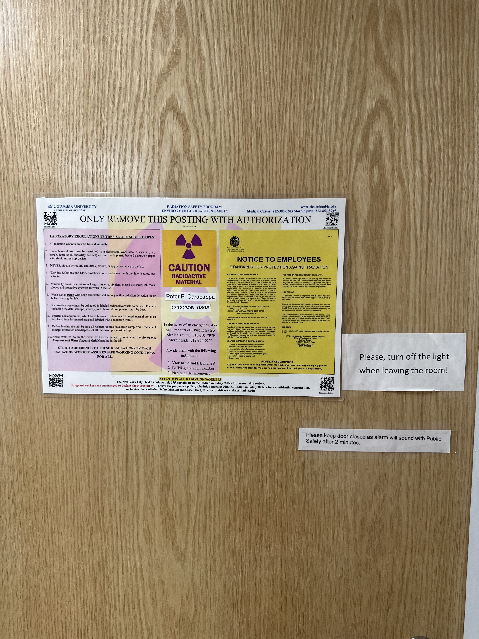
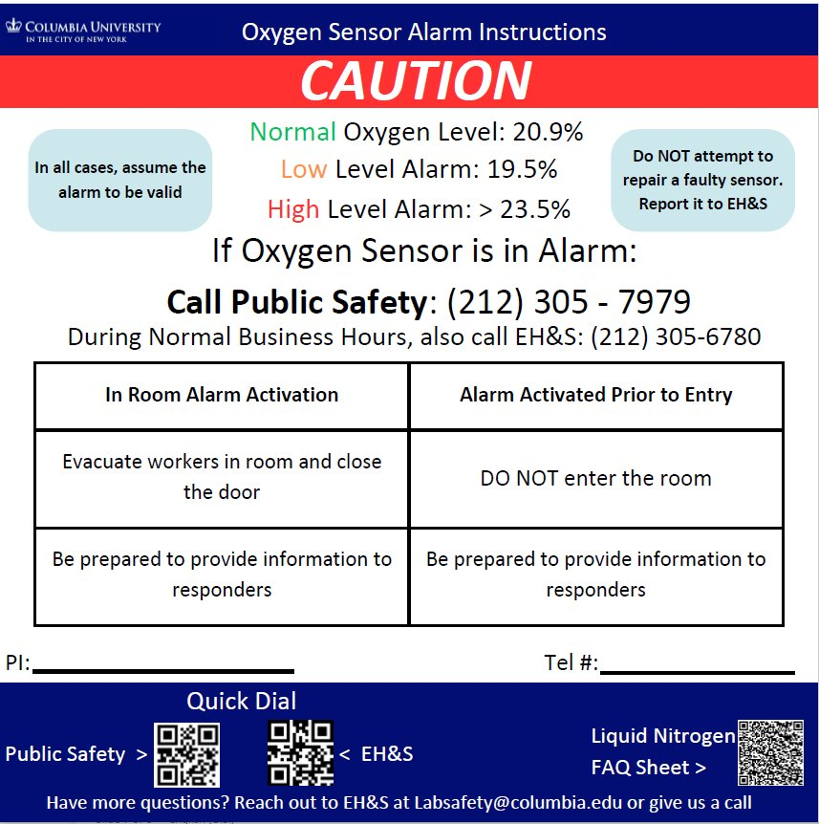
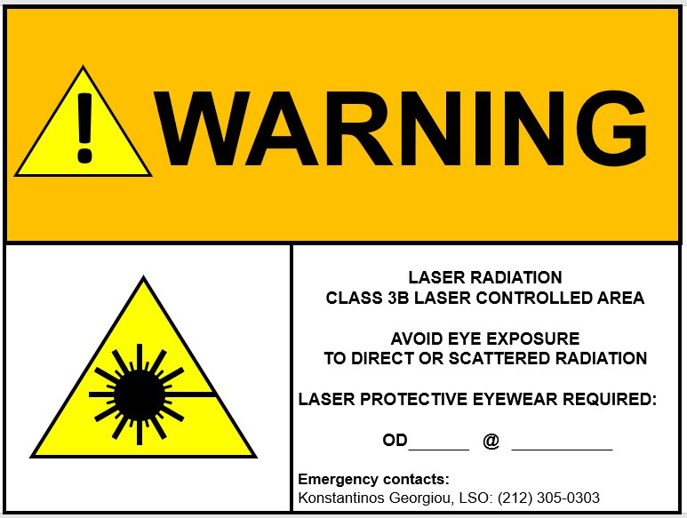
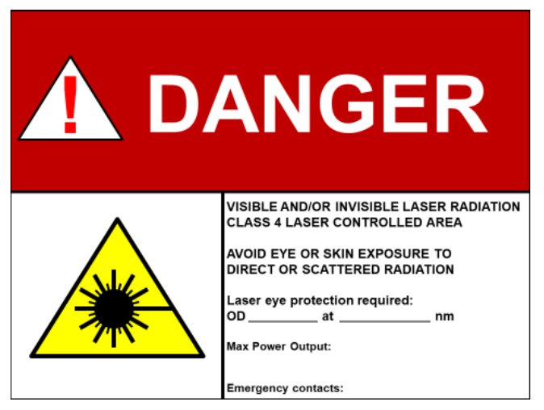
Specialized Hazard Pictograms
This section is only applicable to laboratories that handle specialized hazards. If your laboratory works with the below specialized hazards, please copy and paste relevant symbols between this slide and the next slide (slide 5).
Lasers
Radiation
Cryogenic Materials
Biohazard
If you work with lasers, radioactive materials, or a high volume of cryogenics requiring an oxygen sensor your laboratory door will also require additional signage from EH&S. If you DO NOT have an additional door sign shown below, contact EH&S at the relevant email for signage guidance: ​
Lasers: contact: lasersafety@columbia.edu
Radioactive materials: contact: rso-ehrs@columbia.edu
Cryogenics: contact: labsafety@columbia.edu
Quad 4
Notes:
Not sure if dimensions are right here

Slide 5
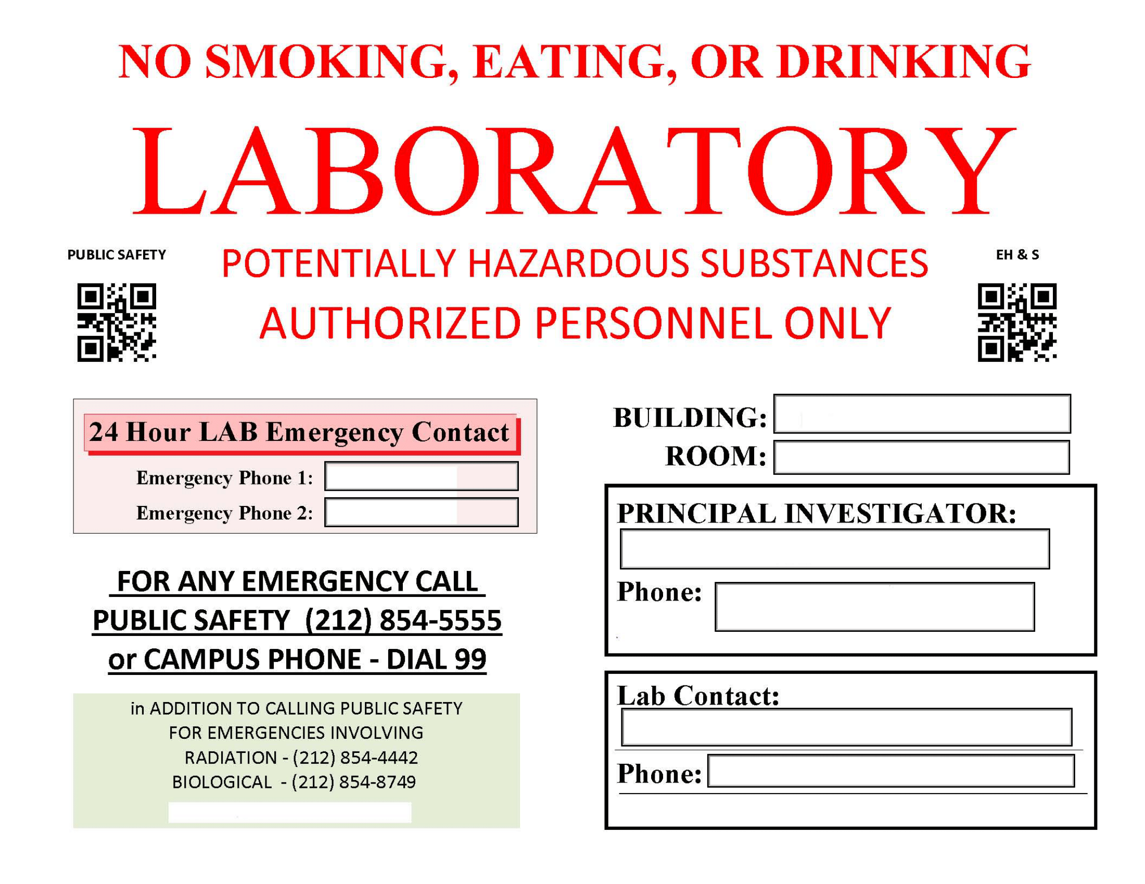



BUILDING:
ROOM:
PRINCIPAL INVESTIGATOR(s) Name(s) and UNI(s) :
24-hour contact person(s)
for this laboratory
can be reached via
Public Safety: (212) 854-5555
Laboratory Hazards:
In case of a Medical, Police or Fire Emergency call 9-1-1 and
Public Safety: (212) 854-5555
or 99 on a campus phone

Slide 6
Welcome to the Morningside laboratory door sign generator courtesy of Environmental Health & Safety!
Slides 6-12 can be used to generate door signs for laboratories with the 4 x 4 door sign holder.
Quads 1-4 should be filled out as follows:
Occupancy Information: Principal Investigators (slide 7)
24-hour Emergency Contact Information (slide 8)
Laboratory Hazard Pictograms (slide 9/10)
Specialty Hazards (if applicable) (slide 11/12)
Note: Each quad has been configured to fit into the signage slot. Please do not change the dimensions of the signs. Print each slide as a full page print out, scaled to fit a 8.5” x11" piece of paper, before cutting out door sign for insertion.
Please contact labsafety@columbia.edu if you have any questions or concerns about this sign maker. Thank you!
Quad 1
Quad 2
Quad 3
Quad 4
Notes:
Edits:
Quad 1: PI info
Quad 2: Emergency Contact (based on SA photos)
Rest stay same, unless SA photos show different

Slide 7
Quad 1: Occupancy Information
Please enter information into the premade text box. Please list name and UNIs for all PIs that occupy the room. Update the sign as PIs information changes.
Principal Investigator(s)
Name(s) & UNI(s) :
BUILDING:
ROOM:
Please make sure to update lab roster & contact information in the LION system.​
The LION system can be accessed at the link below: ​
https://research.columbia.edu/lion ​
Quad 1

Slide 8
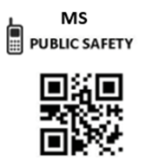
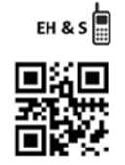
Quad 2: 24-hour Emergency Contact Information
Public Safety and EH&S have collaborated to produce a new laboratory emergency door sign. Note, this new sign does not list specific individuals or their contact information. Instead, Public Safety and EH&S rely on LION for the most up-to-date emergency contact information. To update your laboratory's 24-hour emergency contact information, please follow these instructions:
Log into LION, go to the LATCH section, click the personnel tab, and scroll down to the section for emergency contacts. Click the “Add Phone Number” to add a phone number that is 24-hour accessible so Public Safety can reach laboratory personnel in an emergency.
If your laboratory door sign is missing the emergency contact information, please contact labsafety@columbia.edu.
24-hour contact person(s)
for this laboratory and EH&S
can be reached via Public Safety:
(212) 854-5555
In case of a Medical, Police or
Fire Emergency call 9-1-1
and Public Safety: (212) 854-5555
Quad 2

Slide 9
Quad 3: Laboratory Hazard Pictograms
The following pictograms will be used for the next section of your door sign (found on slide 10). Please copy and paste relevant symbols between this slide and the next slide. To determine what hazard pictograms are relevant, please consult chemical Safety Data Sheets (SDS) and/or the laboratory's LATCH hazard assessment.
Toxics
Health Hazards
Corrosives
Flammables
Oxidizers
Explosives/Reactives
If your laboratory stores compressed gases, please use each relevant hazard gas sign below. If the laboratory only stores inert gases, use the green inert gas sign.
Compressed Gas (Inert)
Corrosive Gas
Flammable Gas
Oxidizing Gas
Quad 3
Notes:
Missing: water reactive, cryogenic, unstable
Insert cryogenic sign
Change gas and dangerous when wet, spontaneously combustible to GHS pictograms

Slide 10
Quad 3: Laboratory Hazard Pictograms
Laboratory hazards must be presented as pictograms. Please copy and paste relevant pictograms from the previous slide onto this slide. The pictograms do not need to be placed in a specific order.
Laboratory Hazards:
Quad 3
Notes:
Not sure about dimensions

Slide 11
Quad 4: Specialized Hazards
This quad is only applicable to laboratories that handle specialized hazards. If your laboratory works with the below specialized hazards, please copy and paste relevant symbols between this slide and the next slide (slide 12).
Lasers
Radiation
Cryogenic Materials
Biohazard
If you work with lasers, radioactive materials, or a high volume of cryogenics requiring an oxygen sensor your laboratory door will also require additional signage from EH&S. If you DO NOT have an additional door sign shown below, contact EH&S at the relevant email for signage guidance: ​
Lasers: contact: lasersafety@columbia.edu
Radioactive materials: contact: rso-ehrs@columbia.edu
Cryogenics: contact: labsafety@columbia.edu
Quad 4
Notes:
Not sure if dimensions are right here

Slide 12
Quad 4: Specialized Hazards
This quad is only applicable to laboratories that handle specialized hazards: Cryogenics, Biologicals, Lasers, and Radiation. Laboratory hazards must be presented as pictograms. Please copy and paste relevant pictograms from the previous slide onto this slide. The pictograms do not need to be placed in a specific order.
Specialized Hazards:
Quad 4
Notes:
Not sure about dimensions

Slide 13
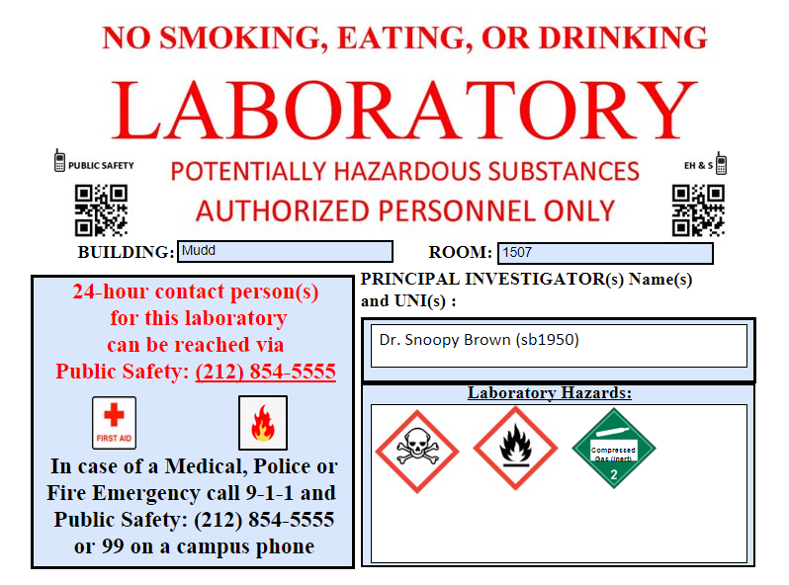
Example 1: Completed Morningside single page door sign using this door sign generator:
Toxics
Flammables
Lasers

Slide 14
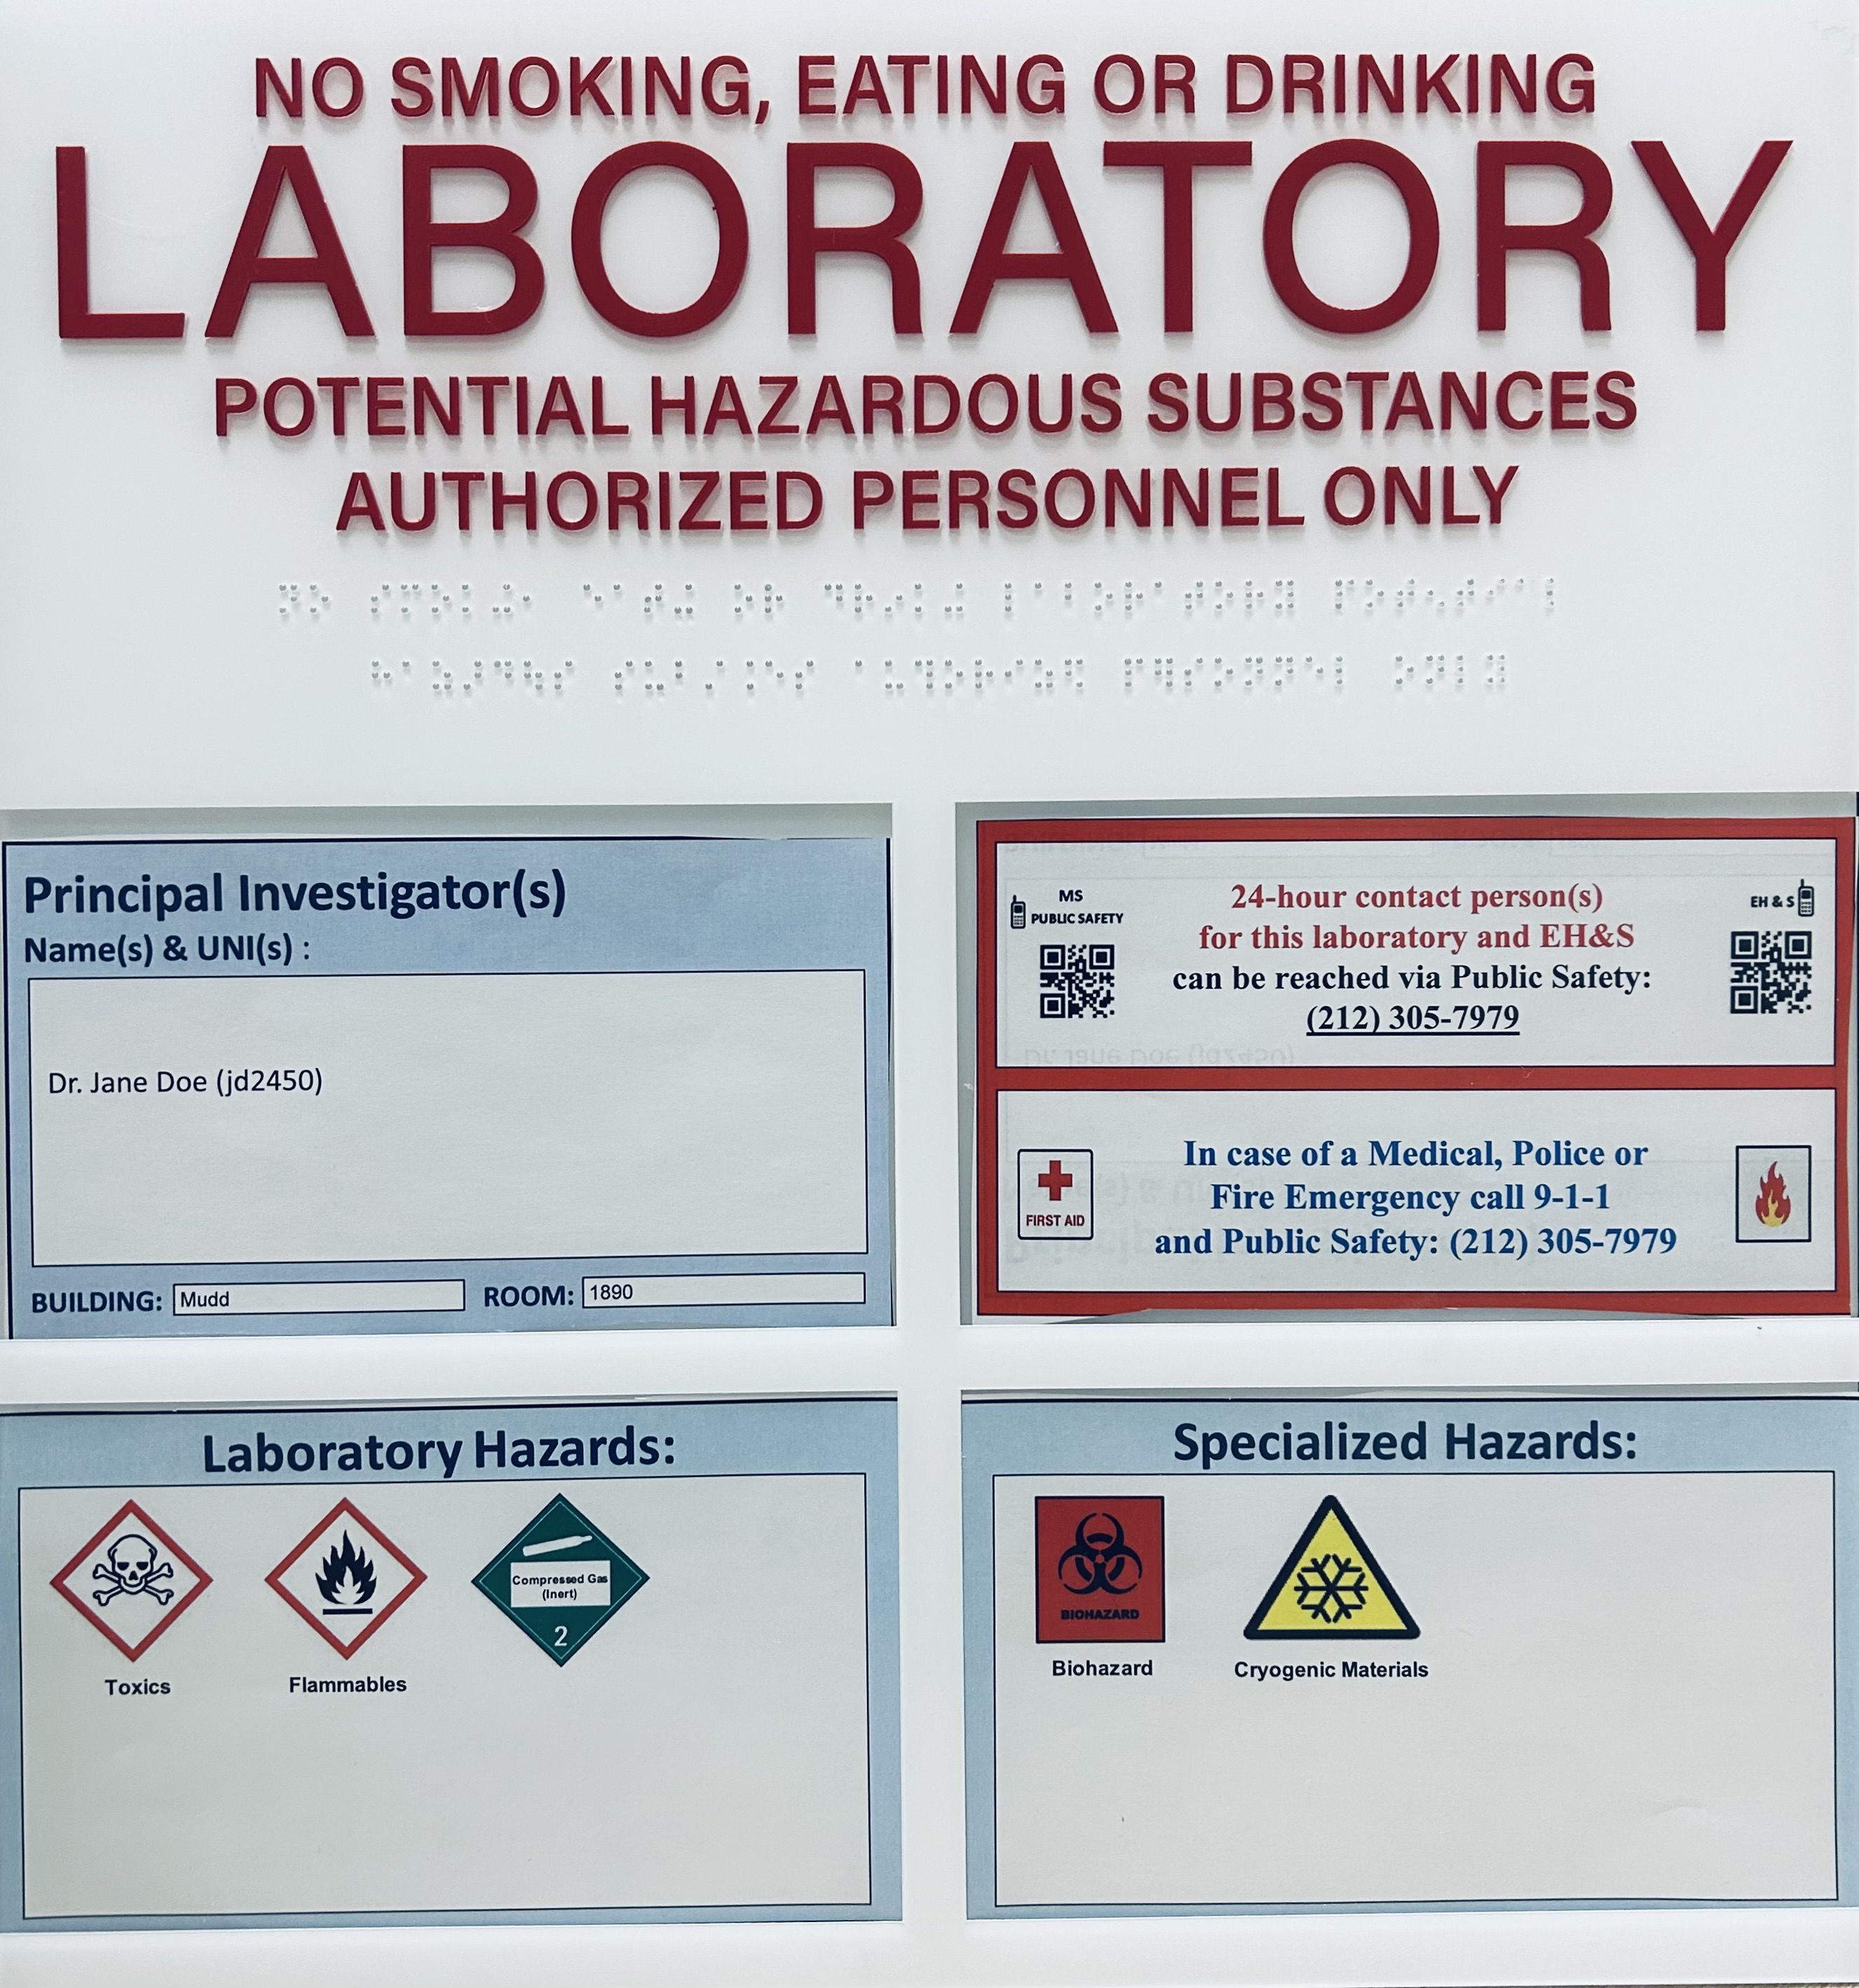
Example 2: Completed Morningside 4 x 4 door sign holder using this door sign generator:

