Slide 1
Shared Research Computing Policy Advisory Committee (SRCPAC)
Fall 2017 Meeting Monday, December 4, 2017

Slide 2
Habanero Update
Kyle Mandli, Chair of the Habanero Operating Committee
George Garrett, Manager of Research Computing, CUIT

Slide 3
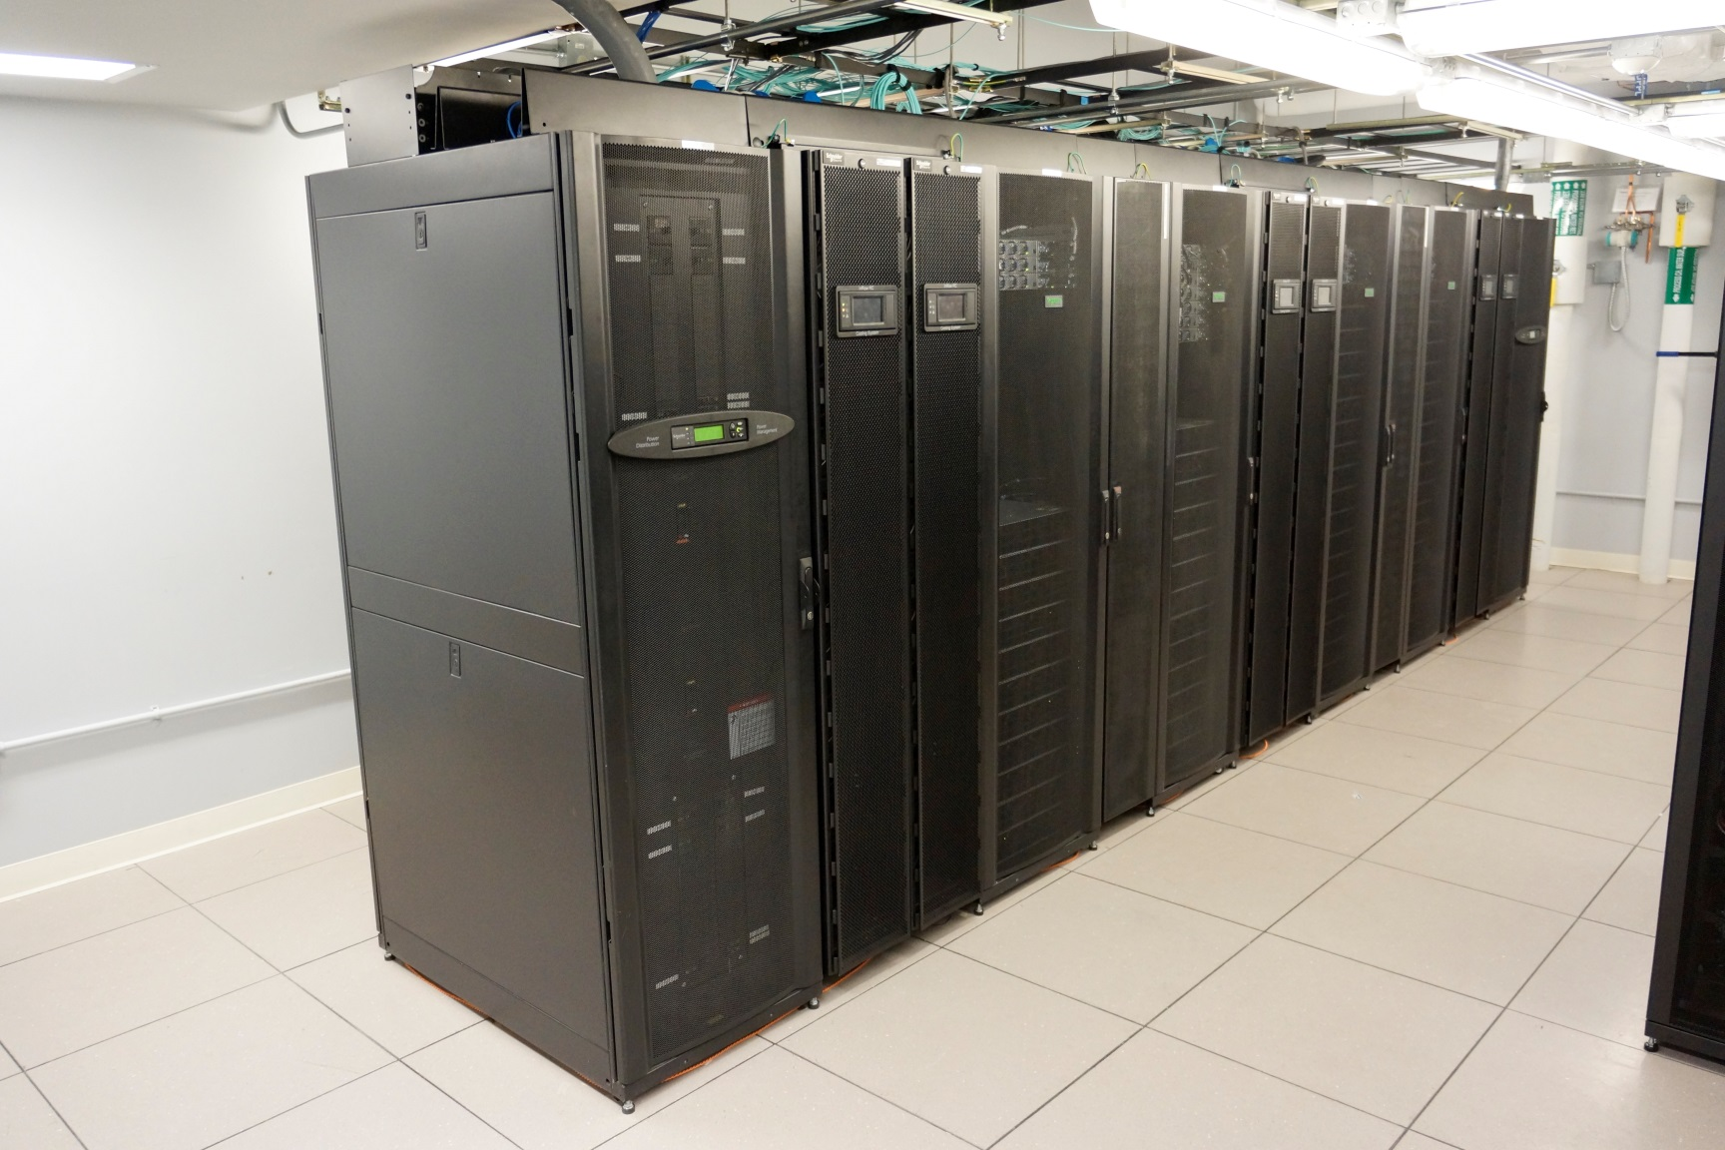
Habanero HPC Cluster
Notes:
GEORGE

Slide 4
Habanero Expansion
18 Research Groups Joined
80 Expansion Nodes (1920 cores)
Same CPUs (24 cores per server)
58 Standard Servers (128 GB)
9 High Memory Servers (512 GB)
13 GPU Servers each with 2 x Nvidia P100 modules
238 TB Storage Added (640 TB total)
Notes:
GEORGE

Slide 5
Cluster Nodes
Type | Nodes | Cores
Standard | 234 | 5616
High Memory | 41 | 984
GPU (K80) | 14 | 336
GPU (P100) | 13 | 312
Total | 302 | 7248
Notes:
GEORGE

Slide 6
Visualization Server
Remote GUI access to Habanero storage
Reduce need to download data
Same configuration as GPU node (2 x K80)
NICE desktop cloud visualization software
Notes:
GEORGE

Slide 7
Participation
44 research groups purchased nodes
840 users
Education Tier (A&S- and SEAS-funded)
Machine Learning COMS4995 (Spring 2017)
Molecular Biology BC3303 (Spring 2017)
Genomics and Bioinformatics BC3308 (Spring 2017)
Research Computing for Earth Sciences GR6901 (Fall 2017)
7 renters, 45 free-tier users
Notes:
GEORGE

Slide 8
Notes:
GEORGE

Slide 9
Business Rules
Business rules set by Habanero Operating Committee
Operating Committee reviews rules in semiannual meetings, or as needed
Notes:
GEORGE

Slide 10
Support Office Hours
HPC support staff are available by request to answer your Habanero questions in person on the first Monday of every month.
Please let us know by the day prior if you plan on attending.
Where: Science & Engineering Library, Northwest Corner Building
When: 3-5 pm first Monday of the month
Next session: 3-5 pm Monday, December 4th
Notes:
GEORGE

Slide 11
Habanero Information Sessions
HPC support staff can come and talk to your group
Topics can be general and introductory or tailored to your group.
Contact hpc-support@columbia.edu to discuss setting up a session.
Notes:
GEORGE

Slide 12
Habanero Information Sessions
Introduction to Habanero
Tuesday, December 5th, 1:00 pm - 2:30 pm
Tuesday, January 30th, 1:00 pm - 2:30 pm
Where: Science & Engineering Library Northwest Corner Building
Topics Covered
Cluster overview
Using the scheduler
Business rules
Notes:
GEORGE

Slide 13
Workshops
Introductory workshops run by CUIT & Libraries.
Research Computing Part 1: Intro to Linux
Research Computing Part 2: Intro to Scripting
Research Computing Part 3: Intro to HPC
Workshop series is typically held once in the Spring and once in the Fall. Spring 2018 workshop schedule TBD.
Notes:
GEORGE

Slide 14
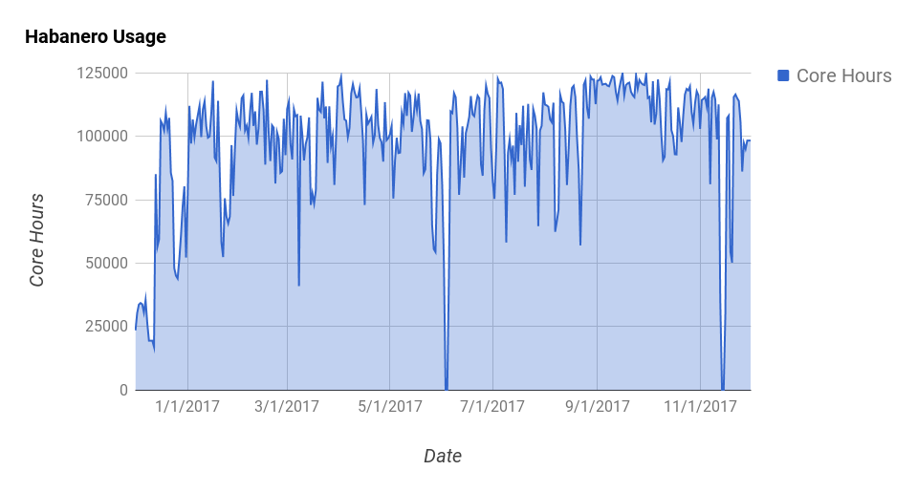
Usage
Notes:
GEORGE

Slide 15
Announcement of Training Subcommittee
Chris Marianetti, Chair of SRCPAC
Marc Spiegelman, Chair of Training Subcommittee

Slide 16
Plans for New Cluster
Chris Marianetti, Chair of SRCPC
George Garrett, Manager of Research Computing

Slide 17
Next Generation HPC
The Spring 2017 Research Computing Executive Committee (RCEC) discussed capacity and HPC growth.
A&S, SEAS, EVPR, and CUIT committed to contributing to the expansion of the cooling capacity in the data center to be able to accommodate HPC for the next several generations.
The data center cooling expansion project has begun, and is on target to be completed by Fall 2018, and ready to house the next HPC cluster.
Notes:
CHRIS

Slide 18
Next Generation HPC
It’s time to start thinking about the next cluster!
We will to start a new RFP committee in January, and are looking for volunteers.
Time Commitment: Meeting four times over four months.
Similarly, given the increased interest in GPUs and Machine Learning, we are looking into expanding the types of GPU offerings we support. Contact us if interested in joining the discussion.
Notes:
CHRIS

Slide 19
Next Generation HPC
Currently exploring cloud bursting and how to integrate it with the HPC cluster.
Considerations:
Funding model
Separate queue(s)
Pre-emptible VMs for cost reduction
Notes:
CHRIS (review with GEORGE first)

Slide 20
Tools for Researchers
Maneesha Aggarwal, Assistant Vice President for Academic IT Solutions

Slide 21
Resources for Researchers
CUIT, the Libraries, and EVPR have been working together to expand the portfolio of tools available to researchers.
Code Ocean
Globus
EVPR – Research Data website
Notes:
HALAYN

Slide 22
Code Ocean – www.codeocean.com
Code Ocean is a cloud-based computational reproducibility platform that provides researchers and developers an easy way to share, discover, and run code published in academic journals and conferences.
Notes:
HALAYN

Slide 23
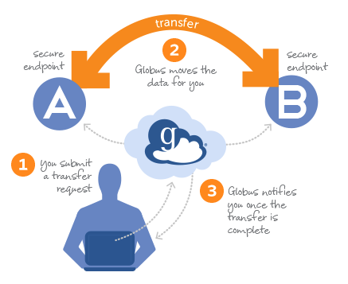
Globus
Globus provides a secure, unified interface to your research data. Use Globus to 'fire and forget' high-performance data transfers between systems within and across organizations.
Working with a consortium of other Ivy+ institutions to procure a enterprise license.
Notes:
HALAYN

Slide 24
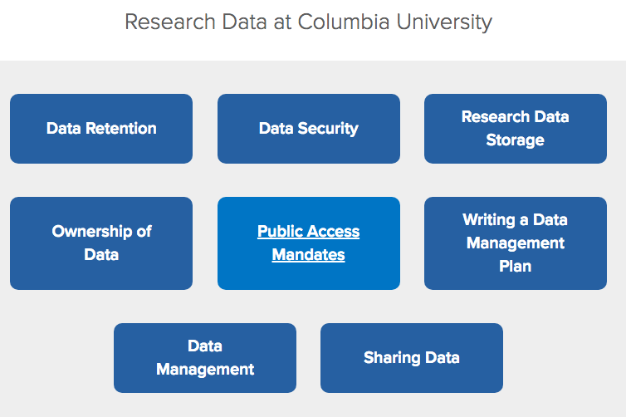
Research Data Website
•Recently launched by the Office of Research Compliance and Training.
•One-stop place for resources, guidelines, and policies specific to research data.
•https://research.columbia.edu/research-data-columbia
Notes:
HALAYN

Slide 25
Yeti & Habanero Publications Reporting
Chris Marianetti, Chair of SRCPAC

