Slide 1
Monthly IRB-Investigator Meeting
IRB Updates
New Resources available on the HRPO/IRB website
February 19, 2026

Slide 2
What We Will Cover Today:
IRB New Protocol Submission User Guide (demo)
New & Updated IRB Policies
New Consent Form Template

Slide 3
NEW: Rascal User Guide
Developed by the IRB staff in collaboration with CTO and Debbie Stiles, previous Vice President of Research Operations
Intended to assist Columbia researchers in submitting new protocols in Rascal
  Contains guidance on each Protocol Content page that may be generated in the Rascal submission
  Includes hyperlinks to published institutional, state, and federal policies or guidance
To act as a living document- future updates are expected
  Guidance on separate modules (e.g. HIPAA Forms) and other attachments (e.g. Documents, Consent Forms) may be forthcoming

Slide 4
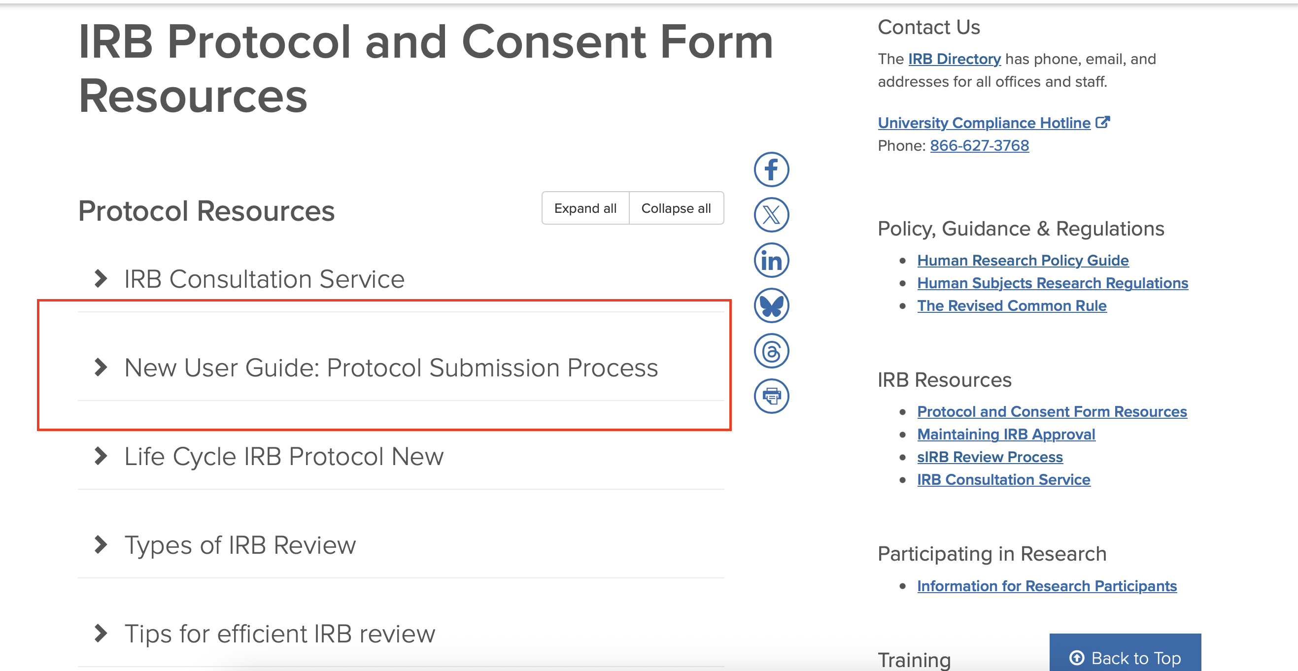
NEW: Rascal User Guide

Slide 5
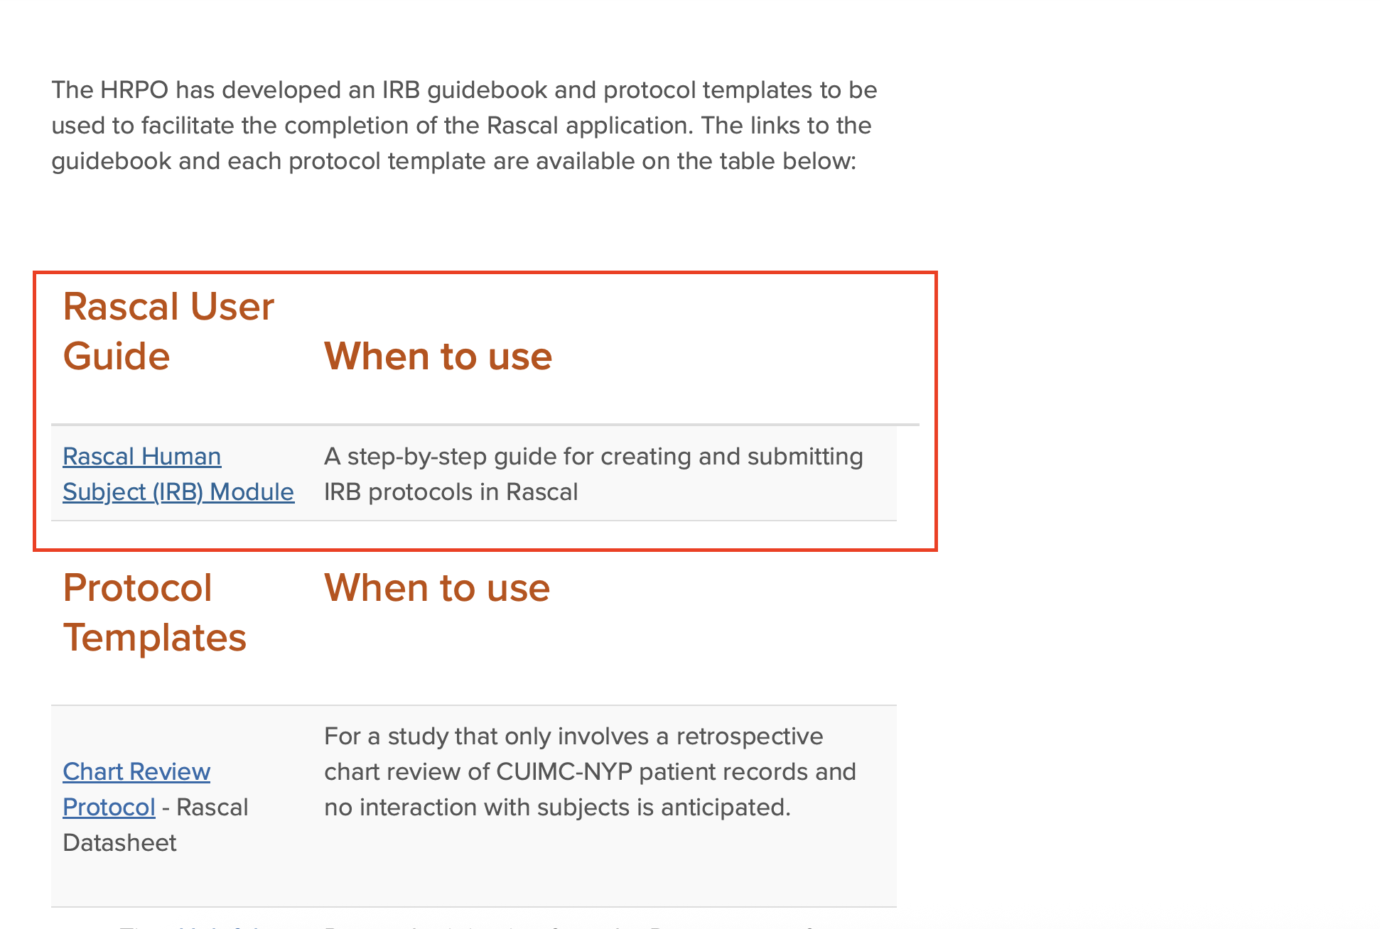
NEW: Rascal User Guide

Slide 6
NEW: Rascal User Guide
Next steps: Testing Usability
  Anyone interested in working with the internal HRPO group for further development or providing feedback on the User Guide, please reach out to Janelle Ortega at jo2629@cumc.columbia.edu

Slide 7
Updated Policies
Updated Sections
….to reflect current DHHS & FDA regulatory elements and criteria
General Requirements for Informed Consent
Elements of Informed Consent required in non-exempt studies including FDA-regulated studies
  9 basic elements
  9 Additional elements
Waiver of Consent criteria
Documentation of consent process
….to reference other consent requirements & other institutional requirements
NIH Data Sharing & Genomic Data Sharing Policies that require certain information about future use and sharing of data to be included in consent
Subjects Participation in study documented in Epic
Additional elements when research involves recording
Informed Consent Policy
Effective
February 1, 2026

Slide 8
Updated Policies
New sections added
Definitions (section III)
Reconsenting Subjects (section VIII)
Additional Protection for Certain Research and vulnerable population (section X):
  Research involving children (no changes)
  Research with non-English speaking subjects
  Research involving students or affiliates
  International research
  Research with pregnant women, fetuses and neonates
  Genetic testing
  Same day elective surgery or procedure
  Research using intentional deception
  Subjects with low literacy and numeracy
  Subjects with physical or sensory disabilities
  Subjects with impaired capacity to consent
Informed Consent Policy
Effective
February 1, 2026

Slide 9
New Policy
Policy incorporates the additional protections from Subpart C (45 CFR 46)
Prisoner Definition and OHRP interpretation
IRB membership: must have a Prisoner Representative
Subpart C also applies when a participant is temporarily incarcerated after enrollment in a study
IRB will approve only if the research involves one of the regulatory permissible categories (45 CFR 46.306) and has made the regulatory required findings (section IV)
For federally-funded studies only: HRPO/IRB will send a subpart C Certification Request to the Office for Human Research Protection (OHRP).
Requirements per other regulations
Research involving Prisoners
Effective
February 1, 2026

Slide 10
Template is available on the HRPO website, under the Consent Form Resources Page: https://research.columbia.edu/irb-protocol-and-consent-form-resources-0
Template for: Consent only, combined Consent & Authorization form, Parental Permission only or combined Parental Permission and Assent
Incorporates language options from previous templates and new language options
Facilitates the IRB review of research but use is not mandated
More specific changes with this template:
  HIPAA Authorization has its own section
  Key Information section: 2 additional elements as recommended by OHRP/FDA guidance
Consent Form Template
for All Research
Posted
February 11, 2026

Slide 11
HRPO/IRB Review of AI
As expected, volume is increasing
Many ‘flavors’ of AI
Some involve large datasets
  Sensitive y/n
May involve multiple systems/tools
Language is not standardized
  Interpretation necessary
  CUIT, CUIMC IT/InfoSec, others

Slide 12
CUIMC IT AIGC
Role: govern and monitor the interaction of AI systems and tools with CUIMC IT-managed platforms for research, business, education, and any other non-clinical function
HRPO collaborating with AIGC on Qs
Some AI studies are routed to the AIGC

