Slide 1
IRB Updates
January 22, 2026
Brenda Ruotolo, Assoc. VP for Human Research Protection
Ashley Halinski, Assistant Director for IRB Management

Slide 2
Agenda
HRPO/IRB SOP changes - imminent
Policies – new and soon-to-be-released
Reaccreditation status
Change in reportable income including for study compensation
Website updates
New services provided: Weekly Walk-in Consultations & Topic Experts
Recent Rascal changes
Upcoming Rascal changes

Slide 3
Changes to HRPO/IRB SOPs
Reasons for change:
Regulatory changes
Changes in interpretation
Updated processes
Next steps:
Posting on HRPO website
Listserv message (newsletter)

Slide 4
General Updates Across the SOP
Updated Names/Titles of IOs, HRPO Directors & Staff
Names of Columbia IRBs
Convened Review (formerly Full Board)
Rascal Process: References to Tasks and new HazMat Appendix R
Change in Office Name: Office of HIPAA Compliance (Privacy Office)
Updated regulatory definitions (2018 requirements):
Research & Human Subject Research
Updated regulatory criteria/reference:
Informed consent & waiver of consent
Limited Review for some exempt protocols
Add full title or updated Reference Documents

Slide 5
Changes to Intro > Section II
Updated process for revising the SOPs
Introduction of the HRPP and updated list of the facilities at CU
Removal of HRPO Committees (education; policy, etc)
Removed MS IRB
Added information on Reliance
When reliance on a non-IRB is appropriate
Required by the single IRB review requirement in the DHHS 2018 requirements for cooperative research or the NIH single IRB policy
Reliance: requests submission and review process: Reliance Team & AVP-HRP
Reliance Agreements: SMART or CU Reliance Agreement Templates

Slide 6
Changes to Section III
HIPAA forms are created in the HIPAA Module
Legacy Protocols in Rascal: approved prior to 1/21/2019
Attestation by PI when relevant: all personnel have completed training in safe handling of potentially infectious materials
Activities that are NHSR but require submission to the IRB
Submissions of Protocol Violations & Deviations: “..For studies that do not require submission of a renewal request, minor violations should be submitted at least annually in the form of a Modification.”
Renewals/ARs: Submission of annual /progress reports when continuing review is not required and for exempt research. HRPO staff reviews

Slide 7
Changes to Section III
Submission of Materials:
  - Renewal: Added timeline for submission of renewals - no fewer than 30 days prior to the expiration date if convened review is not required.
  - New section: Annual/Progress Report: Update of the enrollment information only
  - Closure: Reportable events such as violations and UPs cannot be submitted with a closure request
  Research involving Children:
  If research will be conducted in NYC public schools, approval from the NYC DOE IRB is required.
  Research involving students or employees as subjects:
  Proposals targeting recruitment of either CU or NYP affiliates must include justification for such recruitment and a letter of awareness and support from the head of the unit from which the affiliates will be recruited.

Slide 8
Changes to Section III > IV
Submission materials:
  Collaborative research that will be conducted under a reliance agreement:
  Added description of the Facilitated Review process when Columbia relies on an external IRB to review research conducted by CU PIs
- Federally Supported/Conducted Research
  The 2018 Requirements of 45 CFR 46 eliminated the requirement for the IRB to review the grant application for research that was approved on or after January 25, 2019. However, Columbia requires the grant application to be submitted
Pre-review:
  Reference to the pre-reviewer form to be completed by HRPO staff. Form is embedded in Rascal
Level of Review: Facilitated
  Describe the process and Fac Review Queue in Rascal

Slide 9
Changes to Section V
Pre-Review: Added a section for ARs
IRB Criteria for approval of research:
Added approval criteria to be met for limited IRB review
Criterion: Informed Consent is appropriate
Added basic element of consent added per revised rule;
Reference to required language when the imaging is beyond SOC (IF policy); Updated section on Enrolling Illiterate Subjects to include the FDA recommendations (IC guidance issued in August 2023)

Slide 10
Changes to Section V
- Criterion: Informed Consent is appropriate
No longer recommended that each statement have a yes/no selection option and include space for the participant’s initials next to each statement, as tracking of options can be burdensome.
2 methods added:
Use of the registry of patients who have signed consent forms in Connect (CCR) – this process and TRAC Process should be in application
When the treating physician is also the researcher, the treating physician/investigator can authorize a member of their study team to make the initial approach the patient. (*being confirmed with OGC)
- Criterion: Additional Protection are in place for vulnerable subjects
Added the approval process for protocols targeting the enrollment of CU or NYP affiliates
- Criterion: Recruitment Methods and Advertising Materials are appropriate
Notes:
Use of the registry of patients who have signed consent forms in Connect, the patient portal for the electronic health record system, Epic, that is used collectively by CUIMC, Weill Cornell and NewYork-Presbyterian, to be contacted for research opportunities based on information in their medical records, by researchers who are not their treating physician. Use of the registry must be described in the IRB application. Following IRB approval, a TRAC request must be submitted to obtain the list of potentially eligible patients. Initial outreach to the patient is through the Epic patient portal and can be followed by a maximum of two contacts by mail, email, text, or phone, as described in the protocol and approved by the IRB. Records must be kept of the outreach efforts and results in terms of interest and enrollment.
When the treating physician is also the researcher, the treating physician/investigator can authorize a member of their study team to make the initial approach the patient, with such approach including an explanation that the treating physician/investigator has identified the patient as potentially eligible and authorized the approach.

Slide 11
Changes to Section VI
IRB Review of Continuing Review
Protocols approved before January 21, 2019 are reviewed in accordance with the pre-2018 requirements (legacy protocols)
Updated to include the 2018 requirements for elimination of continuing review for certain protocols approved after 1/21/19. An annual report is required.
Review of funding documentation
For HHS funded studies: Funding documentation will be reviewed by the IRB
Participant compensation
Additional Oversight Monitoring
Submission of Annual reports
Mandatory quarterly monitoring by clinical departments of a subset of their clinical research portfolio
Added reference to guidance on appropriate payment methods for study participants

Slide 12
New and Updated Documents
Released
Noncompliance policy revision –4/2/25
QI vs Research –tripartite - 8/25
Emergency Preparedness Plan (new) – 4/1/25
To be released
Prisoner research (new)
Informed Consent policy revision
Clinical disruption – 1/26
Policy page of HRPO website: https://research.columbia.edu/human-research-policy-guide

Slide 13
In Development
Revision to Non-English Speaking Subjects Policy
Revision to Research with Children Policy
Revision to Incidental Findings Policy
New Repository Policy
New policy for requirement to include a standalone protocol for clinical trials
New policy requiring use of combined consent and authorization form for clinical research

Slide 14
IRB Guide for Creating a New Protocol
Step by step guide to creating a New Protocol (Y1M0 Event)
Hyperlink to each section – following Rascal screens
Screenshots
Explanations of the question flow
Reasons why questions are being asked
Tips
“Living” document to be updated frequently
Anticipated release: by February 15, 2026
THANK YOU
TO HRPO
GUIDE
COMMITTEE!

Slide 15
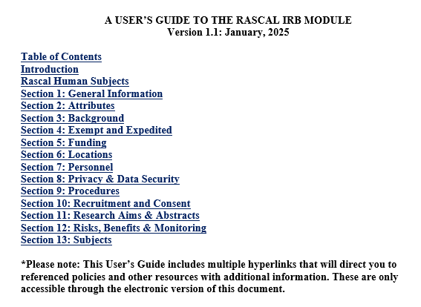

Slide 16
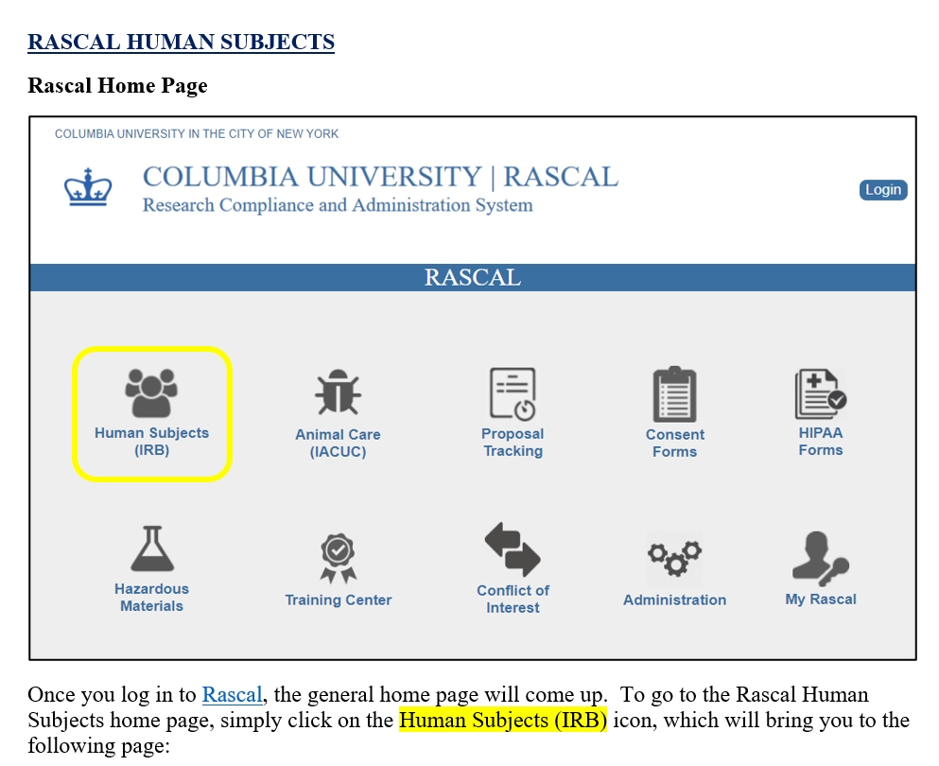

Slide 17
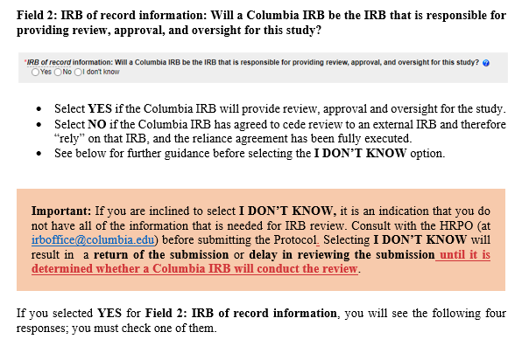

Slide 18
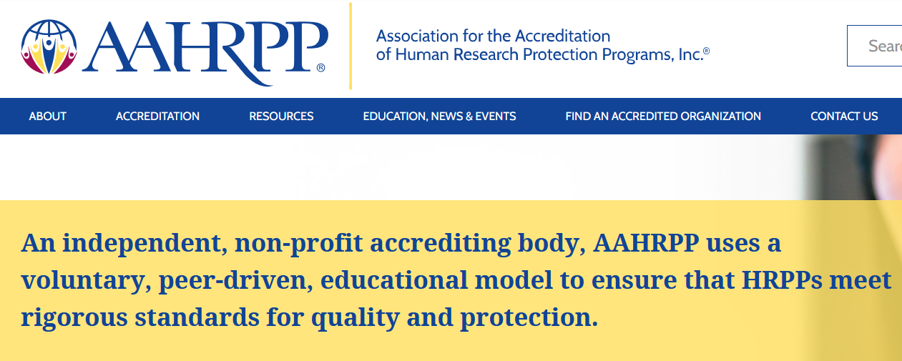
Reaccreditation Status
Association for the Accreditation of Human Research Protection Programs (AAHRPP)
March 2010 – initial accreditation
2 reaccreditations
Reaccreditation pending March 2026
  Site visit October 2025
  Response to draft site visit report Dec 2025
  Review by AAHRPP Council March 2026

Slide 19
IRS Reportable Income Change
Compensation to research participants may be taxable income
Columbia is required to report certain payments to the IRS
Collection of SSNs are required for reporting purposes
Pre-CY2026, threshold for reporting was $600 or more in a calendar year
Effective January 2026, threshold is increased to $2,000
IRS has stated that this amount will be adjusted for inflation every subsequent year
Updating IRB SOPs and guidance documents
Updating ICF Sample Language available on the HRPO/IRB website
For active studies affected by this change, research participants should be informed
  Plans to inform participants should be submitted to the IRB
Listserv announcement and website changes drafted

Slide 20
Website Changes
Banner changes
Reorganization of Protocol Resources page
Centralized protocol templates
Additional templates to be posted
Upcoming changes to Consent Form Resources page
New template/updated consent form language
Revised/additional short forms
Website: https://research.columbia.edu/irb

Slide 21

In-Person Consultations
Q. Who are these consultations for?
A. Research teams for CUIMC studies that have not yet been submitted
Q. When are consultations held?
A. Weekly on Thursdays, 1:00–2:00 PM in Hammer Health Sciences Building, Room 314
Q. Do I need an appointment?
A. No – these are walk-in hours
Q. Are consultations available for other campuses?
A. Morningside and Manhattanville consultations remain remote via Microsoft Teams. Please contact askirb@columbia.edu

Slide 22
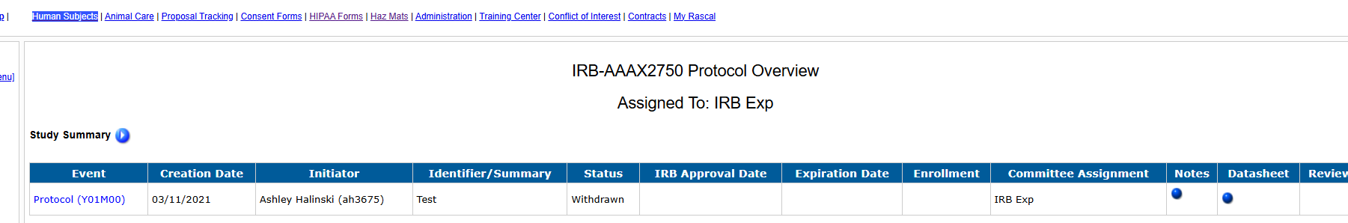
In-Person Consultations
Q. What if my protocol is already assigned to an IRB?
A. We recommend you contact the HRPO Staff supporting that IRB to schedule a protocol-specific consultation.
Q. Who will I meet with?
A. Two HRPO staff members are present at each session. A member of Compliance Oversight Team will attend on the 2nd Thursday of each month. A member of the Reliance Team will attend on the 4th Thursday of each month.
More information (including the schedule) can be found here.

Slide 23
Topic Experts
Designated topic experts across key HRPO areas
Topics include RASCAL, informed consent, HIPAA, recruitment, and more
Two staff members per topic
Experts available to support investigators and HRPO colleagues
Full topic expert list available here

Slide 24
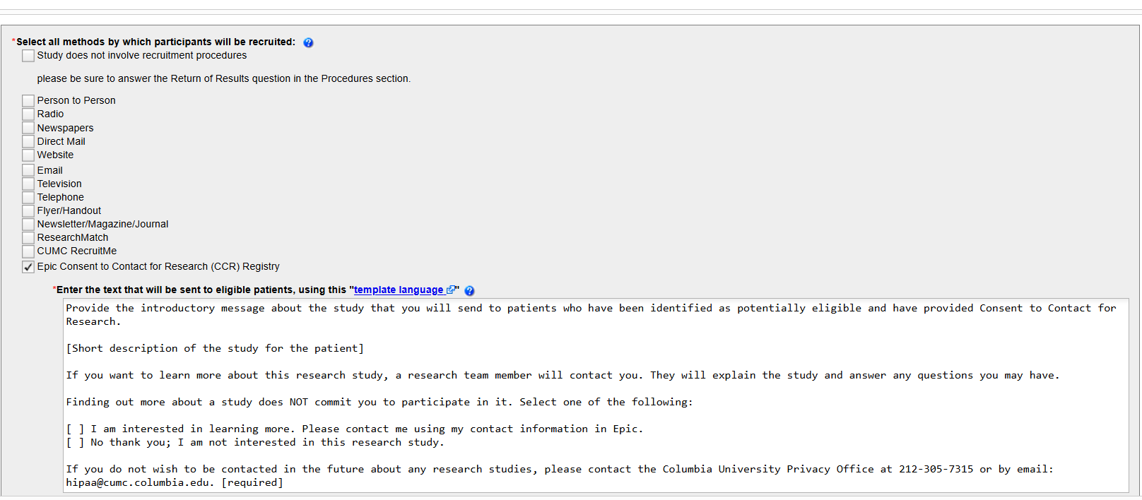
Recent Rascal Enhancements
The “Recruitment and Consent” Page in Rascal has been updated to add the Consent to Contact for Research (CCR) Registry

Slide 25
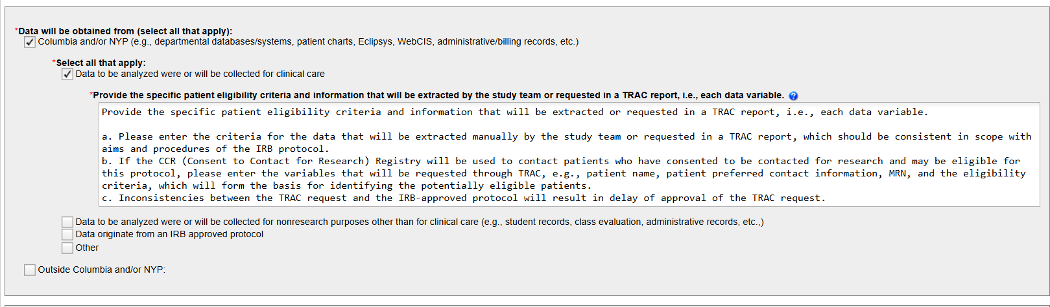
Recent Rascal Enhancements
The “Analysis of Existing Data page has been updated to add a question relating to the data variables that are extracted by the study team or requested in a TRAC report

Slide 26
Upcoming Rascal Changes
Automated Personnel Modifications
The ‘Personnel Modification’ event has been designed to allow for auto-approval and processing of an event solely to add or remove personnel.
Testing of this module is underway.
Additional cell therapy and gene transfer questions
This proposal addresses the need to identify cell therapy and gene transfer protocols and to route cell therapy studies to the Cancer Center Protocol Review and Monitoring Committee (PRMC) for review
Ancillary Review Status box
This proposal will make all the ancillary review statuses for a protocol visible to the research team. The box will include the contact information for the ancillary review committee

Slide 27
Questions?
Contact the HRPO:
irboffice@columbia.edu
212.305.5883
Website: https://research.columbia.edu/irb
Staff directory

