Slide 1
IRB Monthly Investigator Meeting (MIM):
Submission of Tracking Protocols When CU Is Relying on an External IRB
Presenter: Ashley Halinski

Slide 2
Objective
By the end of this session, participants will be able to:
  Understand how and when reliance determinations are made
  Navigate the process for creating and submitting a tracking protocol in Rascal.
  Identify the stages of the tracking protocol review process and understand the status of a submission.

Slide 3
Terminology
Reliance: Ceding of responsibility for IRB review
Reviewing IRB: In reliance situation, the IRB that is responsible for conducting the review (also referred to as IRB of Record)
Single IRB (sIRB): A Reviewing IRB that conducts the review for participating sites of a multisite study
Central IRB (cIRB): A Reviewing IRB that conducts the review of all studies for all sites in a consortium/network
Relying Site: In a reliance situation, the IRB that cedes responsibility for IRB review to an external IRB
Reliance Agreement: A document that articulates the terms under which one institution will rely on the IRB review of an external institution
“Tracking Protocol:” A Columbia-specific terminology referring to the protocol submitted in Rascal for review of local requirements when Columbia is relying on an external institution

Slide 4
NIH Single IRB Review Requirements vs. Common Rule “2018” Requirements
NIH Single IRB Review Policy:
  Effective: January 25, 2018
  Requires a sIRB for NIH-funded, non-exempt studies involving 2 or more domestic sites conducting the same protocol.
Common Rule “2018 Requirements”
  Compliance date of January 20, 2020
  Requires a sIRB for HHS-funded, non-exempt studies involving 2 or more domestic sites
  **Even if the NIH Single IRB Review policy does not apply, a sIRB may be required under the Common Rule 2018 Requirements

Slide 5
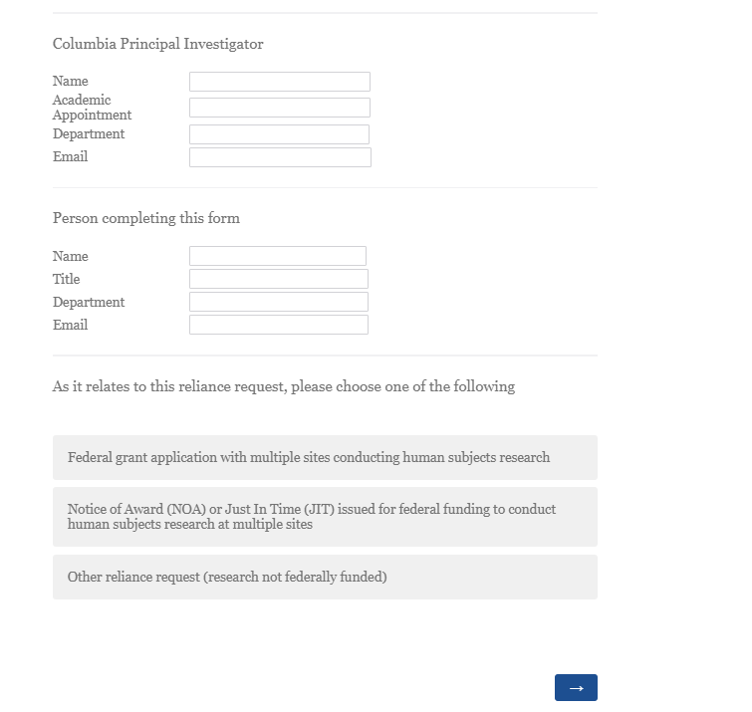
Reliance Determination
The reliance process starts with obtaining confirmation that Columbia will either cede review to an external IRB or serve as the Reviewing IRB for other sites within a multi-center, HHS funded study.
Step 1: Complete the CU Reliance Request survey
Step 2: Await a determination from the CU HRPO confirming whether Columbia will rely on an external IRB or serve as the IRB of Record for other sites within a research study

Slide 6
Tracking Protocol
If Columbia has agreed to rely on an external IRB, a tracking protocol is required.
Why?
Even when another IRB reviews the research for the regulatory requirements, Columbia remains responsible for:
  Local ancillary reviews
  Conflict of Interest review
  Training verification
  Institutional approvals
  Confirmation of compliance with local (institutional, state, etc.) policy or requirements

Slide 7
Tracking Protocol
The tracking protocol should include the following materials:
  Initial IRB determination letter from the Reviewing IRB.
  Approved Master protocol.
  Approved recruitment materials.
  Approved study instruments.
  Approved Master consent form templates.
  CU-specific consent forms (tracked and clean).
  Local context form. If the Reviewing IRB does not provide one, use the Columbia local context form.
  Draft of reliance agreement.
  Subcontract and/or scope of work

Slide 8
Tracking Protocol
*New Resource!* Tips for Creating a Rascal Tracking Protocol for CU Research Submitted to an External IRB
This guide is intended to simplify the tracking protocol submission process by walking investigators through each section of the Rascal application. It explains what information should be entered, when abbreviated responses may be appropriate, and what supporting documents should be included, helping reduce common deficiencies and review delays.

Slide 9
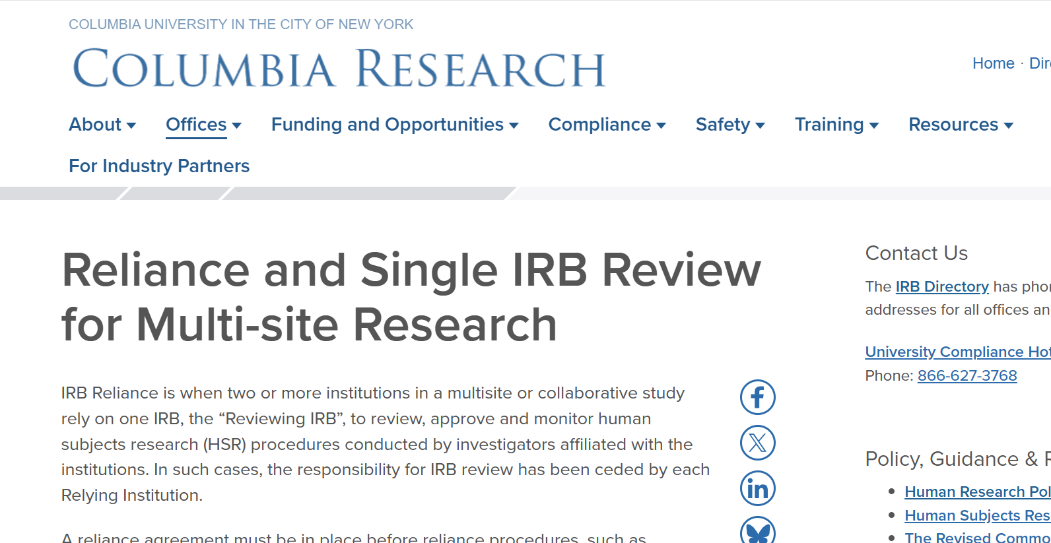

Slide 10
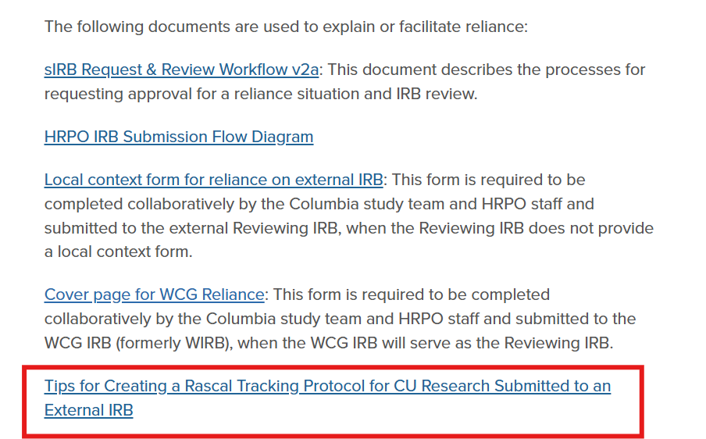
*Note: This template is also available on the Protocol and Consent Form Resources page under “Rascal IRB User’s Guide and Protocol Templates”

Slide 11
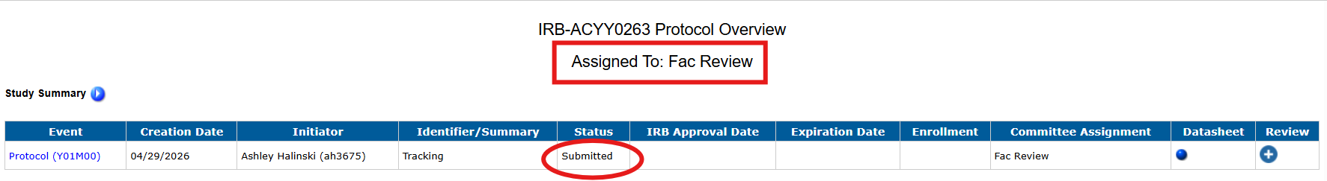
The tracking protocol was submitted…now what?
Once submitted, the protocol will be assigned to our Facilitated Review team (Fac Rev)
A member of our Fac Rev team will then conduct a local review of the submission, confirming all local requirements (state laws, local policies) are satisfied

Slide 12
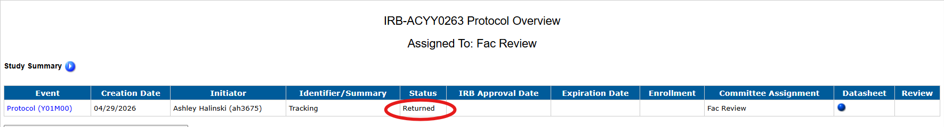
The tracking protocol was submitted…now what?
If documents are missing, the submission does not align with local requirements, or the tracking protocol is inconsistent with the determinations made by the Reviewing IRB → Return in Rascal
You’ll be assigned a list of tasks to be addressed. Once addressed, the protocol should be resubmitted. The protocol will be routed back to an HRPO reviewer on our Fac Rev team.

Slide 13
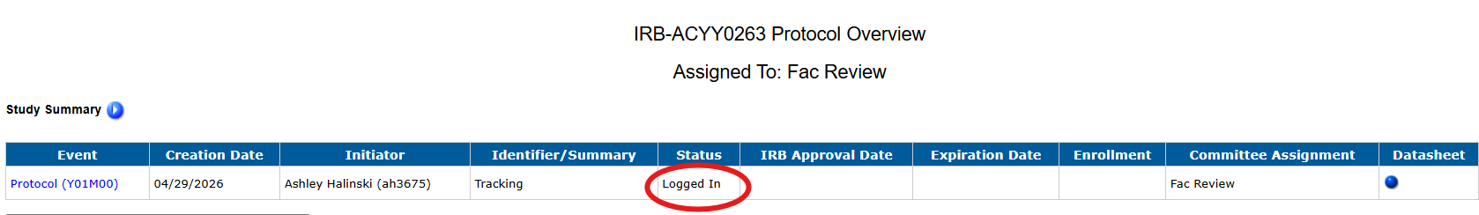
The tracking protocol was submitted…now what?
Once the tracking protocol has been reviewed, and the protocol has been confirmed to include all required documents and align with local/state/institutional requirements, the protocol will be logged in for administrative review by our Chair.
The Chair will review the submission and confirm all local requirements are satisfied

Slide 14
The tracking protocol was submitted…now what?
Simultaneously…
  Sr. IRB Specialist-Liaison will route the reliance agreement will be routed for signature by our Institutional Official or their designee
  The protocol will remain as logged in until all ancillary reviews are complete (if applicable). This includes COI review, PRMC, or any appendices
  *Note: The status of any ancillary reviews (if applicable) can be found on the Protocol History page under ‘Current Ancillary Reviews Statuses’

Slide 15
The tracking protocol was submitted…now what?
When all ancillary reviews have been completed and the reliance agreement has been signed by the IO or their designee, the protocol will again be returned in Rascal
Please review the Correspondence in Rascal. You should coordinate with the Lead Site on the submission to the Reviewing IRB for approval of Columbia as a study site. The local context form and any Columbia-specific materials should be provided to the Reviewing IRB
Please do not resubmit in Rascal until approval from the Reviewing IRB has been obtained, documenting the addition of Columbia as a study site.

Slide 16
The tracking protocol was submitted…now what?
Once approval from the Reviewing IRB has been obtained, please resubmit in Rascal with the following attached:
  Approval from Reviewing IRB for CU as a study site
  Any documents (consent forms, etc.) approved on CU’s behalf (with stamp from Reviewing IRB, if applicable)
Again, the protocol will be routed back to an HRPO reviewer for our Fac Rev team. Once reviewed and confirmed that all materials are attached, the protocol will be logged in and approved.

Slide 17
IRB Review Process for Reliance on External IRB (Flowchart)
*New Resource!* HRPO IRB Submission Flow Diagram
This document describes the review workflow for tracking protocols submitted to the CU IRB for reliance on an external IRB.

Slide 19
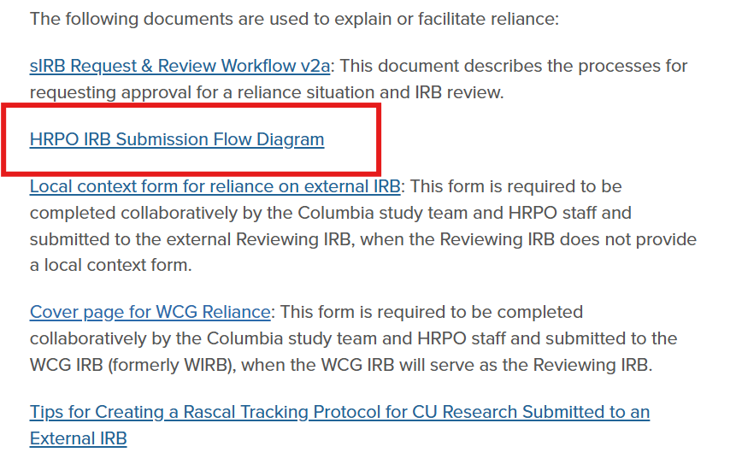

Slide 20
HRPO reliance team
Tasha Isle Smith, Senior IRB Specialist- Liaison
  Manages interactions with institutions with regards to reliance agreements
  Processes and tracks reliance agreements
Mariella Hernandez, IRB Specialist
  Processes submission that involve reliance on an external IRB
IRB Specialist (vacant)
  Currently vacant
  Processes submission that involve reliance on an external IRB

