Slide 1
Important Research Security Requirements:
Current & Pending (Other) Support and Biosketch Disclosures
April 2026

Slide 2
Columbia University Mission
“Columbia University … seeks to attract a diverse and international faculty and student body, to support research and teaching on global issues, and to create academic relationships with many countries and regions. It expects all areas of the University to advance knowledge and learning at the highest level and to convey the products of its efforts to the world.”
https://www.columbia.edu/content/about-columbia
Notes:
Columbia’s mission statement reinforces the University’s commitment to attract international faculty and students, to create academic relationships with many countries, and to disseminate what we learn to the world.

Slide 3
Research Security
“[S]afeguarding the research enterprise against behaviors aimed at misappropriating research and development to the detriment of national or economic security, related violations of research integrity, and foreign government interference.”
  Guidance for Implementing National Security Presidential Memorandum (NSPM) 33 on National Security Strategy for United States Government-Supported Research and Development (2022)
“Importantly, federal research agencies should implement research security policies in a way that treats everyone equally under law, without xenophobia, prejudice, or discrimination…. The law also requires that research security activities be carried out in a manner that does not target, stigmatize, or discriminate against individuals on the basis of race, ethnicity, or national origin.”
  Guidelines for Research Security Programs at Covered Institutions issued by White House Office of Science and Technology Policy (July 9, 2024)
Notes:
Research security, defined here, addresses the concern that some non-U.S. governments might seek to take advantage of the openness of institutions like Columbia. Over the past several years, the U.S. federal government has established new rules and procedures in response to this concern. The government has also reiterated that these requirements must be implemented in such a way that does not target, stigmatize or discriminate against individuals on the basis of race, ethnicity, or national origin. This presentation provides a high-level introduction to important research security concepts with a focus on disclosure to funding agencies and how agencies use disclosed information. Please download the slides at the end for your reference..

Slide 4
Foreign Countries of Concern (FCOCs)
Research security risk is higher for activities involving FCOCs:
    China (including Hong Kong and Macau)
    Iran
    North Korea
    Russia
Seek guidance from Research Compliance & Training before collaborating with entities or individuals in FCOCs so you are aware of the risks.
Notes:
Research security risk is higher for activities involving countries the U.S. government has designated as Foreign Countries of Concern:. These are China (including Hong Kong and Macau), Iran, North Korea, and Russia. A key takeway from today’s presentation is to seek guidance from Research Compliance & Training before engaging with entities or individuals in FCOCs.

Slide 5
Disclosure is Fundamental to Research Security
Accuracy and completeness of Current & Pending (Other) Support (CPOS) and Biographical Sketch disclosures is a federal focus area.
Federal agencies use such disclosures to, among other things, assess research security risk.
When uncertain, err on the side of disclosure; if you need help, contact SPA for help.
Notes:
Accuracy and completeness of Current and Pending (Other) Support (or “Sea Pea Oh Ess”) and Biographical Sketch disclosures is a federal focus area. Agencies use the disclosures to assess research security risk. A second key takeaway of today’s presentation is: if you are uncertain whether to include something, air on the side of disclosure. Contact your Sponsored Projects Administration project officer for help.

Slide 6
Researchers Must Certify to Accurate Disclosures
“I certify that the information provided is current, accurate, and complete…. I also certify that, at the time of submission, I am not a party in a malign foreign talent recruitment program.”
Knowingly inaccurate certifications may have serious consequences, including
  Heightened sponsor requirements to ensure disclosures are complete and accurate
  Funding restrictions or de-funding
  Civil or criminal prosecution
Notes:
Researchers must certify to the accuracy of their funding agency disclosures. These certifications can be completed only by the researchers themselves and cannot be completed by administrators. They are important. Researchers may face real and serious consequences if they knowingly certify to false information.

Slide 7
What needs to be disclosed to funding agencies?
Disclosure obligations are broad, exceeding current awards and pending proposals, and include
  Certain outside consulting
  In-kind contributions that support research, including, e.g., space, materials, personnel, with a value of $5k or more and requiring a time commitment
  Certain agreements styled as gifts
  All professional affiliations over the past 3 years
  All appointments, including part-time and voluntary or honorary appointments
  And more!
Notes:
Researchers must include a broad range of information in funding agency disclosures. Five important examples are listed on this slide, with more detail to follow.

Slide 8
1. Certain Consulting
Consulting activities must be disclosed in CPOS when any of the following apply:
  Requires performance of research;
  Does not involve performing research, but is related to the consultant’s research portfolio and may have the ability to impact funding, alter time or effort commitments, or otherwise impact scientific integrity; or
  The consulting contract requires the consultant to conceal or withhold the relationship or information about it.
Notes:
Consulting activities must be disclosed in Current and Pending (Other) Support in three scenarios: (1) it requires the individual to perform research; (2) it is related to the consultant’s research portfolio and may have the ability to impact funding, alter time or effort commitments, or otherwise impact scientific integrity; or (3) the contract requires the consultant to conceal or withhold the relationship or information about it.

Slide 9
2. In-kind Contributions
All in-kind contributions that (1) have an estimated dollar value of $5000 or more, and (2) require a commitment of the individual’s time must be disclosed in CPOS.
  An in-kind contribution is a non-cash contribution provided by an external entity that directly supports an individual’s research.
  Even if the dollar value or time commitment are not specified, they still must be reasonably estimated and disclosed if they meet the above criteria.
    Reviewing market pricing for the contribution could help estimate its dollar value. If it is typically available for free, the value could be zero.
  Examples could include but are not limited to: laboratory space; equipment; data or data sets; supplies; goods and services; and employees or students not funded by the University.
Notes:
All in-kind contributions that (1) have a value of at least $5,000 and (2) require a time commitment must be disclosed in CPOS. Even if the dollar value or time commitment are not specified, they still must be reasonably estimated and disclosed if they meets these two criteria. Reviewing market pricing for the contribution could help estimate its dollar value. If it is typically available for free, the value could be zero. Examples could include space, equipment, data, supplies, services, and employees or students not funded by the University.

Slide 10
3. Certain gifts
Gifts are resources provided with no expectation of anything (e.g., time, services, specific research activities, money, etc.) in return.
As a result, if a gift’s terms include, e.g., specific research aims and objectives, intellectual property rights, require a time commitment or activity, or require reporting on progress, then the gift must be disclosed in CPOS.
Monetary donations given to institutions or directly to senior/key personnel that support research activities related to an individual must be disclosed in CPOS.
If you have questions about a particular gift, we strongly recommend erring on the side of disclosure.
Notes:
Gifts are resources provided where there is no expectation of anything in return. Certain gifts that support research must be disclosed in C P O S. These are gifts that include a specific expectation by the funder regarding a scope of work, time commitment or progress report, or that provide the donor with benefits such as intellectual property rights. Monetary donations that support research activities related to an individual must be disclosed in C P O S. If you are not sure whether a gift should be disclosed, air on the side of disclosure.

Slide 11
4. Professional Affiliations and 5. Appointments
All professional affiliations within the past 3 years must be disclosed in the biographical sketch, e.g., service as a journal editor or peer reviewer.
All academic appointments must be included in the biographical sketch, even if unpaid or honorary, across the entire career.
All participation in Foreign Talent Recruitment Programs must be disclosed. See next slide.
Notes:
Biographical sketches must include all professional affiliations from the past three years, and all academic appointments, even if they are unpaid or honorary, across the entire career. In addition, participation in Foreign Talent Recruitment Programs must be disclosed. These programs are described on the next slide.

Slide 12
Foreign Talent Recruitment Programs (FTRPs)
FTRPs are efforts organized, managed, or funded by a foreign government, or a foreign government instrumentality or entity, to recruit U.S. based science and technology professionals or students to support the other country’s research and development.
  Many FTRPs incentivize individuals to relocate physically to the foreign state.
  Some programs allow for continued employment at United States research facilities or receipt of Federal research funds while concurrently working at a foreign institution.
  May involve any country.
All participation in FTRPs must be disclosed in either CPOS or Biosketch, whichever is most appropriate.
Notes:
Foreign Talent Recruitment Programs (F T R Ps) are programs organized, managed or funded by a foreign government or entity and aim to recruit science and technology professionals or students to support the other country’s research and development. All participation in F T R Ps, regardless of country, must be disclosed in either in C P O S or the Biosketch, whichever is most appropriate.

Slide 13
“Malign” FTRP Participation is Prohibited
Malign FTRPs are a subset of FTRPs that meet the following 3 requirements:
  Involve a Foreign Country of Concern as defined above; and
  Involve compensation of any kind (not just cash) to the researcher; and
  Impose certain requirements or obligations on the researcher that are inconsistent with federal and University policy, such as one-sided intellectual property requirements, excessive time commitments, or inappropriate confidentiality requirements.
Under federal law, individuals who participate in malign FTRPs are ineligible to serve as senior/key personnel on federal awards.
Notes:
Malign FTRPs are defined as programs that meet the three requirements detailed on this slide. Individuals who participate in malign foreign talent recruitment programs are ineligible to serve as senior or key personnel on federal awards and are in violation of Columbia policy.

Slide 14
How Funding Agencies Use Disclosed Information
Assess potential budgetary, scientific or commitment overlap, which is prohibited.
Identify potential conflicts of commitment.
Assess research security risk.
  Agencies may compare researcher disclosures to publicly available information, e.g., scientific literature, U.S. Patent and Trademark Office data, and other information.
  Inconsistencies will prompt follow-up inquiries
  Identified risks may jeopardize funding and/or require mitigation plans.
Notes:
Funding agencies use the information researchers disclose to assess potential overlap, conflicts of commitment, and research security risk. Agencies may compare researcher disclosures to publicly available information. Identified risks may jeopardize funding and/or require mitigation plans.

Slide 15
Key Takeaways
If an activity may involve a FCOC, seek guidance before moving forward so you are aware of the risks.
If you are not sure whether to include something in your biosketch or CPOS, err on the side of disclosure.
Download these slides for reference and visit the Research Security website for more information.
Notes:
The key takeaways for this presentation are, (1) if you are thinking of engaging in activities with foreign countries of concern, seek guidance first so you are aware of the risks; and (2) if you are not sure whether to include something in your biosketch or C P O S, air on the side of disclosure. Download these slides for reference and visit the Research Security website for more information.

Slide 16
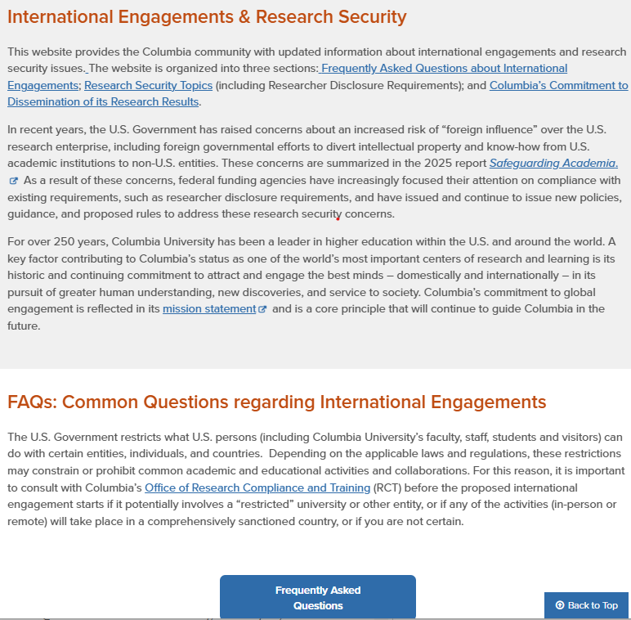
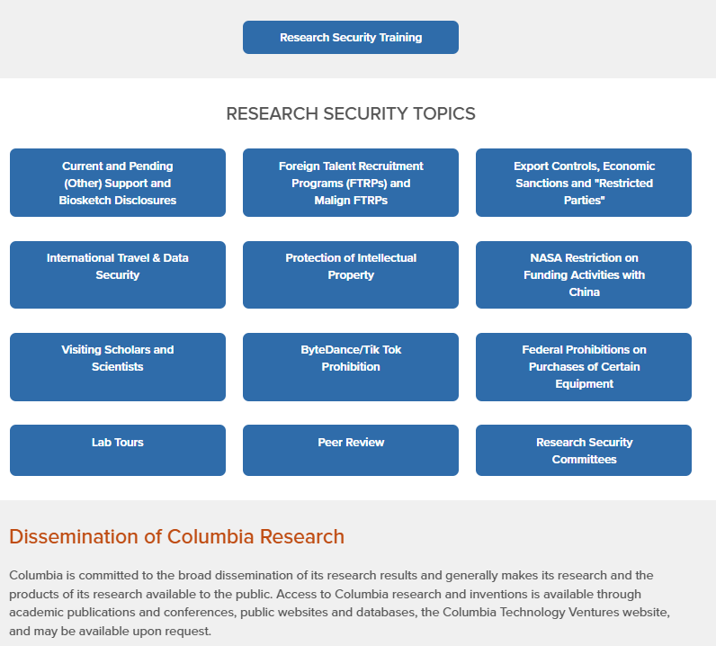
https://research.columbia.edu/science-security

Slide 17
Questions
For questions about a potential international engagement, please contact the Office of Research Compliance and Training at research-compliance@columbia.edu.
For questions about current and pending (other) support or biosketch disclosures, contact your Sponsored Projects Administration project officer.
Click below to download these slides.
Notes:
If you have questions, please do not hesitate to contact the Office of Research Compliance and Training or your SPA project officer.

